Slide 1
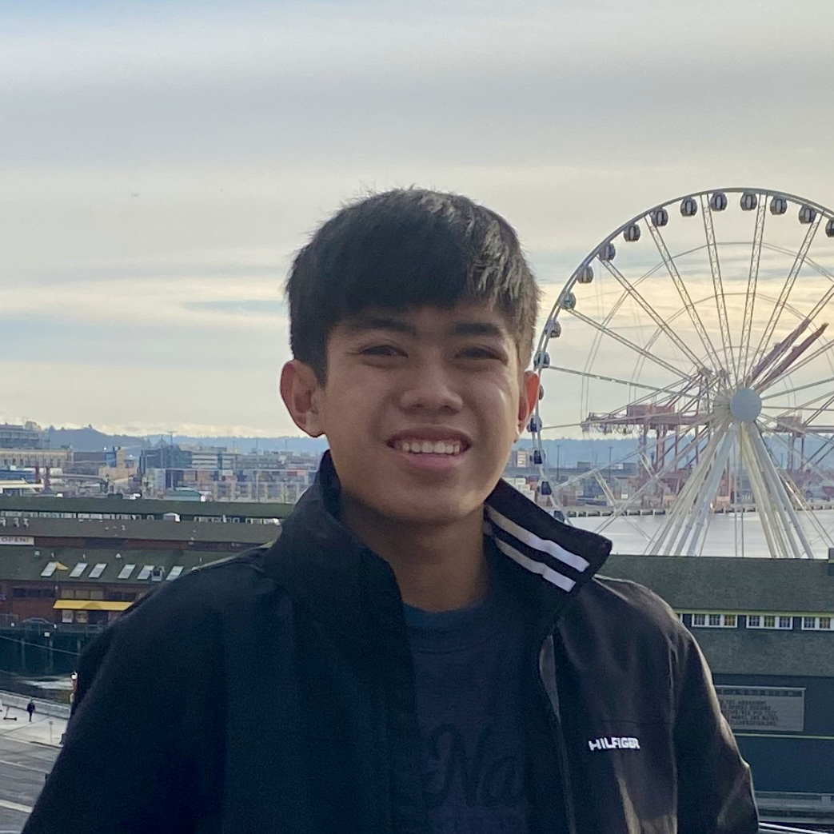
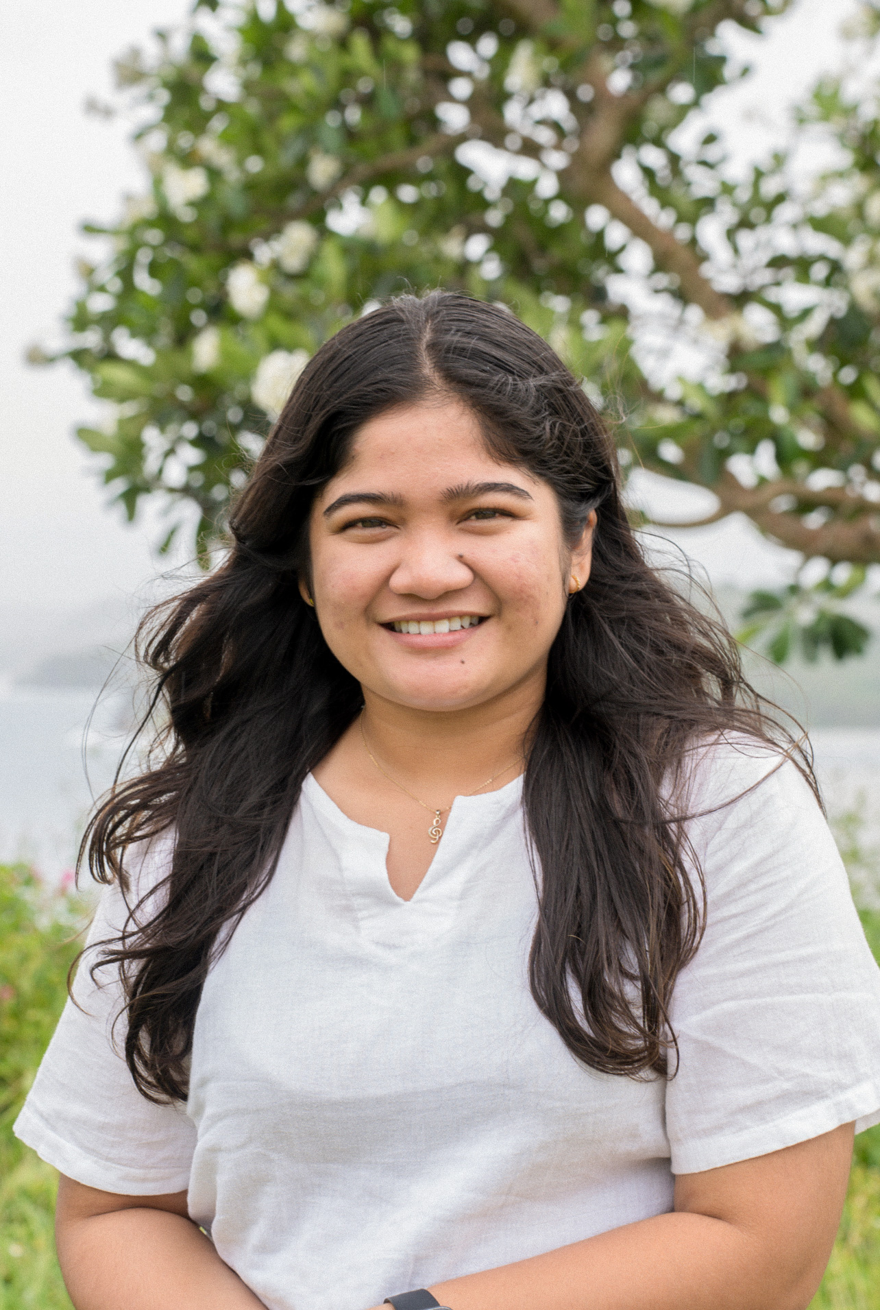
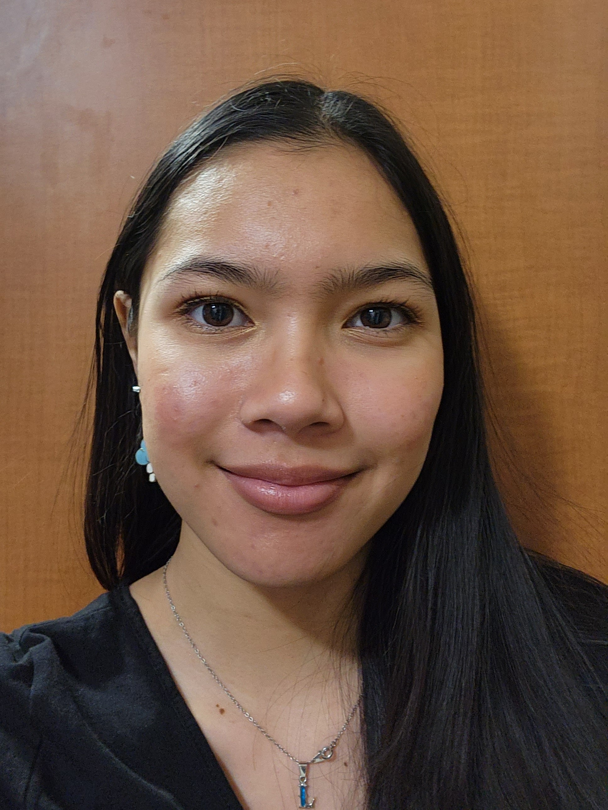

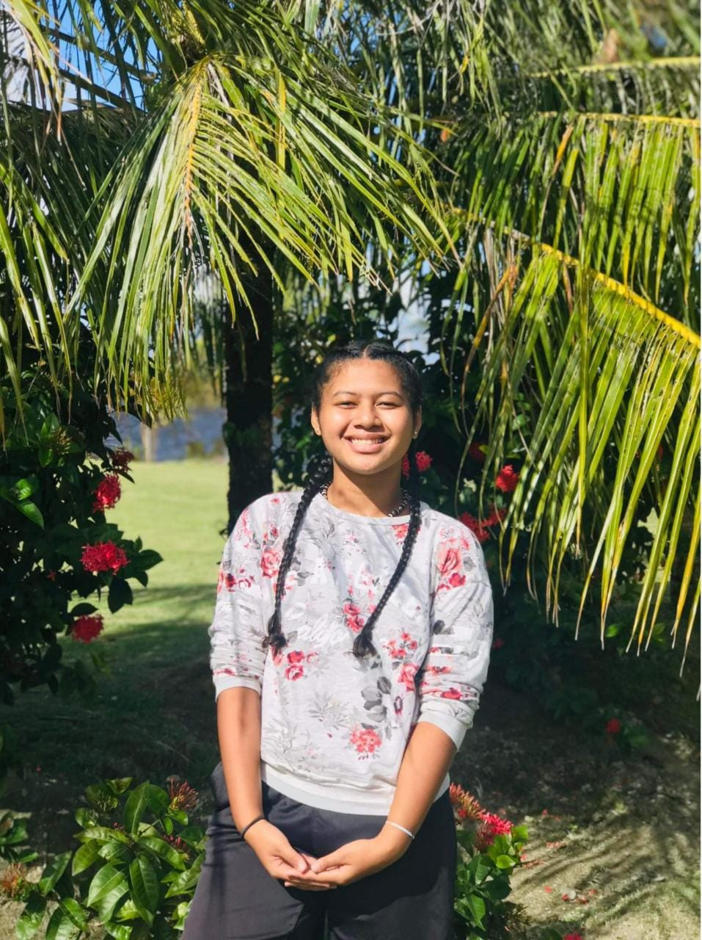
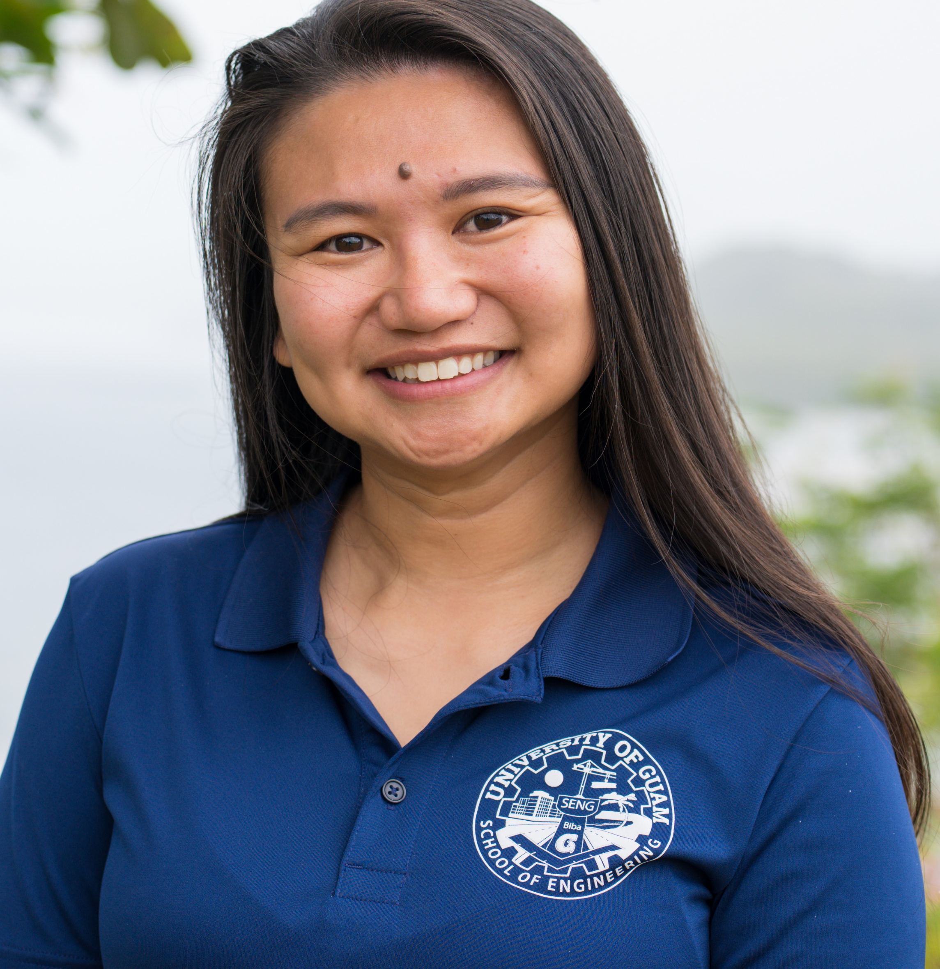
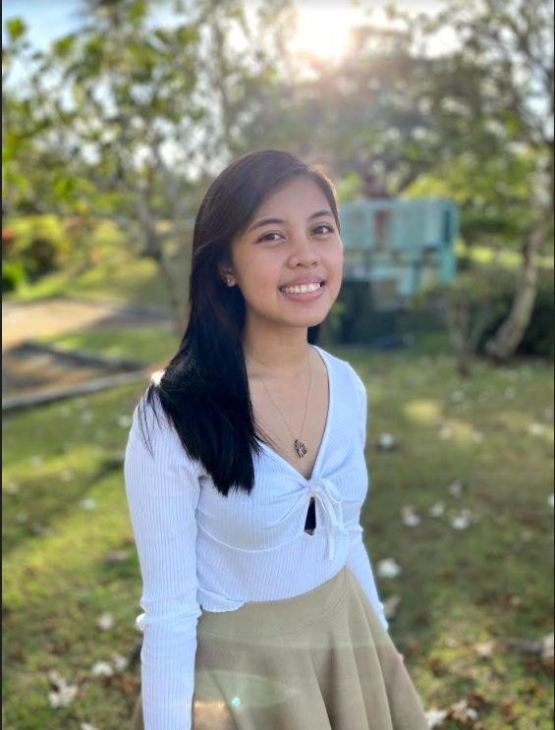
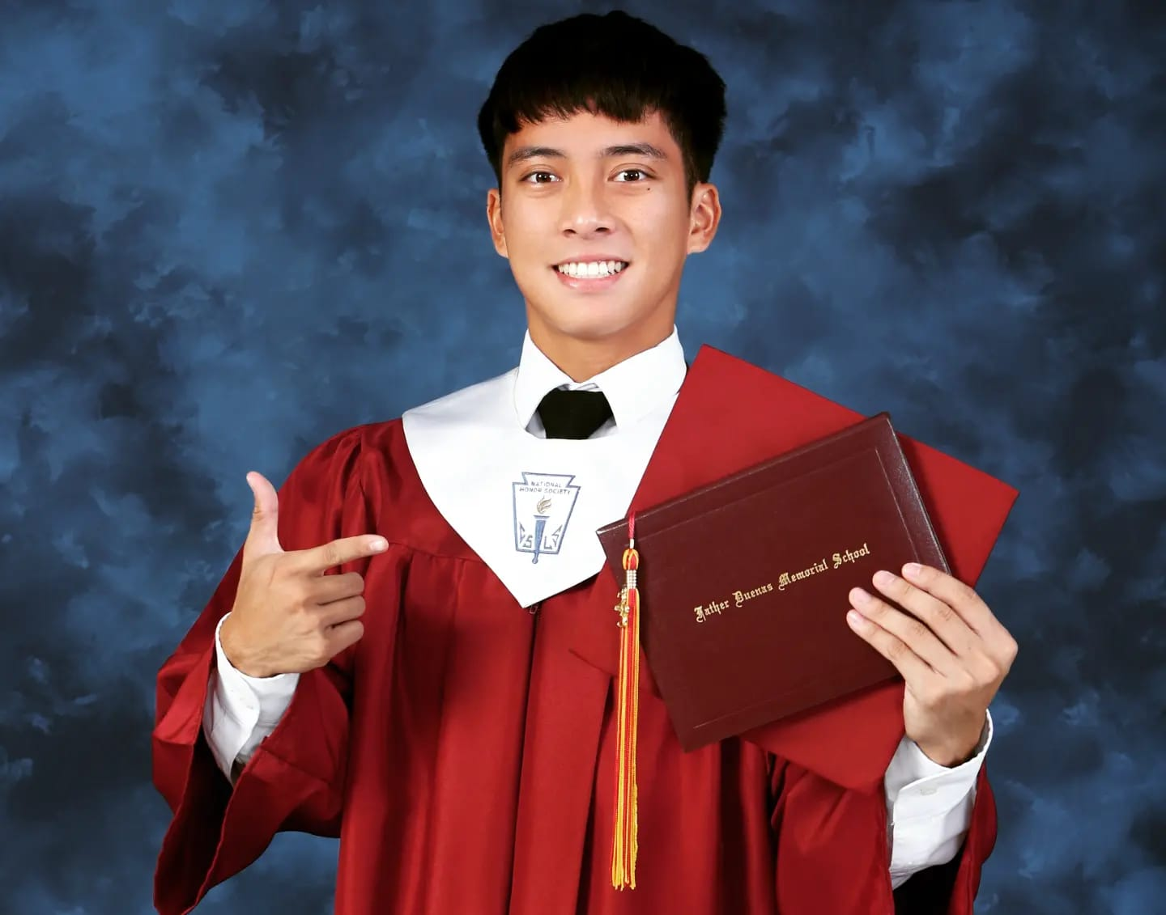
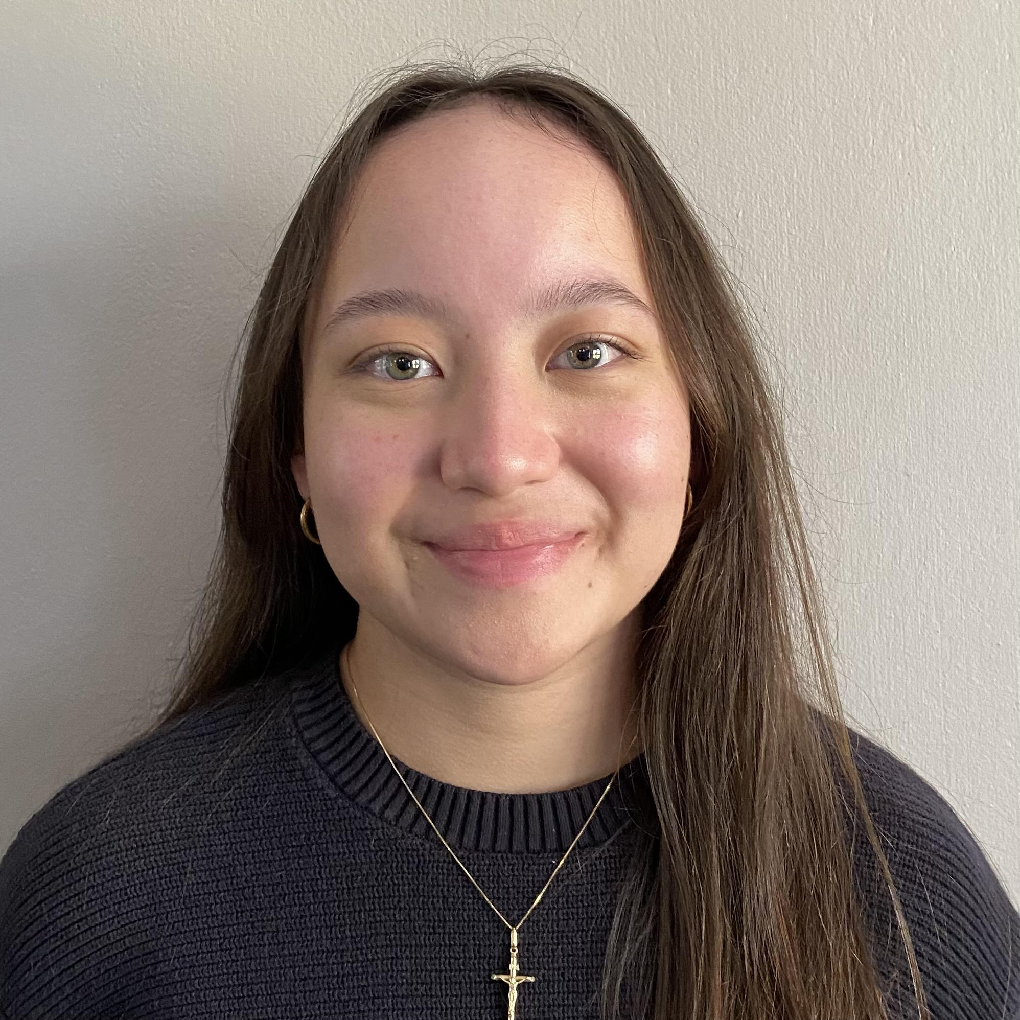
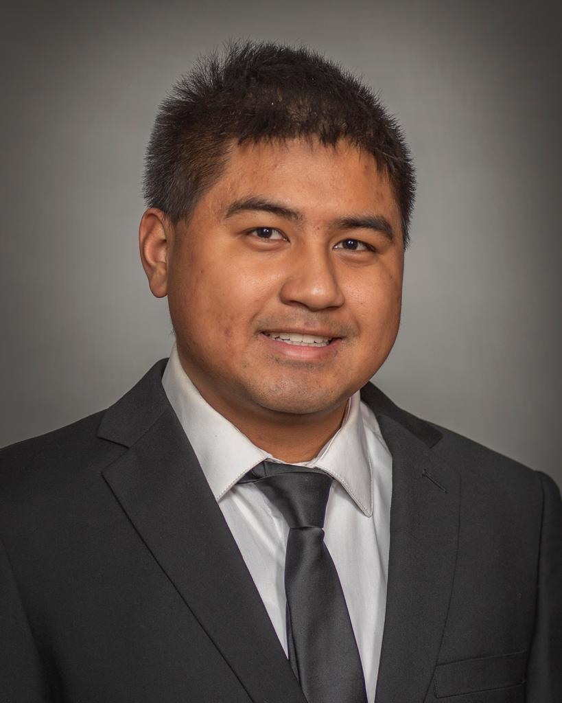
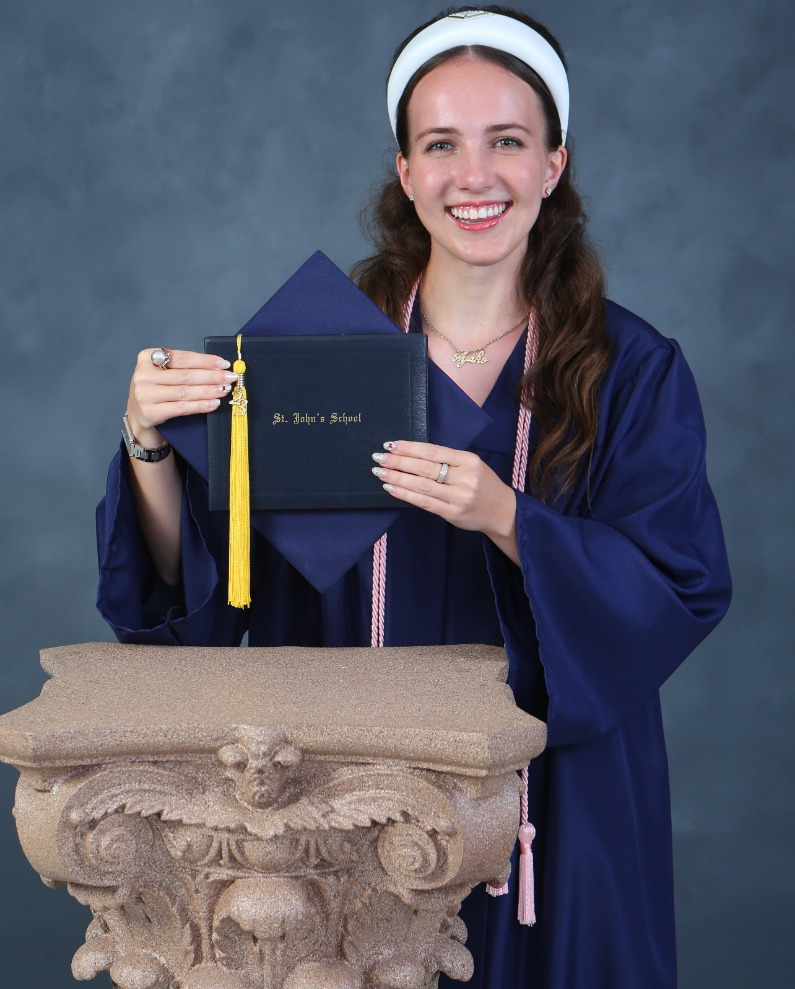
2023-2024
SAME
Charlie Corn Scholarship
Award Ceremony
Thursday - May 18, 2023
Presentation: Tor Gudmundsen, PE – Scholarship Committee Chariman

Slide 2
Scholarship Notes
Who is Scholarship Program Namesake Charlie Corn?
SAME Guam Post Annual Scholarship Program typically makes 10+ awards in the range of $1,500 - $5,000 every year!
Scholarship program is funded by our annual SAME Golf Tournament all sponsors and individuals who join are appreciated!
This year 13-Applicants and 10-Awards
1-Recipient – 4x Scholarship Awards
2-Recipients – 3x Scholarship Awards
1-Recipient – 2x Scholarship Awards
6-Recipients – First Awards
3-Recipients – Attending UOG
1-Recipient – Attending GCC
2023 – 2024: 10-Awards >>>>> $2,500 - $4,500
1st Place is a Tie with 2-Awards

Slide 3
Kaia g.c damian
Currently attending the University of Notre Dame, Indiana majoring in Civil Engineering
Class Valedictorian for Notre Dame High School Guam, Class of 2022
She is a current member of the Engineers without Borders-USA and the Society of Women Engineers.
Rank No. 09 – Scholarship Amount = $2,500

Slide 4

Thuy dao ngoc nguyen
Currently in her 3rd year attending the University of Guam majoring in Civil Engineering
Attended the University of California, Los Angeles - Bachelor of Arts and majored in Asian American Studies
Vice President for SAME at UOG
Senator for the UOG Student Government Association
Treasurer for the Tourism Awareness Group
Rank No. 08 – Scholarship Amount = $2,500

Slide 5
Lola M. martin
Attending her sophomore year at the Colorado School of Mines, majoring in Environmental Engineering.
Member of the Society of Women Engineers, Society of Asian Scientists and Engineers, Zeta Pi Chapter of Sigma Kappa, and the Green team.
She volunteers for all philanthropy events held by any of the mentioned organizations, with Sigma Kappa as the most notable.
Started her internship with TG Engineers, PC for Summer 2023.
Rank No. 07 – Scholarship Amount = $3,000

Slide 6

Miwa y. gudmundsen
2023 Graduate of St. John’s School
Will be attending the University of California, Berkeley in fall 2023, majoring in Civil Engineering
Intern for the University of Guam Marine Lab
Drummer for the Dolphin Jump Wadaiko Group and plays the Cello for St. John School’s orchestra and the Guam Symphony.
National Merit Scholarship Finalist
Won 2nd place in Ecology and 3rd place in Plants for the 2022 Island wide Science Fair and won 2nd place in Ecology for the 2022 Asia Pacific Conference of Youth Scientists
Rank No. 06 – Scholarship Amount = $3,000

Slide 7
ETHAN d. GARCIA
Junior year student at the University of Notre Dame, majoring in Mechanical Engineering and is currently studying abroad in London.
Charlie Corn Scholarship Recipient for 2021-2022 and 2022-2023
Was a member of the Washington University Summer Engineering Fellowship (WUSEF) program.
Involved in the Notre Dame Rocketry Team, Band of the Fighting Irish, Band Ambassador Program.
Rank No. 05 – Scholarship Amount = $3,000

Slide 8
anna lhyn o. mallari
Currently attending the University of Guam, majoring in Civil Engineering
Teaching Assistant for CEE-308/L Intro to Surveying and Lab for this Spring 2023 semester
Part of the EPSCoR Student Research Experience for 2023
Rank No. 04 – Scholarship Amount = $3,000

Slide 9
Christian r. mariano
Currently attends Seattle University, majoring in Electrical Engineering.
Charlie Corn Scholarship Recipient for 2021-2022 and 2022-2023.
Member of the Institute of Electrical and Electronics Engineers, United Filipino Club, Marianas Tao Tao Club
Interned at the Guam Power Authority, summer 2022 and at EMCE Consulting Engineers in December 2022
Deans List – Fall Qtr. 2021, Winter Qtr. 2022 and Spring Qtr. 2022
President’s List – Fall Qtr. 2021 and Winter Qtr. 2022
Rank No. 03 – Scholarship Amount = $3,000

Slide 10
CHRISTIAN Joseph I. LOBATON
2023 graduate from Father Duenas Memorial School (FDMS)
Attending the University of Portland in Fall 2023 to major in Mechanical Engineering
Member of the FDMS National Honor Society and NJROTC
Received the American Veterans Award (4/2022), Legion of Valor Bronze Cross Award (9/2022), 2nd place for the Chemistry Titration Competition (5/2022),
Involved in various sports and activities such as, Volleyball, Cross Country, Tennis, and Taekwondo.
Part of his Church Ministry as an alter server and a guitarist for the church choir.
Rank No. 02 – Scholarship Amount = $4,000

Slide 11
MAYA L. TAMNGIG
Attending the Guam Community College, majoring in Civil Engineering.
Charlie Corn Scholarship Recipient for year 2022-2023
Recent 2022 graduate from Yap Catholic High School, ranked #4 in her class.
Vice President for her school’s Student Government.
Participated in the Marine Island Ecology Course (MIEC)
Won first place in her school’s Academic Bowl.
Received the Magis Award, Fr. David Ciancimino, S.J Scholar Award, First Honors and Second Honors.
Rank No. 01 – Scholarship Amount = $4,500

Slide 12
Andrea d.m. Gutierrez
Attending her 3rd year at the University of Guam, majoring in Civil Engineering
Charlie Corn Scholarship Recipient for 2020-2021, 2021-2022 and 2022-20023
Received a certificate of award for Matson Navigation Scholarship Recipient, year 2022-2023
National Association of Women in Construction Scholarship for year 2021-2022
Volunteered for the 42nd and 43rd Charlie Corn Scholarship Golf Tournaments
Volunteered for Catholic Social Services Back to School Drive in Summer 2021
Over the years Ms. Gutierrez has volunteered at multiple events, clean ups and other community out reaches.
Rank No. 01 – Scholarship Amount = $4,500

Slide 13
Congratulations to all the recipients!

