Slide 1
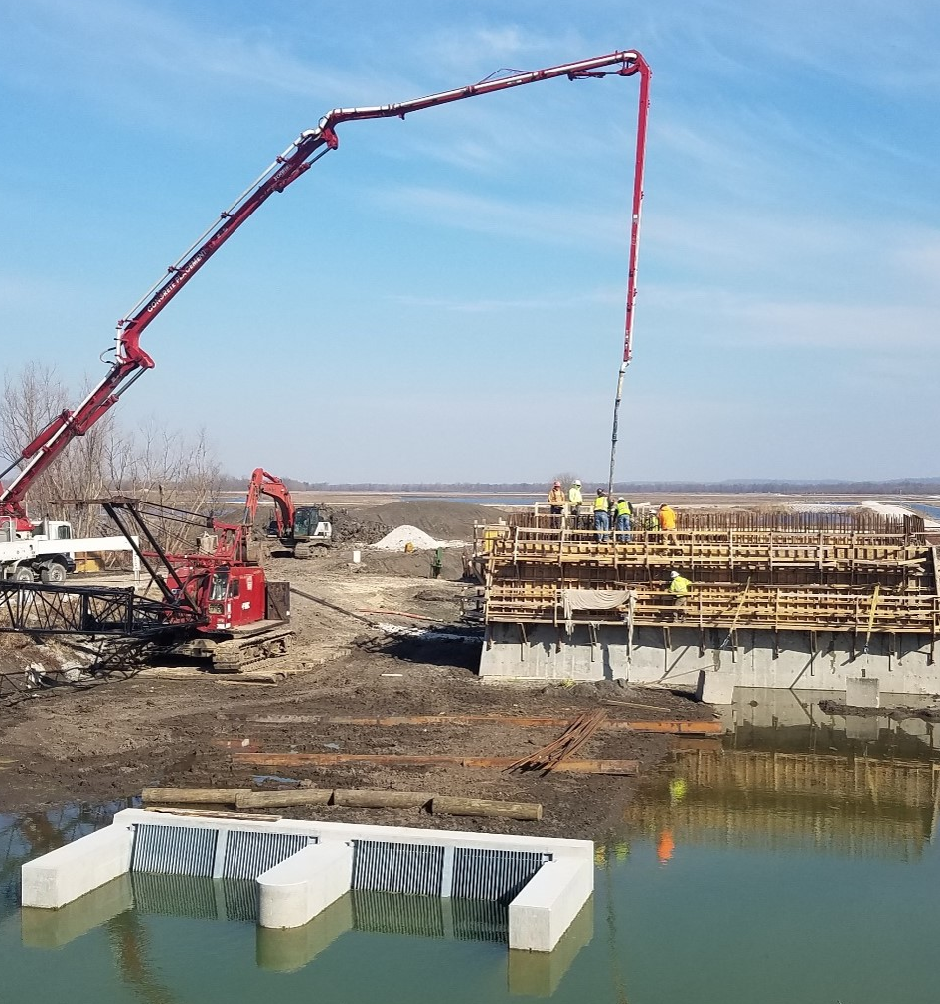
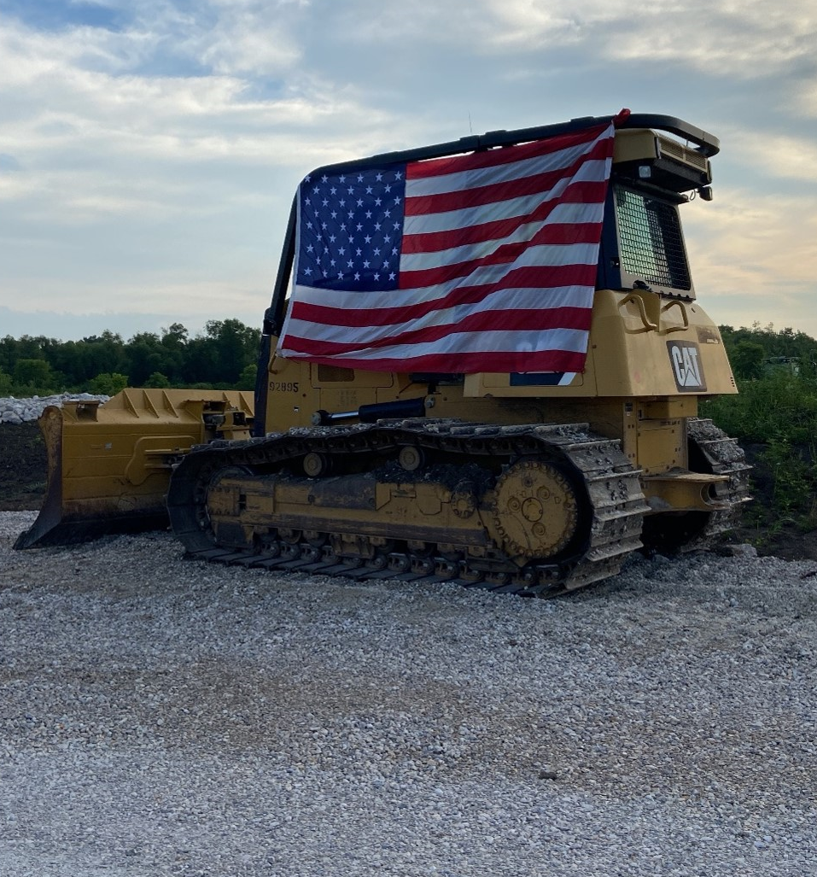
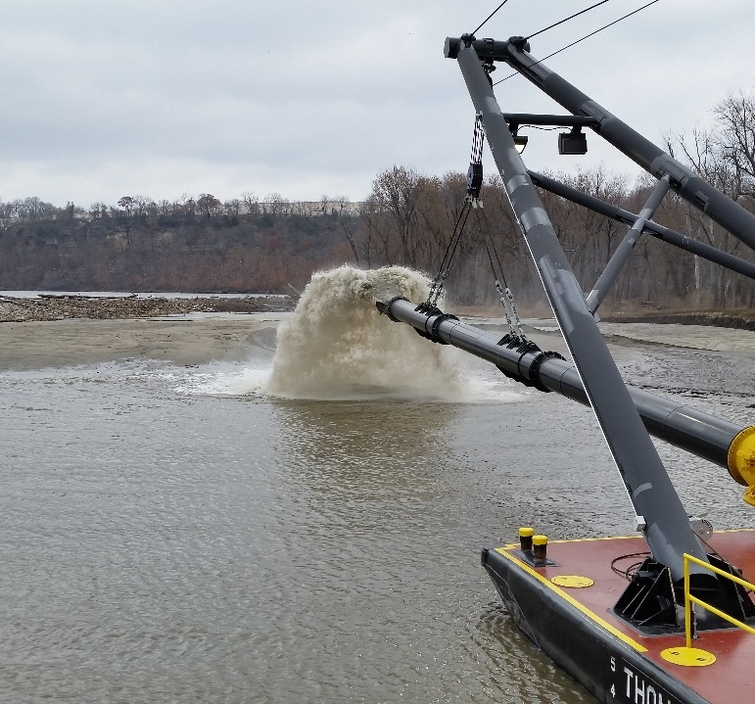
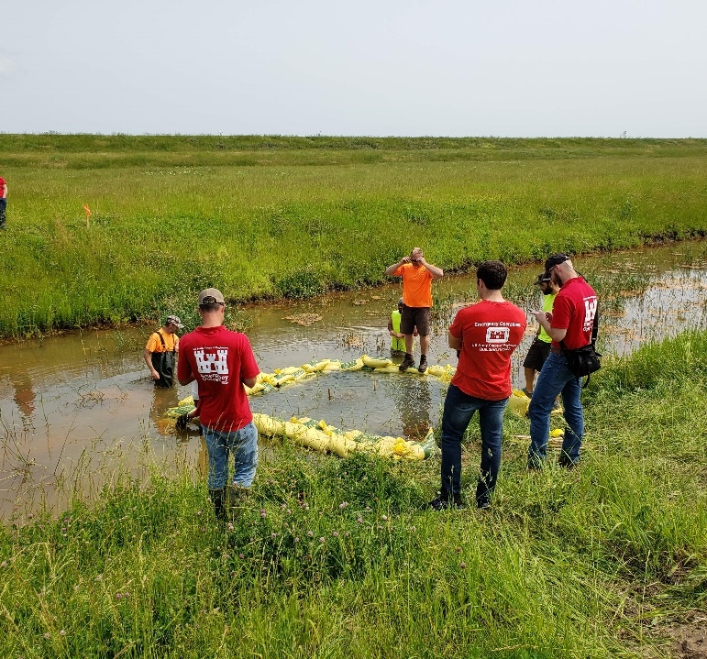
Usace
ST. Louis district
1

Slide 2


US Army Corps Of Engineers St. Louis District (MVS)
Overview

Slide 3

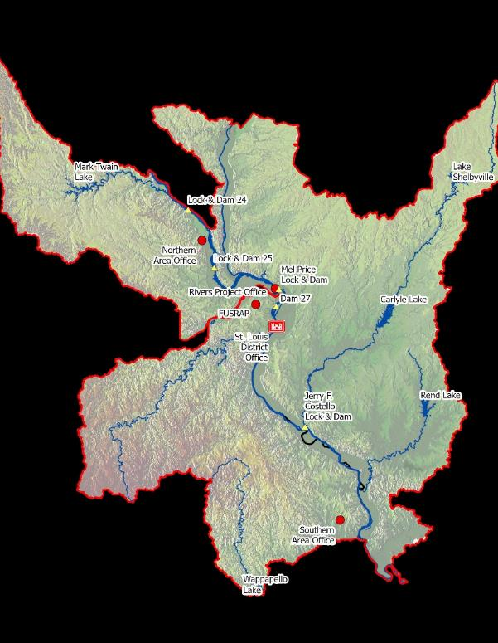
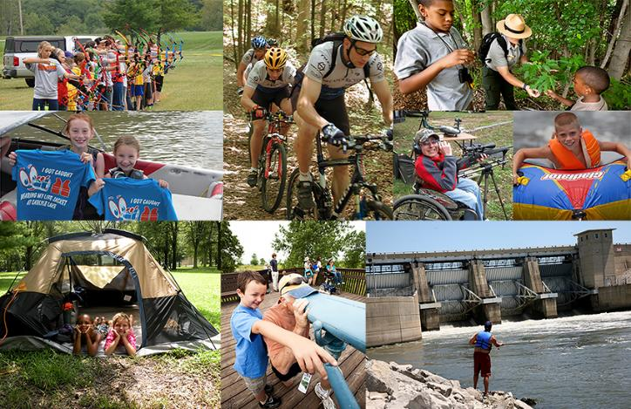
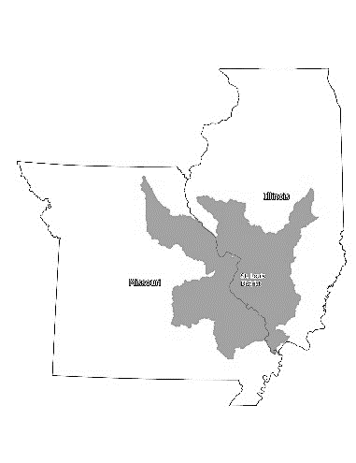
St. Louis District Mission – Value to the Nation
3
Navigation
3 rivers
5 lock and dam sites
416 miles of navigable channel
110M tons of commodities transferred annually
Saving more than $1B a year
Flood Risk Management
74 levee systems with 93 levee segments
750 miles of levees
5 Corps lakes
Ecosystem Restoration
21,000 acres restored
10,000 acres in design & feasibility
6,700 acres of habitat under construction
Recreation
9.1M visitors per year
120,000 acres of fishing, boating, and swimming
49 recreational use areas
Hydropower
58 MW production capability
20,000 households supplied with electricity
FUSRAP
1.4M cubic yard of contaminated soil removed
415 properties remediated
St. Louis District Corps of Engineers
The Gateway to Excellence
Mission – Provide engineering & water resource solutions that improve safety, energize the economy, sustain the environment & enhance the quality of life for those we serve through expertise, innovation & partnerships.
More that 700 veterans
Trained at 6 labs
With more than 91%
Job and education placement rate
After graduation from the program!
Notes:
Overall objective of this slide is to orient the audience to the district AOR so they can more effectively learn how and where to connect their construction company’s capability now but also into the future, with MVS requirements.
Notes for Left side of slide:
St Louis District is part of the Mississippi Valley Division in the Corps of Engineers. Our mission is Civil Works only. Our sister districts to the east and west (Kansas City for MO, and Louisville for IL) are in charge of Military Construction Missions in our states.
Our Civil Works district boundaries follow drainage areas boundaries for waterways since our civil works mission is heavily Water Resources based.
The states of Missouri and Illinois each have 5 separate Corps of Engineers districts with Civil Works responsibility in the state. Each district works closely together though and we can and will happily connect you with the correct district counterpart if you have a question, issue, or have interest in work that is outside of our AOR. (MO districts: MVM, MVS, MVR, SWL, NWK) (IL districts: MVM, MVS, MVR, LRL, LRC)
Notes for Center Column:
Our agency’s Civil Works portfolio is associated with several projects that are typically aligned with several business lines. You see our business lines listed here with some of our District’s unique features.
Navigation BL:
There are 3 navigable rivers in MVS, The 36 navigable miles of the Kaskaskia, the lower 80 miles of the Illinois, and 300 miles of the Mississippi from its confluence with the Ohio near Cairo IL to Saverton MO at L&D 22 where MVR AOR picks up.
There is one lock at the mouth of the Kaskaskia (Costello L&D) and four locks on the Mississippi (24, 25, Mel Price, 27) Lock 27 is the last, downstream most lock on the Mississippi River. Navigation is maintained below that Lock by means of river training structures and dredging. Our authorized navigation channel is 300ft wide by 9ft deep.
FRM BL:
There are 750 miles of levees in MVS that comprise 92 separate levee systems. About two thirds of those systems were federally constructed, the remainder privately constructed. However all but a portion of one of those systems are privately owned, operated, and maintained by individual levee districts. The exception is the Chain of Rocks segment within the East St Louis system which if federally owned and maintained. In addition to assisting these levee districts with flood preparedness and response activities during a flood, our authority under PL 84-99 allows federal assistance in repair of damages to those levee systems from a flood event. Those levee repair projects are nearly always accomplished by construction contracts and are key connection point for us and construction industry.
There are 5 federal lake/reservoirs in MVS AOR (MO: Mark Twain and Wapapello, IL: Shelbyville, Carlyle, and Rend). Each contributes to reducing flood risk downstream but each project has additional purposes including water supply, environmental stewardship, and recreation. Each project has several day use and camping facilities. As a result there are several regular and recurring contract requirements at these lakes, as well as along the Mississippi River ranging from minor construction and road maintenance to mowing and custodial services. This is another key connection point for the construction and service industry with MVS.
ER BL:
Ecosystem Restoration is another important and vibrant business line in MVS. Of particular note, the UMRR Program (Upper Mississippi River Restoration Program, previously known as EMP) is an enduring program that has made a vital impact on the Upper Mississippi River. The program is regional in nature with work in St Paul, Rock Island, and St Louis Districts. The projects typically comprise enhancement of flood plain areas as well as side channels to improve habitat diversity. There is always some active construction in MVS under this program with additional work planned in the future. Work typically involves construction of earthen berms, water control structures, channel excavation or modification and some revetment work. All of this work happens via our construction industry partners.
Recreation BL:
NSTR, see comments in item 3b above.
Hydropower
There is one Hydropower facility in MVS at the Clarence Cannon Dam/Mark Twain Lake
FUSRAP
This is the Formerly Utilized Sites Remedial Action Program. There are 4 active project sites in St Louis including one in IOWA that we also manage. This program has been active for several years and is focused on addressing residual radioactive contamination at facilities associated with the advent of nuclear devices in WWII. The team executing this highly specialized program relies heavily on the assistance of the engineering and construction contractor industries for delivering this work each year. There are several regular and recurring multiyear contracts that support this program.
MVS also has some unique areas of expertise not listed here but worth noting:
The photogrammetry center of expertise in MVS supports USACE districts, military installations, tribal nations, and other federal, state, and local entiites with several specialty aerial mapping and specialty capabilities. These services rely on specialty engineering services contracts for data acquisition and production. This center too has several regular and recurring multiyear contract that support this program.
The Mandatory Center of Expertise for Curations Management in MVS serves USACE districts and military entities across the country with expert Curations services and uses multiple regular and recurring multi year contracts for those services.
Last, over and above our Civil Works mission, MVS works to support several other federal agencies to provide engineering and construction capability. We are currently executing projects for the EPA (both regions 5 and 7 in Mo and IL), Department of Energy, NASA, and VA Cemetery Association.

Slide 4
St. Louis District (MVS) Project List: Engineering & Construction – Construction Branch
4
# | Opportunity | Location | NAICS | Release Date (Qtr) | Anticipated Award Date | Cost Range | Acquisition Strategy | Award/IDV Type
1 | Big River Trap 31 CP Pilot Construction Contract | MO | 237990 | 4Q, FY25 | 4Q, FY25 | $1M-$5M | TBD | TBD
2 | VA San Francisco Lodge Historic Rehabilitation Construction Contract | CA | 236220 | 3Q, FY25 | 4Q, FY25 | ~ $1M | SBSA | LPTA

Slide 5
St. Louis District (MVS) Project List: Engineering & Construction – Services & A/E
5
# | Opportunity | Location | NAICS | Release Date (Qtr) | Anticipated Award Date | Cost Range | Acquisition Strategy | Award/IDV Type
1 | Historic Preservation AE Contract | Multiple | 541330 | 4Q, FY25 | 1Q, FY26 | $25M Capacity | SBSA | MATOC

Slide 6
6
St. Louis District (MVS) Project List:
Operations – Lakes and Rivers (Missouri & Illinois)
# | Opportunity | Location | NAICS | Release Date (Qtr) | Anticipated Award Date | Cost Range | Acquisition Strategy | Award/IDV Type
1 | RPO Facility & Land Repair IDIQ | IL/MO | 238910 | 3Q, FY25 | 4Q, FY25 | $25M- $50M | Small Business Set-Aside | IDIQ
2 | Operations & Maintenance Dredging IDIQ | IL/MO | 237990 | 3Q, FY25 | 4Q, FY25 | $25M- $50M | Small Business Set-Aside | IDIQ
3 | PL 84-99 MATOC | IL/MO | 237900 | 3Q, FY25 | 1Q, FY26 | $50M-$100M | Small Business Set-Aside | MATOC IDIQ
4 | Mark Twain Lake Facilities & Maintenance Construction IDIQ | MO | 237900 | 3Q, FY25 | 3Q, FY25 | $15M-$25M | Small Business Set-Aside | IDIQ
5 | FY25 Rivers Project Office Mel Price Lock & Dam Tainter Gate 4/5 Admiralty Repairs | MO / IL | TBD | 3Q, FY25 | 3Q, FY25 | $1M-$5M | TBD | TBD

Slide 7
St. Louis District (MVS) Project List:
Project Management – Civil Works
7
# | Opportunity | Location | NAICS | Release ate (Qtr) | Anticipated Award Date | Cost Range | Acquisition Strategy | Award/IDV Type
1 | UMRR - MVS Harlow Island, MO Stage 2* | MO | 237990 | TBD | TBD | $1M - $5M | Small Business Set-Aside | IFB, FFP
2 | UMRR -MVS Yorkinut Slough, IL Stage 1* | IL | TBD | 1Q, FY26 | 2Q, FY26 | $1M - $10M | TBD | IFB, FFP
3 | UMRR - Construction IDIQ* | Multiple | TBD | 1Q, FY26 | 2Q, FY26 | $25M - $75M | TBD | SATOC
4 | UMRR – Stone Dike Alteration (Navigation and Ecosystem Sustainability Program (NESP))* | MO | TBD | 4Q, FY25 | 4Q, FY25 | $5 - $15M | TBD | IFB
5 | Denmark & Drift Island (NESP Eco)* | IL | TBD | FY26 | FY26 | $10M - $15M | TBD | BVTO
6 | ESTL Design Deficiency – Bid Package 12 Phase 2 | IL | TBD | FY26 | FY26 | $10M-15M | TBD | IFB

Slide 8
St. Louis District (MVS) Project List:
Project Management – International & Interagency Services
# | Opportunity | Location | NAICS | Release ate (Qtr) | Anticipated Award Date | Cost Range | Acquisition Strategy | Award/IDV Type
1 | Curation Services MATOC | Nationwide | 541720 | 3Q, FY25 | 4Q, FY25 | $40M Capacity | WOSB | MATOC

Slide 9
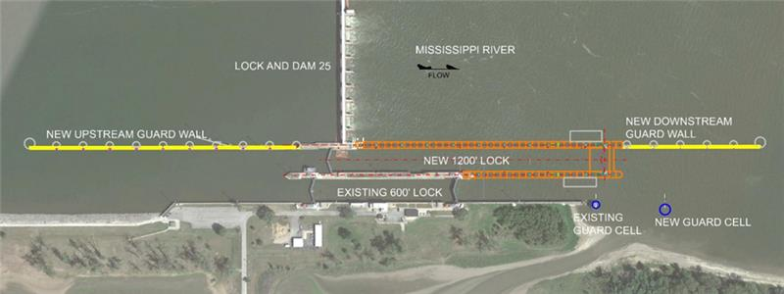
Bipartisan Infrastructure Law (BIL)
Projected Projects - Missouri
9
Opportunity | Location | NAICS | Release Date (Qtr) | Anticipated Award Date | Cost Range | Acquisition Strategy | Award/IDV Type
NESP Lock & Dam 25 Expansion – Lock Foundation & Site Prep | Winfield, MO | 237990 | 2Q, FY26 | 4Q, FY26 | $25M - $50M | BVTO | Contract
The NESP Lock and Dam 25 Expansion Project received $732M in FY22 BIL funding. The new 1200 ft Lock Project consists of the following features:
Design and construction of a new 1200 ft long drilled shaft-founded lock chamber to be constructed on the Downstream side of the existing auxiliary miter gate bay;
Design and construction of a new Upstream ported guard wall approximately 1250 ft long;
Design and construction of a Downstream Guard Wall approximately 650 ft long designed to block flow through the wall;
Design and construction of a Downstream Guide Cell;
Fabricated Lock Bulkheads; and
Design and construction of new Facilities to support lock operations.
Notes:
IIJA: $732M is for the NESP L25 new 1200ft Lock project. NESP, or Navigation and Ecosystem Sustainability Program, is an authorized, multi purpose program that contains projects across three USACE districts (MVP, MVR, MVS) to get at improved Navigation Efficiency and additional Ecosystem Restoration on the Upper Mississippi and Illinois Rivers. High points of the project include 7 new 1200ft locks at existing facilities. L25 is the first of those new locks to be funded. Look for more information later in this presentation on L25 as we will be awarding an initial construction contract yet this year but will also be looking to engage the construction industry on overall delivery strategy later this year as well.

Slide 10
Small Business Program – FY25
Current Numbers as of 4/8/2025
Achievement / Dollars Obligated | Small Business | Small Disadvantaged Business | Women Owned Small Business | Service-Disabled Veteran Owned Small Business | HUBZone Small Business
Awarded Actions | 216 | 109 | 84 | 24 | 12
Achievements | 78.80% | 37.26% | 13.65% | 10.59% | 9.11%
Dollars Obligated | $65,333,651 | $51,484,746 | $8,917,515 | $6,921,570 | $5,950,868
Total Actions: 298 for a total value of $65,333,651
Total Small Business Actions: 216 for a total value of $51,484,749
Small Business Program – Current FY25 Goals
Achievement / Dollars Obligated | Small Business | Small Disadvantage Business | Women Owned Small Business | Service-Disabled Veteran Owned Small Business | HUBZone Small Business
Current | 55.00% | 15.00% | 8.00% | 4.00% | 4.00%
Current Stats (as of 08 APR 2025) | 78.80% | 37.26% | 13.65% | 10.59% | 9.11%

Slide 11
FY24 – Top 5 NAICS Codes For Small Business
Small Business $ by Top NACIS Codes
NAICS Codes | Description | SB $
237990 | Other Heavy and Civil Engineering Construction | $5,900,993
336611 | Ship Building and Repairing | $1,314,488
541370 | Surveying and Mapping (Except Geophysical) Services | $1,257,054
562211 | Hazardous Waste Treatment and Disposal | $934,679
562910 | Remediation Services | $14,720,335
Small Disadvantage $ by Top NACIS Codes
NAICS Codes | Description | SDB $
324110 | Petroleum Refineries | $720,892
336611 | Ship Building and Repairing | $587,209
541370 | Surveying and Mapping (Except Geophysical) Services | $797,330
541380 | Testing Laboratories and Services | $892,360
562910 | Remediation Services | $13,570,335

Slide 12
FY24 – Top 5 NAICS Codes For Small Business
Service-Disabled Veteran Owned $ by Top NACIS Codes
NAICS Codes | Description | SDVOSB $
237990 | Other Heavy and Civil Engineering Construction | $5,320,260
238220 | Plumbing, Heating, and Air-Conditioning Contractors | $70,426
541720 | Research and Development in the Social Sciences and Humanities | $56,360
561720 | Janitorial Services | $27,255
561730 | Landscaping Service | $168,973
Women Owned Small Business $ by Top NACIS Codes
NAICS Codes | Description | WOSB $
324110 | Petroleum Refineries | $720,892
541370 | Surveying and Mapping (Except Geophysical) Services | $508,948
541380 | Testing Laboratories and Services | $892,360
561210 | Facilities Support Services | $404,950
562211 | Hazardous Waste Treatment and Disposal | $934,679

Slide 13
FY24 – Top 5 NAICS Codes For Small Business
HubZone $ by Top NACIS Codes
NAICS Codes | Description | HubZone SB $
213115 | Support Activities for Nonmetallic Minerals (Except Fuels) | $35,000
237990 | Other Heavy & Civil Engineering Construction | $5,447,166
332321 | Metal Window and Door Manufacturing | $0
333313 | Office Machinery Manufacturing | $0
333618 | Other Engine Equipment Manufacturing | $0

Slide 14
Interested in Doing Business with Us
14
MVS Points of Contact
COL Andy Pannier, District Commander
LTC Andrew James, Deputy Commander
John Peukert, Chief, Programs and Project Mgt.
(314) 331-8012
Susan Wilson, Chief, Engineering-Construction Division
(314) 331-8202
Lou Dell’Orco, Chief, Operations Division
(314) 331-8100
Tony Jones, Chief, Construction Branch
(314) 331-8130
Aaron Sanford, Chief, Contracting Division
(314) 331-8500
Kelsey Daniels, Deputy of Small Business Programs
(314) 331-8181
Register in the System for Award Management database. https://www.sam.gov
It is MANDATORY that all vendors be registered under the SAM program.
Search Contract Opportunities by going to SAM and select:
  Search→ Any Words→ W912P9 for St. Louis
Complete the appropriate forms stated or provided in the synopsis or solicitation.
Visit the St. Louis District website in order to learn about the missions and the types of services/supplies we procure.
  St. Louis District: https://www.mvs.usace.army.mil/
If you are a small or small disadvantaged business, call, email or visit the St. Louis District’s Deputy for Small Business Programs to discuss your firm's capabilities, interest and capacities to perform.
  kelsey.m.daniels@usace.army.mil, 314-331-8181

