Slide 1


Society of American
Military Engineers
TEXAS REGION
Leader Development Program
Class 2025-26

Slide 2
Name
Insert your photo here
Birthday:
Company:
Job Title:
Company Address:
Phone Number:
Education
Activities/Hobbies
Interests:
Professional/Non-Profit Organizations:
Anything else to share?:

Slide 3
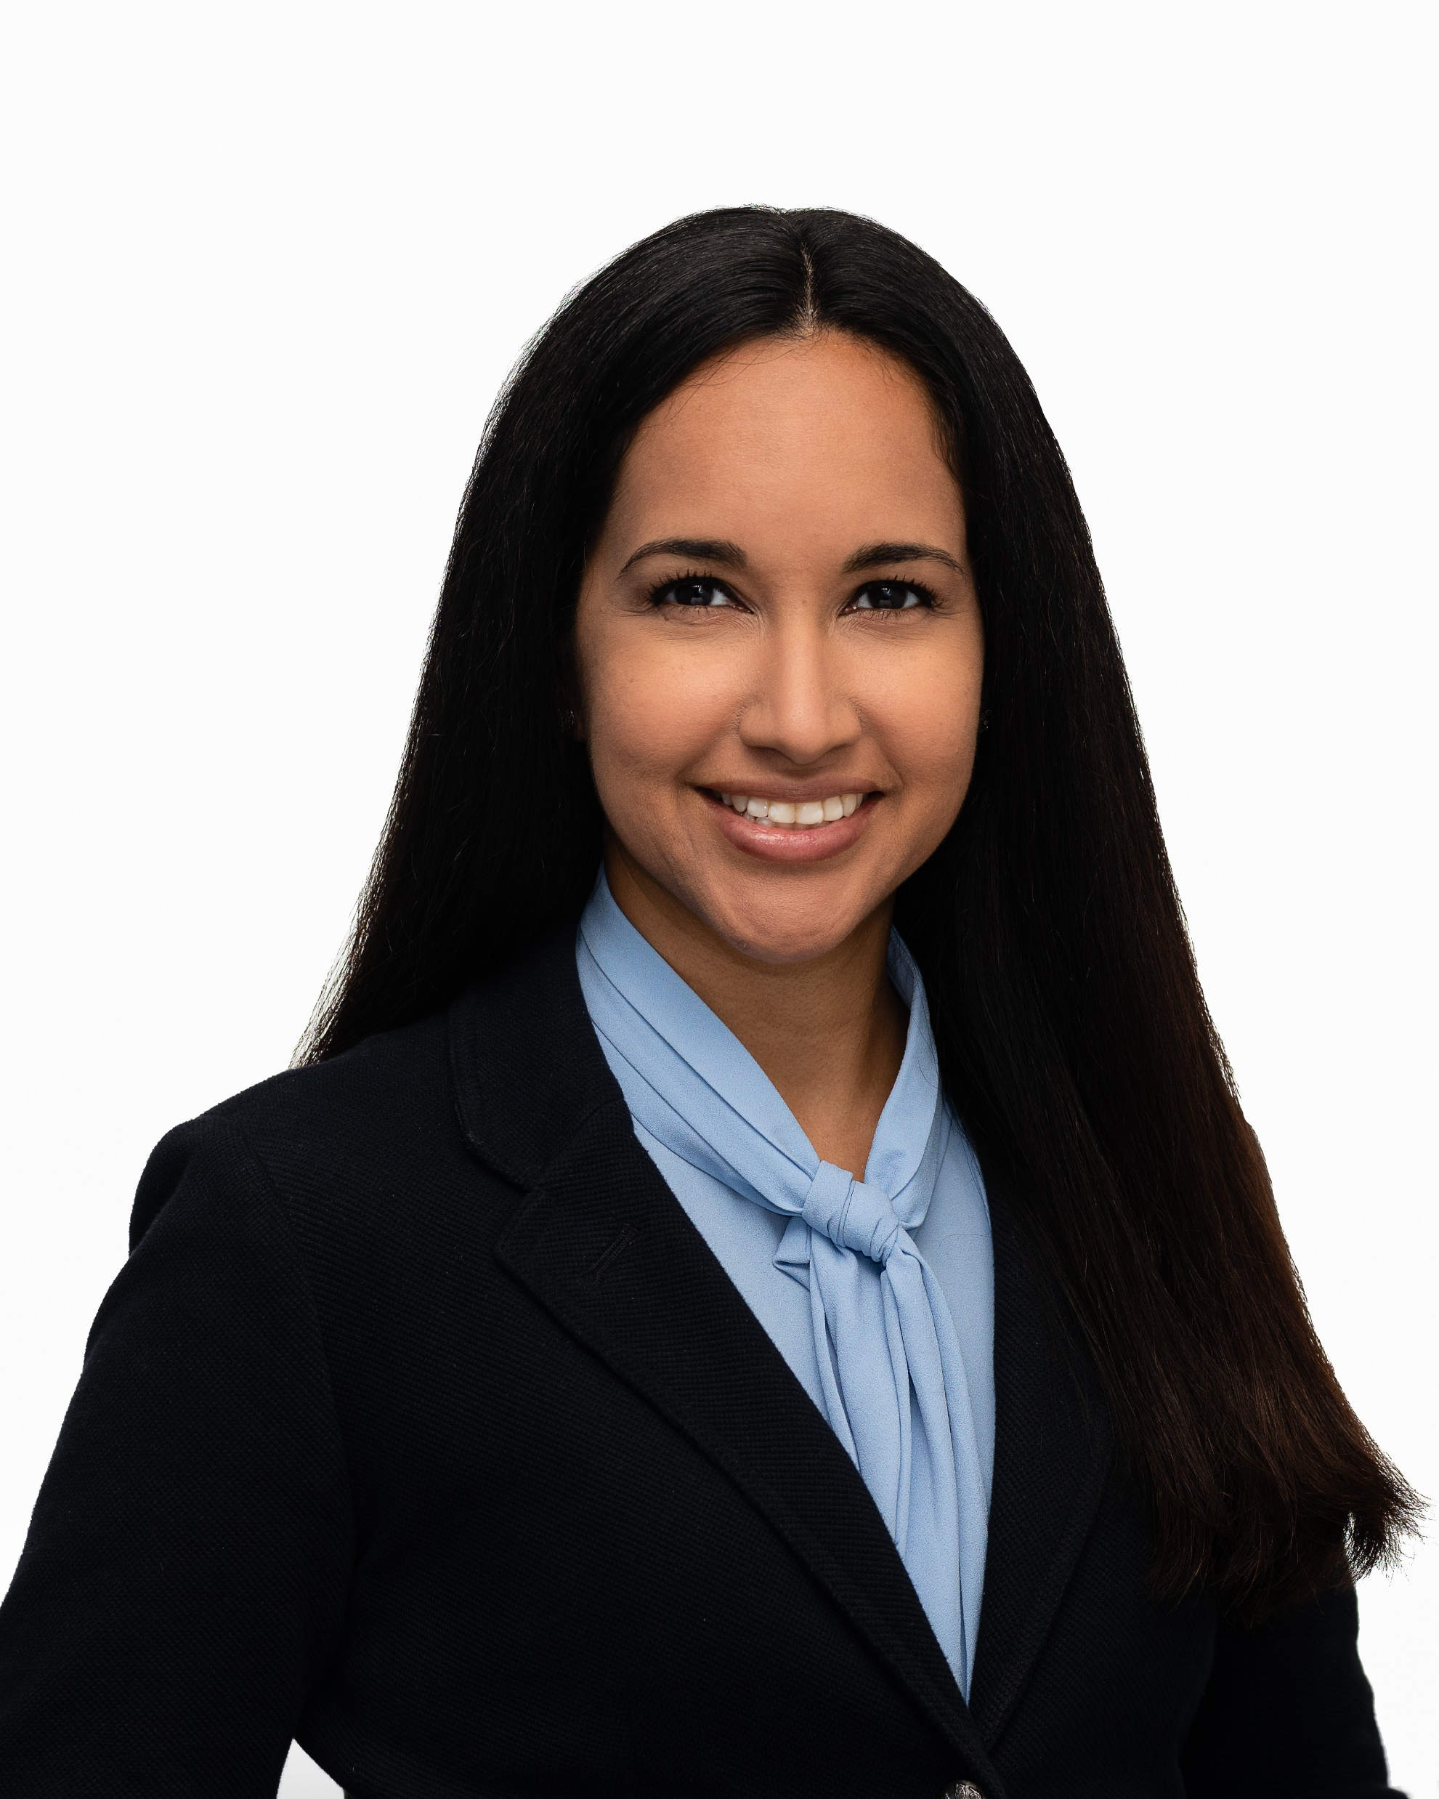




Yvonne Rivera
Birthday: June 5
Company: DEC / Gannett Fleming
Job Title: Project Manager
Company Address: 3100 W. Alabama St., Houston, TX 77098
Phone Number: 832-455-7540
Education: BS Civil Engineering Texas Tech University, Master’s Civil Engineering University of Houston
Activities/Hobbies: traveling (16 countries so far)!, playing violin, trying new restaurants
Interests: mentoring, music, fashion, going to the beach, healthy food
Professional/Non-Profit Organizations: SAME, APWA, Houston Civic Symphony, Houston Rodeo Scholarship Alumni Association, Texas Water Leaders Class V, Leadership Houston Class XXXV
Anything else to share?: I was born and raised in Houston. I am half Colombian/half Puerto Rican. I have a 5-year-old daughter, Natalia, and a 2-year-old son, Camilo.
S A M P L E

