Slide 1
Welcome 2025 Veteran’s Event

Slide 2
Agenda
Opening (Prayer/Pledge)
Lunch
Introduction
Speaker Presentations
HC VSD Mr. James Cabarrus
COH MOVMA Dr. Lashondra Jones 147th AW Maj Alyson White
VA-VR&E Mr. Darwin Dawson NextOP-Ms. Lawren Johnson
Special Announcement: Fleet Week Houston!
Final Announcements

Slide 3








Platinum Sponsors

Slide 4




Gold Sponsors

Slide 5






















Silver Sponsors

Slide 6









Public Agency Partners

Slide 7
Announcements
Fleet Week Houston
First Ever!
Nov 10th, 9:30-12:30; NRG Stadium
Please sponsor the event at NRG and support our veterans
SAME Upcoming Events (all but Golf at Junior League)
15 Oct CIP Briefs w/APWA
10 Nov Fleet Week Houston (see above)
11 Nov Golf Tournament; Blackhorse Golf Club
2 Dec Sponsor Member Breakfast
20 Jan 2026 Installation Banquet
All 2026 dates locked in at Junior League.

Slide 8
Presentations
Harris County Veteran Services Department
Mr. James Cabarrus

Slide 9


Slide 10
Presentations
City of Houston Mayor’s Office of Veterans and Military Affairs
Dr. Lashondra Jones

Slide 11

City of Houston Office of Veterans & Military Affairs Dr. LaShondra Jones

Slide 12
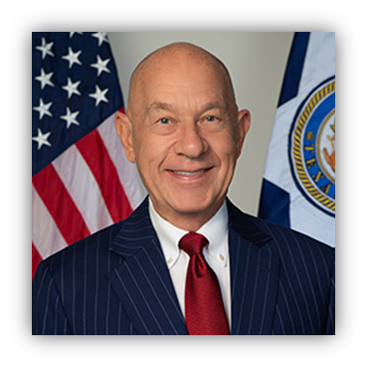
Mayor John Whitmire serves as the Executive Officer of the City. As the City's chief administrator and official representative, the Mayor is responsible for the general management of the City and for seeing that all laws and ordinances are enforced. Administrative duties include the appointments, with Council approval, of department heads and persons serving on advisory boards.

Slide 13
Mission Since our inception in 2007, the Office of Veterans & Military Affairs has steadfastly, continued the mission of advocating on behalf of active-duty, Guard/Reserves, veterans, spouses and their children. We also coordinate and facilitate access to resources through federal, state, local initiatives and programs.

Slide 14
This office coordinates with government agencies, non-profit organizations, faith-based organizations and other community service providers to ensure comprehensive support throughout the community and beyond. We provide and support and guidance to stakeholders (ERG’s, local veteran and active-duty groups, etc.) on events, projects and issues of interest. We serve as the City of Houston’s Military/Veteran liaison - Providing a forum for members of the military and military-affiliated community to express their respective views and interests directly to local, state and federal government officials.

Slide 15
OVMA advocates to raise awareness, informs and advises the Mayor’s Office, City of Houston Departments and City Council on matters impacting the military and military-affiliated community. OVMA provides peer-to-peer counseling to the Military and Military-Affiliated community. OVMA plans, attends, and show support for community events.

Slide 16
Vietnam Veterans Day
Texas Women Veterans Day
Women Veterans Empowerment Expo
9/11 Remembrance Day
Vanessa Guillen Day
Veterans Day/ Salute to Heroes Parade
Military Branch Days
Houston Veteran Stand Down
Houston Veteran Business Chamber of Commerce Expo
Navy Fleet Week (2025)

Slide 17
Vietnam Veterans Day
Texas Women Veterans Day
Women Veterans Empowerment Expo
9/11 Remembrance Day
Vanessa Guillen Day
Veterans Day/ Salute to Heroes Parade
Military Branch Days
Houston Veteran Stand Down
Houston Veteran Business Chamber of Commerce Expo
Navy Fleet Week (2025)

Slide 18
Retirement Ceremonies
Change of Command
Birthdays
Ribbon-cuttings
Proclamation Readings
Galas
Hospice Visits
Funerals/Wakes
Job/Resource Fairs
Active-Duty Military Events
Volunteer Events
City Council District Events
Memorial Day Ceremonies
Wreaths Across America
College/Student Events
ERG Group Visits
Press Conferences
City Employee Events
Dignified Transfers
Podcasts
Radio Stations

Slide 19

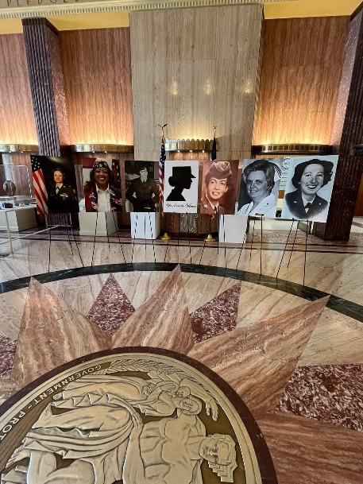
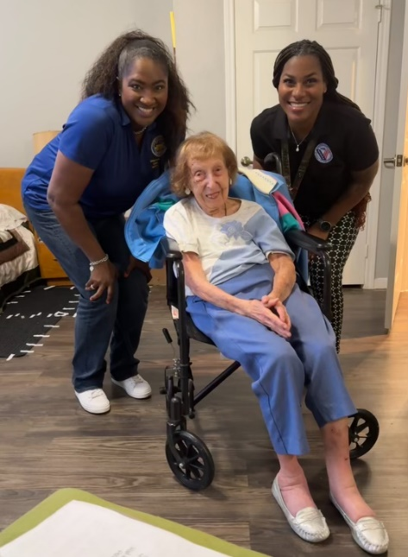
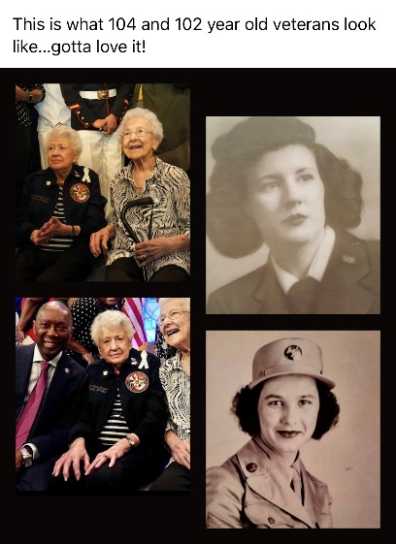
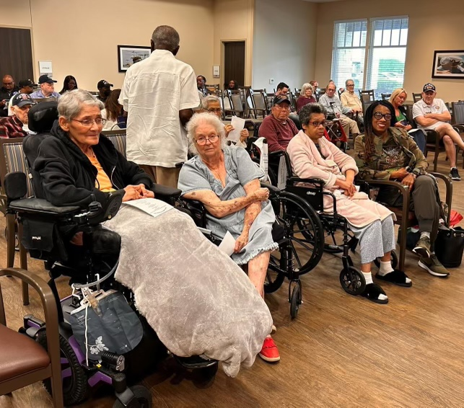

Slide 20
