Slide 1
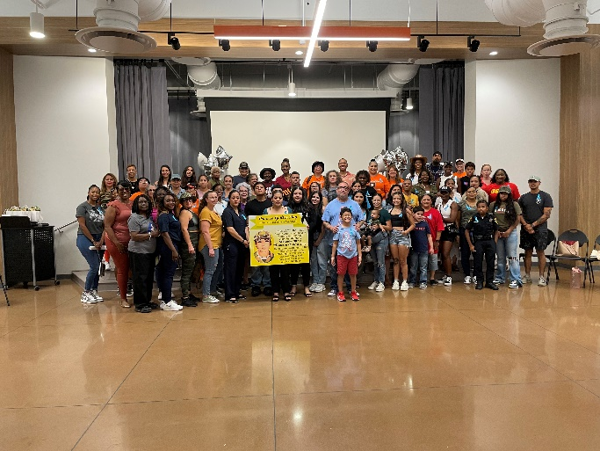

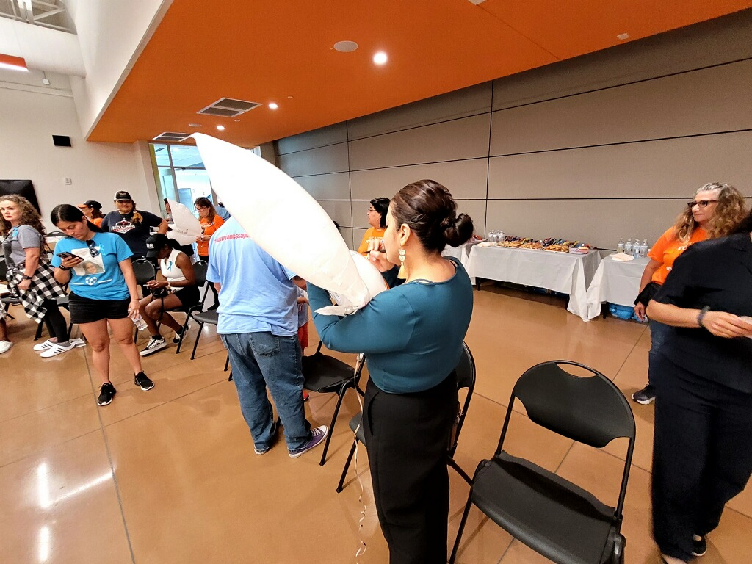
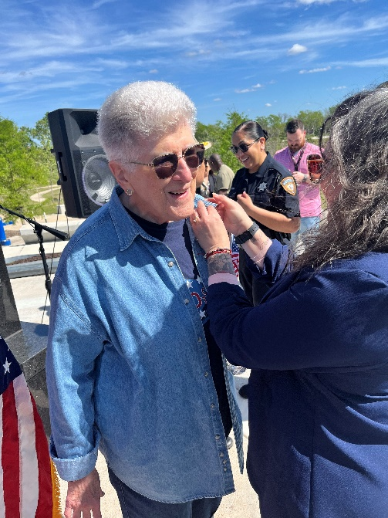
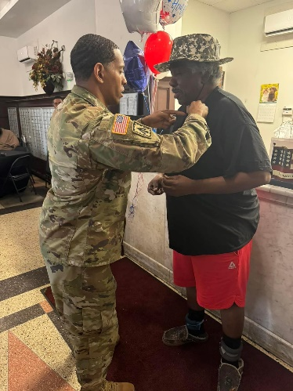
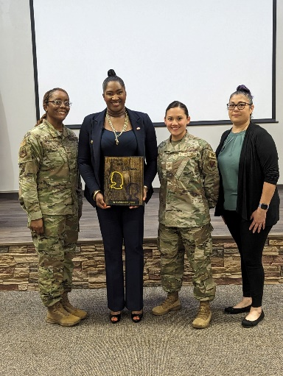
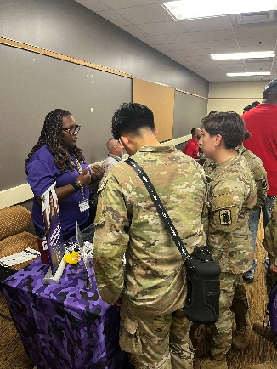
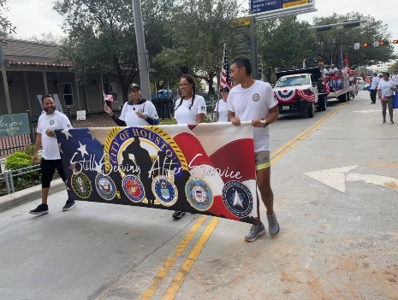
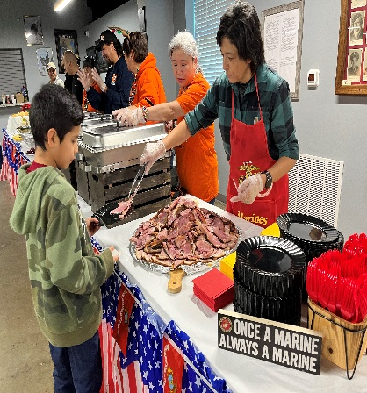


Slide 2
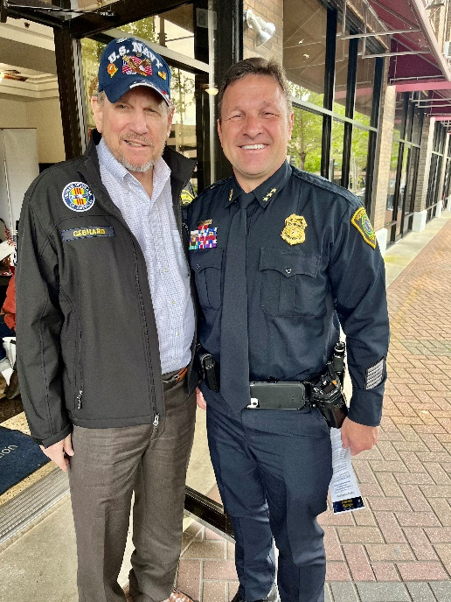
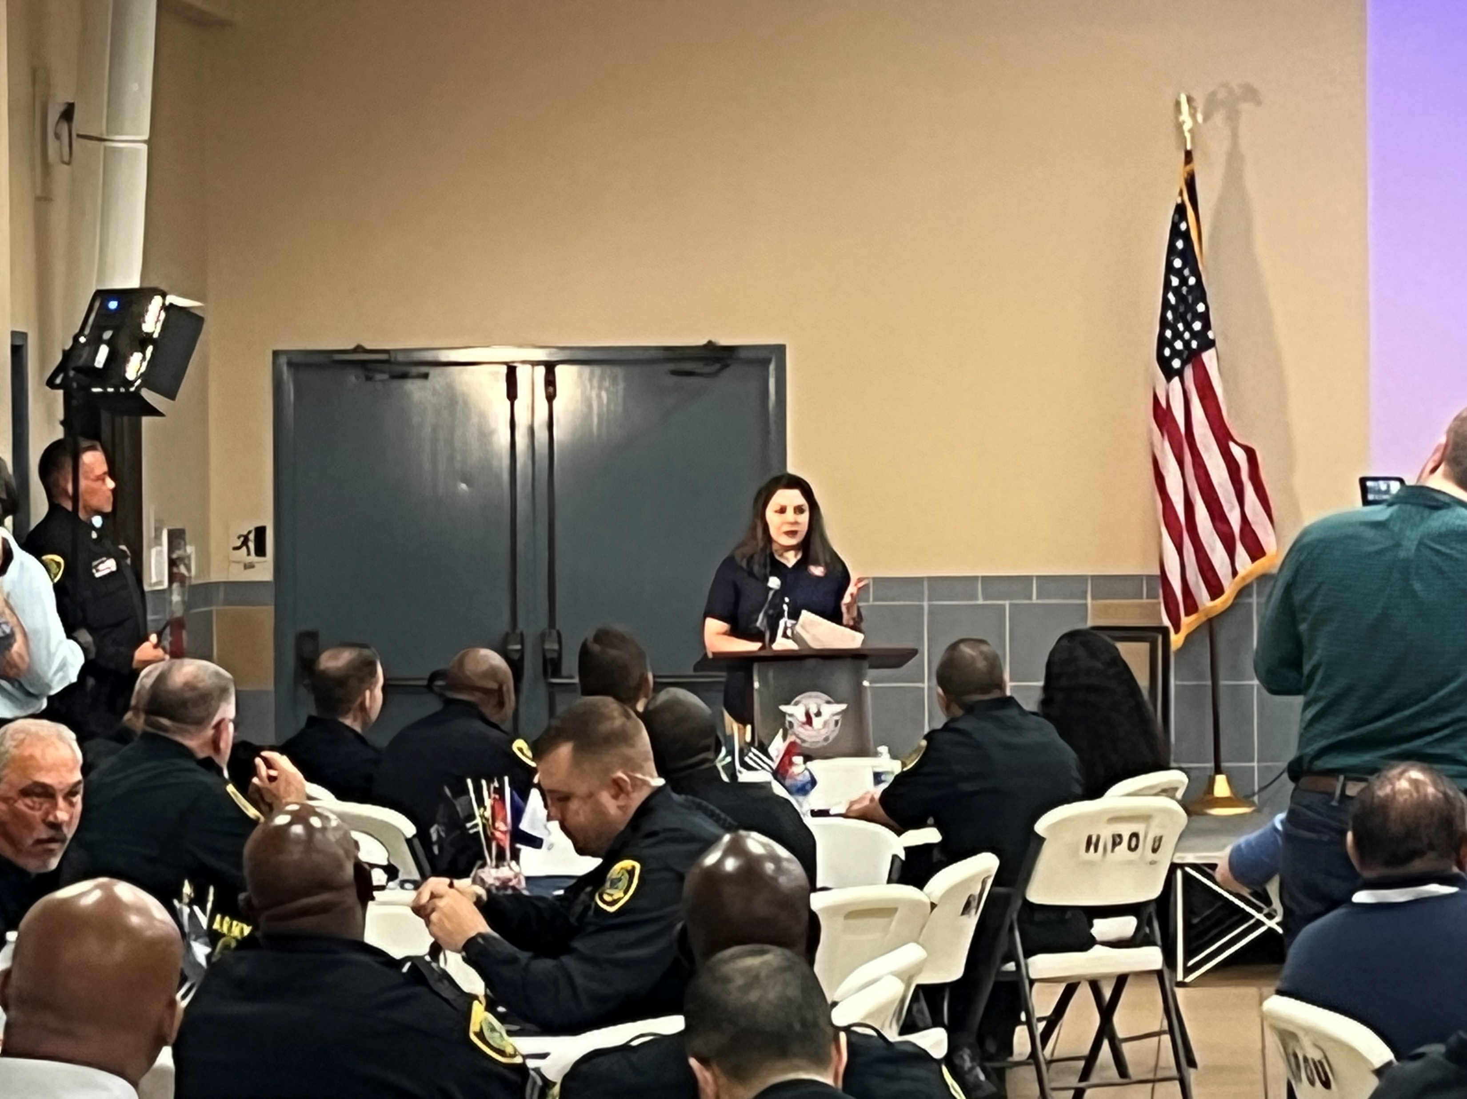
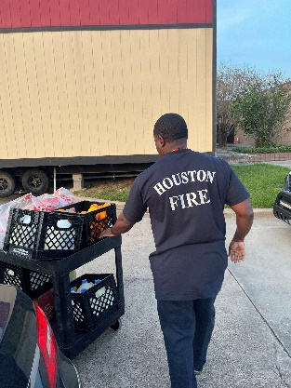


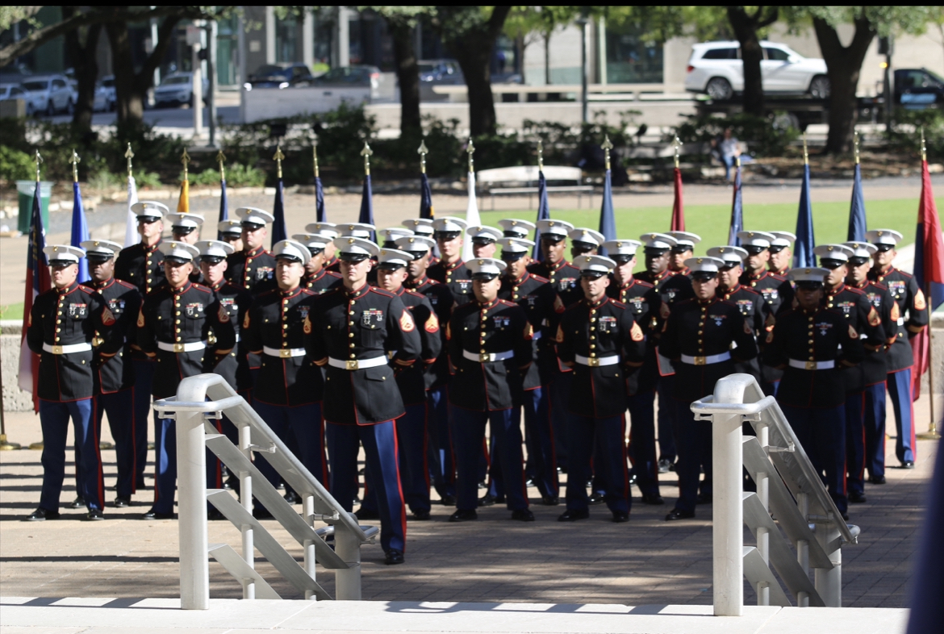
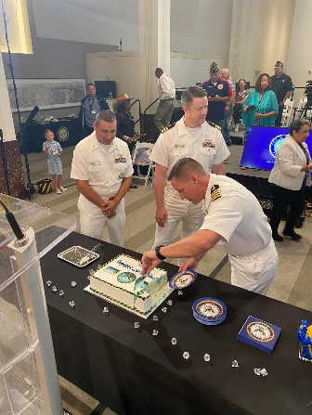
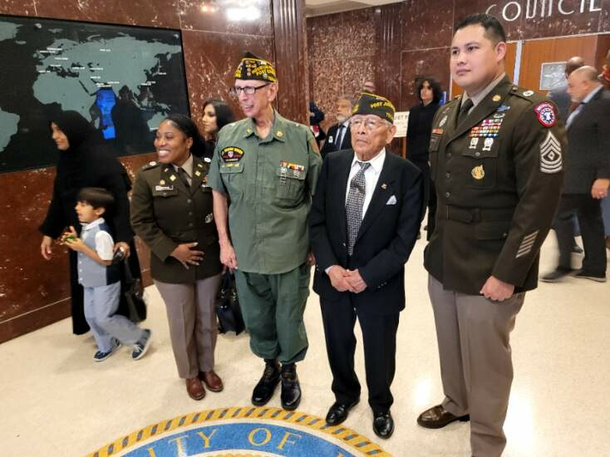
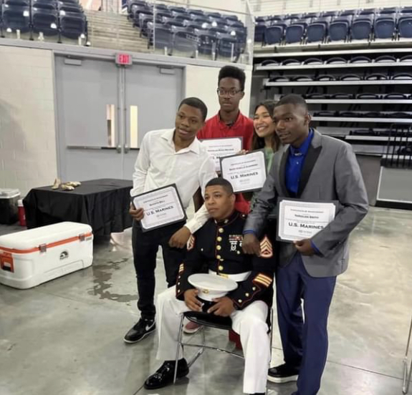

Slide 3
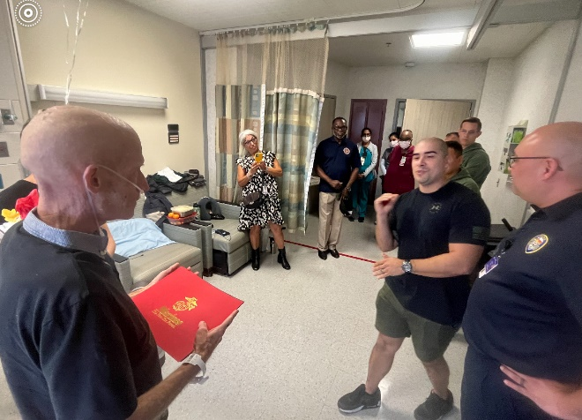
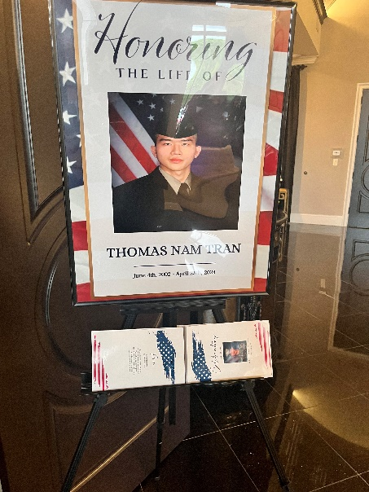
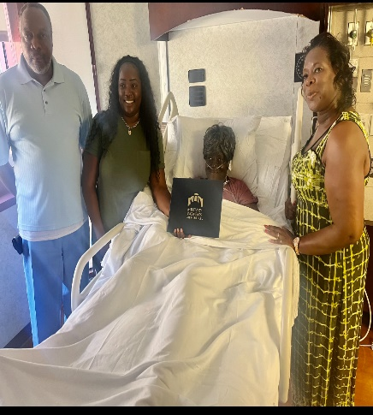
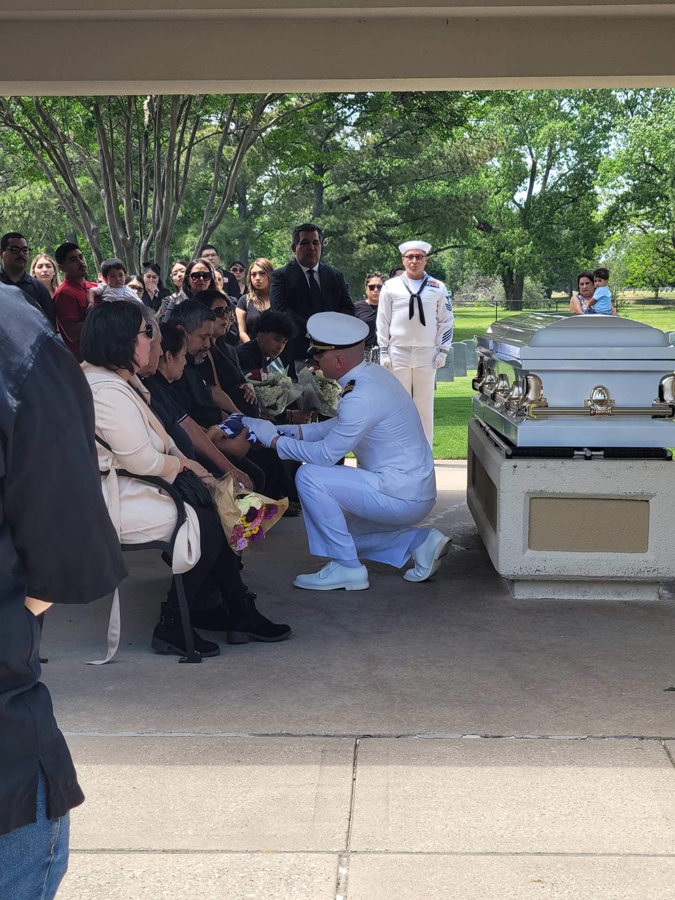

Slide 4
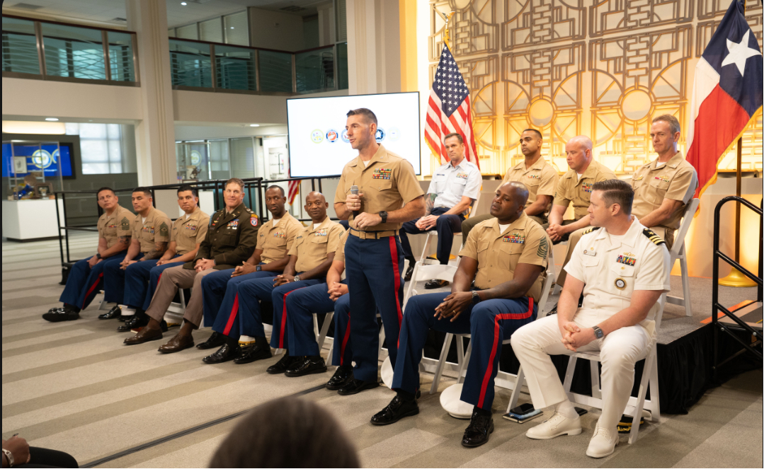

Slide 5
https://youtu.be/syyJ8YpiwSk?si=r16UTMbvOqSikrsz

Slide 6
Office of Veterans and Military Affairs
901 Bagby, Legacy Room Offices
Houston, TX 77002
PHONE: 832.393.0992 or 832.393.8147
Email: movma@houstontx.gov

Slide 7
Presentations
147th Attack Wing; Joint Reserve Base Ellington Field
Maj Alyson White

Slide 8
Presentations
VA Veterans Readiness and Employment Office
Mr. Darwin Dawson

Slide 9

VETERAN READINESS & EMPLOYMENT
VR&E

Slide 10
VR&E Program Purpose
To provide services and assistance to Service members and Veterans with service-connected disabilities
  Assist Veterans in obtaining and maintaining suitable employment
  Help Veterans achieve independence in daily living

Slide 11
VR&E Eligibility and Entitlement
Veterans:
  Honorable or other than dishonorable discharge
  VA service-connected disability rating or memo rating of 10% or more
  Apply for Vocational Rehabilitation & Employment services
  Entitlement based on establishment of employment handicap resulting from SCD
  Serious employment handicap establishes entitlement for veterans rated 10%

Slide 12
Basic Benefit Information
48 months of entitlement
  May be utilized within 12 years from the date of initial VA disability rating notification
  Exception for those with a Serious Employment Handicap

Slide 13
VR&E Services
Employment
Orientation
Entitlement
Determination
Track
Selection
Re-Employment
Employment
Rapid Access
Self
Employment
Employment Thru
Long Term
Services
Independent
Living

Slide 14

Re-employment
For individuals separating from active duty, National Guard, or Reserves
Return to previous employers
Services include:
  Job accommodations
  Job modifications
  Work adjustment assistance
  Consultation with employer

Slide 15
Rapid Access to Employment
For individuals seeking employment soon after separation or who already have necessary skills to be competitive in the job market
Services include:
  Resume writing and job search assistance
  Interviewing skills training
  Job accommodations
  Refresher courses
  Licensure and certification
  Post-employment adjustment services

Slide 16
Self-Employment
For individuals with limited access to traditional employment, or who need flexible work schedules or a more accommodating work environment due to their disabilities
Services include:
  Analysis of viability of business concept
  Development of a business plan
  Training in small business operations
  Marketing assistance
  Guidance on obtaining resources

Slide 17

Employment Through Long-Term Services
For individuals needing specialized training and/or education to obtain and maintain suitable employment
Services may include:
  On-the-Job Training (OJT) / NPWE (Non Paid Work Experience)
  Apprenticeships and internships
  Higher education or vocational training
  Tuition/fees/books/tools
  Subsistence allowance
  Tutoring

Slide 18
Independent Living
For individuals not able to work who need rehabilitation services to live more independently
Services include:
  Comprehensive in-home assessment
  Assistive technologies
  Independent living skills training
  Connection to community-based support services
  Case management services
  Coordination with VA’s Specially Adapted Housing Program

Slide 19
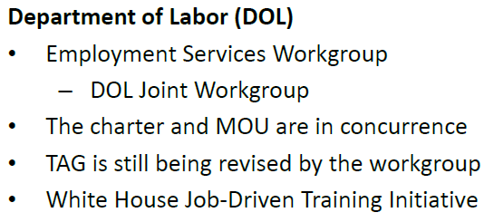
Employment Services

Slide 20
Special Employer Incentive
The Department of Veterans Affairs (VA) VR&E program provides eligible Veterans an opportunity to obtain training and practical hands-on experience concurrently through the Special Employer Incentive (SEI). The SEI program is for eligible Veterans that face extraordinary obstacles to obtaining employment. Veterans are hired by participating private employers at the on-set of the SEI and employment is expected to continue following successful completion of the SEI.
Reimbursement of up to 50% of Veteran’s salary during the SEI program to cover:
- Additional expenses incurred for cost of instruction
- Loss of production
- Additional supplies and equipment costs
Hire qualified Veterans trained to the agency’s specifications
Hire a trainee at an apprenticeship wage
VA provides the necessary tool, equipment, uniforms and other supplies
Appropriate accommodations are made based on individual needs

