Slide 1
Services Available For Veterans
Comprehensive Evaluation
Medical Referrals
* Dental
* Optical
Subsistence Allowance
Tuition, Books, Fees
Tutoring
Tools, Supplies, Equipment
NPWE
On The Job Training
Special Employer Incentive
Case Management
Special Hiring Authority
Guidance & Counseling
Worksite Evaluations
Other Services Necessary To Achieve Rehabilitation

Slide 2
How Do Veterans Apply For Services?
Submit VA Form 28-0588, Request for Memorandum Rating, along with your service or other medical records, and;
Submit VA Form 28-1900, Application For Vocational Rehabilitation & Employment Benefits
VARO Fax 713-383-1984
VONAPP. WWW.VA.GOV
Mail / Hand Carry To VA:
Veterans Affairs Regional Office
Vocational Rehabilitation & Employment
6900 Almeda Rd.
Houston, TX 77030

Slide 3

VR&E Office Locations
Several VR&E Locations
Houston VA Regional Office – Main Campus
(Bill Processing Center)
San Antonio, TX – Out-based Office
McAllen, TX – Satellite Office
Corpus Christi, TX – Satellite Office

Slide 4






VA Telephone Contact 1-800-827-1000
www.va.gov
www.vba.va.gov/bln/vre/index.htm
www.vba.va.gov/bln/21/index.htm
www1.va.gov/health_benefits/
www.gibill.va.gov/
www.ebenefits.va.gov/

Slide 5
Houston VARO Employment Coordinators
Darwin E. Dawson, MS
Chapter 31, Vocational Rehabilitation & Employment
Employment Coordinator
6900 Almeda Rd.
Houston, TX 77030
email.: darwin.e.dawson@va.gov
Telephone: 713-383-1958 Fax: 713-383-1984
(Houston, Corpus Christi & McAllen Areas)

Slide 6


Questions?
Thanks for all you do!!

Slide 7
Presentations
NextOp
Ms. Lawren Johnson

Slide 8

Notes:
1. Welcome Slide:
No Notes:
2. Resume 101:
Title Slide
3. What resume tips or suggestions have you come across?
Ask the question: “What resume tips or suggestions have you come across?”
"Share: Today’s focus will be on basic resume building and targeting toward a job in software engineering/development. These are basic guidelines! Your resumes can look different so long as they target the job you’re going after."
4. Introduction to Resume Basics:
Notes: "Objectives:
Introduction to Resume Basics - Understand the key principles of resume building.
First Impressions & Readability - Learn how to make your resume stand out in 5-7 seconds.
Targeting & Customization - Tailor your resume for specific job roles and industries.
Applicant Tracking Systems (ATS) - Optimize your resume to pass ATS screening.
Resume Structure - Master the use of action verbs, quantified achievements, and relevant experience.
Avoiding Common Mistakes - Identify and fix common resume pitfalls."
5. True or False? (Interactive Slide):
Notes: "Interact! Use the thumbs up or thumbs down reactions in Zoom. Thumbs up is True, Surprise Face is Maybe, Thumbs down is False."
6. Easy Apply has made job search easier for job seekers and recruiters (True or False?):
Notes: False - "You have something ready to go but it does not allow you to target your resume. Easy apply makes it quicker but you often miss the opportunity to speak directly to the role."
7. What is an Applicant Tracking System?
Notes: Show of Hands, who knows what an applicant tracking system is?
"ATS = Application Tracking Software: ATS scans your resume and questionnaire answers vs job requirements then feeds relevant info back to recruiting team. This is typically one of the first hurdles during your application process."
8. About ATS
Parses resumes into predefined sections (e.g., Contact Information, Work Experience, Education). Reads left to right. WARNING! May miss info if the format is complex.
Scores resumes based on relevance to the job description, often using keywords.
Filters resumes based on criteria set by the recruiter (e.g., years of experience, specific skills).
Stores and organizes resumes in a searchable database for recruiters to review later.
Flags resumes that meet or exceed keyword thresholds.
Matches candidates to job openings based on skills, experience, and qualifications.
9. Recruiters typically only spend 1-2 minutes looking AT resumes (True or False?):
NEXT SLIDE
10. False: Recruiters typically spend only 5 to 7 seconds looking at a resume.
First Impressions Matter. Make it count!
Recruiters typically read in an F format. They'll focus on your most recent experience (read the job title, bullets), skim through your previous job titles & companies.
Keep your resume between 475-600 words to hit the sweet spot.
Customize each resume to the specific job title and description.
11. Resume Structure:
Notes: HR professionals, hiring managers, and recruiters often hold varied opinions on which resume format they prefer. Some might favor a classic chronological layout, while others might appreciate a modern, visually engaging style. These preferences can be subjective and influenced by current trends in hiring practices. Ultimately, if you use a generic template that’s easy to read, it works best for most audiences. What matters most is the information you share.
12. Core Elements of Effective Resume Content
Notes: Let’s briefly touch on the Core Elements of Effective Resume Content
Contact Information
Summary /Objective
Work Experience
Education
Skills/Certifications
Additional Sections
13. Contact Information & Summary:
Notes:
Contact Information: Clearly state your name, phone number, and professional email address. Include your LinkedIn profile or professional website if relevant. There is no need to include your street address. No one needs to visit you during the job search process. Your zip code can also provide information about the part of town you live in. The city and state is enough.
Professional Summary or Objective: A brief section at the top of your resume that summarizes your qualifications or states your career objectives, tailored to. Your professional summary is the first thing recruiters see, so keep it concise. In 2-3 sentences, explain how your experience and skills can help the company solve a problem. Highlight your years of experience, key accomplishments, and expertise. Your experience should reflect your soft skills, so no need to list them separately. Stay brief and focused on the role you are applying for
14. I Should Put Everything I Ever Did in a Resume (True or False?):
Notes: "No. Focus on relevant experiences and achievements."
15. Work Experience:
Notes: "Highlight key achievements that demonstrate your leadership, communication, and other essential soft skills. Use the formula: ACTION VERB + TASK + IMPACT to create strong statements."
Work Experience: List your relevant job experiences in reverse chronological order. For each position, include your job title, the company's name, location, and the dates of employment. Under each role, bullet out your key responsibilities and achievements, quantifying results with numbers when possible.
List your most important and relevant accomplishments and responsibilities using accomplishment-driven bullet points.
Make sure your bullets demonstrate your soft skills e.g. leadership, communication, responsibility, time management, mentoring, teaching, supervising, etc.
Use the formula ACTION VERB + TASK + RESULT to format the bullets
Quantify your bullet points using numbers, percentages and dollar amounts. Note, not every bullet point needs to be a quantifiable responsibility.
Put your strongest selling point first; You won’t have enough room to list everything, so only list the accomplishments that relate to the position you’re applying for.
Focus on accomplishments and results, not just job duties
16. Resumes Should Be Exactly 1 Page (True or False?):
Notes: Two-page resumes are 2.9 times more likely to be chosen for candidates applying to managerial roles.
You want to target your resume to show only the most relevant experience possible. We need to stay focused on our audience.
Everything you have done in your military career can go on your master resume -some that will definitely translate over to other industries.
On a tailored resume you will want to translate your military acronyms and jargon into something that a civilian will understand.
17. Education & Skills:
Notes: "Education: Provide details of your educational background listing the most recent or highest degree first."
Education: Provide details of your educational background, listing the most recent or highest degree first. Include the name of the institution, its location, and your degree.
If you’ve completed your degree, do not list your high school diploma. If you are pursuing a degree you would add your expected graduation date
If you didn't complete the degree program, list the college and location and major you studied instead of the degree. (Ex. Studied Biology)
Skills: Highlight relevant skills, both hard and soft, that are specific to the job you're applying for. Include any certifications, languages, or technical skills.
Additional Sections: Depending on your industry, you might also include sections for publications, conferences, courses, volunteer work, or professional affiliations.
18. Why Use Chat GPT?
Notes: "Save time with AI-generated suggestions, tailor resumes to specific jobs and industries, and get help with structure, formatting, and phrasing."
19. Key Takeaways
Resumes should be easy to read and organized for quick scanning.
First Impressions Matter: Recruiters spend 5-7 seconds on initial review.
Target each resume to the specific job/industry.
Honest representation of experience is crucial—avoid jargon.
Applicant Tracking Systems (ATS): Optimize for keywords, avoid complex formats.
Structure is key: Action verbs, quantifiable results, and tailored job descriptions.
Avoid overloading: Focus on relevant accomplishments.
Two-page resumes are okay for managerial roles or experienced professionals.

Slide 9


Connecting Military Talent to SAME Industries
September 10, 2025
AIR FORCE | ARMY | COAST GUARD | MARINES | NAVY | SPACE FORCE
Lawren Johnson, MBA | U.S. Army Veteran | Employment Coordinator
Notes:
“Good afternoon, and thank you for welcoming me. I’m Lawren Johnson, a retired Army veteran and Employment Coordinator with NextOp. I’m here to show you how veterans can be a solution to workforce gaps in SAME industries.”

Slide 10

NextOp launched in 2015 to help high performing, enlisted leaders translate their exceptional military experience into successful civilian careers.
NextOp has offices in Houston, TX and New Orleans, LA, and remote staff in North Texas, North Carolina, Virginia, and Wisconsin.
Notes:
“Good afternoon, and thank you for welcoming me. I’m Lawren Johnson, a retired Army veteran and Employment Coordinator with NextOp. I’m here to show you how veterans can be a solution to workforce gaps in SAME industries.”

Slide 11

WHO WE ARE
NextOp Inc. is a 501(c)(3) nonprofit veteran service organization (VSO)
OUR MISSION
NextOp recruits, develops and places high-performing enlisted leaders into careers
OUR VISION
To be the strongest link between industry and military talent

Slide 12




ALL-TIME IMPACT
4000+
<36 days
$70K+
Veteran candidates placed
Average time to place a veteran candidate
Average NextOp candidate starting salary for 2023
Notes:
“NextOp exists to connect highly skilled enlisted leaders with civilian careers. Since 2015, we’ve placed over 4,000 veterans into meaningful roles, with most hired in just over a month at salaries around $70,000.”

Slide 13

BENEFITS & SERVICES
Candidate preparation
Resume building
Interview practice
1 on 1 career coaching & mentorship
Employer veteran pipeline readiness and mentoring
Direct connection between employers & candidates
Federal Program management
DoD SkillBridge
DoL Employment Navigator Partner Program
Navy Submarine Industrial Base

Slide 14

Why Veterans?
Proven leadership & teamwork
Mission-driven work ethic
Technical + soft skills across industries
Adaptable & safety-minded
NEXTOP >> EMPOWERING AMERICA'S VETERANS
Sources:
March Marketing, “Veteran Employment & Inclusion Programs”, 2013
5
Notes:
Proven leadership & teamwork
Mission-driven work ethic
Technical + soft skills across industries
Adaptable & safety-minded
Speaker notes: “Military Veterans don’t just bring skills, they bring leadership under pressure, accountability, and adaptability. These qualities are exactly what construction, engineering, and logistics companies value most.”

Slide 15
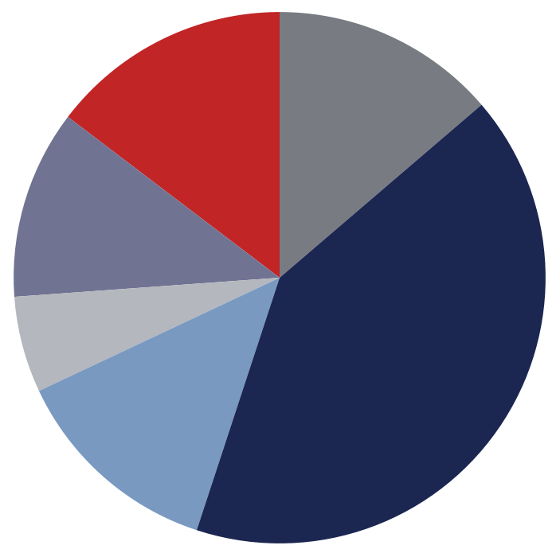
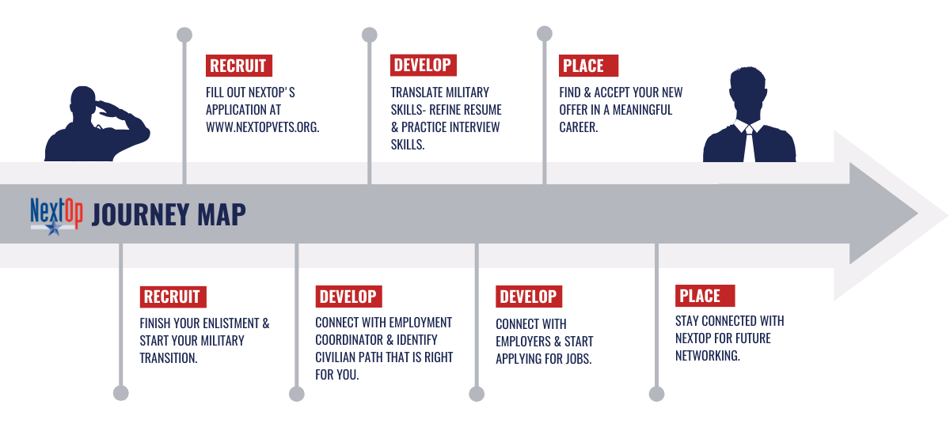

THE PROCESS: RECRUIT, DEVELOP, PLACE
Where we find high quality candidates
Employment Coordinators connect within 72 hours to begin 1:1 mentorship
Word of Mouth, 41%
Referral Program, 14%
Military Base, 13%
Social Media, 6%
Website, 11%
Other, 15%
Traditional NextOp Candidate
Technically & mechanically talented veterans in their mid 20s with 5 to 10 years of experience.

Slide 16
SAME Industry Alignment
Manufacturing 218+ hires $13M+ impact | Energy 727+ hires $47M+ impact | Logistics 389+ hires $21M+ impact
Construction 733+ hires $40M+ impact | Maritime/ Industrial Base 166+ hires $10M+ impact
Project Engineer, Heavy Equipment Operator, Structural Welder / Pipefitter, Logistics Coordinator, CNC Machinist / Technician, Safety Coordinator, GIS Analyst
Notes:
“These numbers are real placements since 2015. The veterans we serve are already filling project manager, engineer, welder, heavy equipment operator, and logistics roles — the same jobs your firms depend on. Their economic impact in Texas industries alone is in the tens of millions.”
“Here are some of the roles veterans step into right away. These aren’t abstract skills — they’re practical, job-ready capabilities you already need.”

