Slide 1

Blueprints for Crisis: Engineering with Preparedness in Mind

Slide 2
Blueprints for Crisis:
Engineering with Preparedness in Mind
Agenda:
1130: Registration, Networking and Lunch
1200: Program Start/Call to Order by Seattle Post
1205: Committee Chair Reports
1210: WAsafe Presentation
1215: Introduction of Speaker Panel
1255: Q&A
1300: Adjourn

Slide 3

Society of American Military engineers, Seattle Post
December 9, 2025
Elenka Jarolimek, CEM; Seattle Dept of Construction & Inspections
Jon Siu, Pe, SE; WAsafe Steering Committee

Slide 4

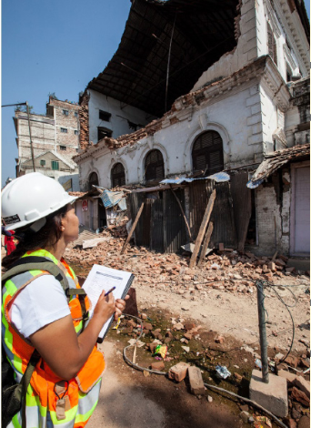
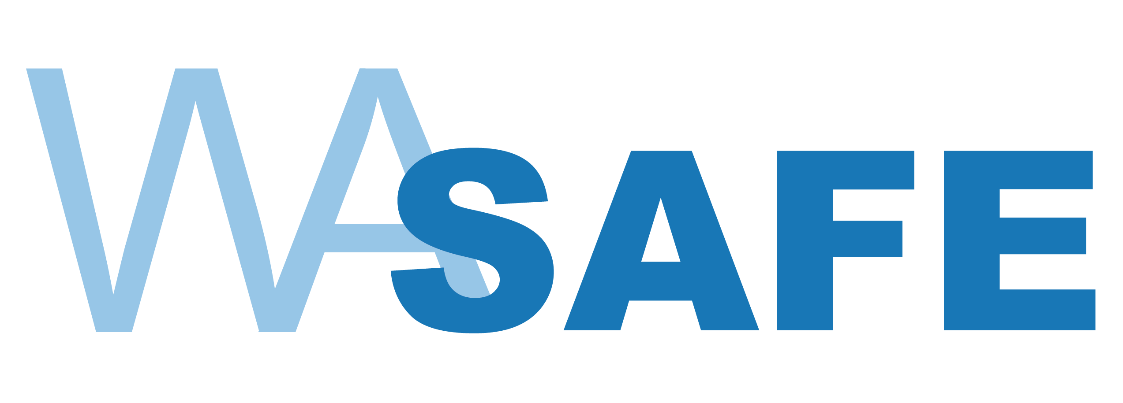
Who is WAsafe?
Coalition of 4 NGOs
Statewide program to assist local building officials with building safety assessments following a disaster (earthquake, flood, storm)
Develop a group of qualified volunteer Building Safety Evaluators (BSEs)
Provide WAsafe BSE training
Maintain roll of volunteers
Assist WA State EMD in calling up and dispatching volunteers to where they are needed in large events
Share/distribute resources
Notes:
We are a coalition of 4 NGOs—Washington Association of Building Officials, Structural Engineers Association of Washington, Washington Council of the American Institute of Architects, and the Seattle Section of the American Society of Civil Engineers.
If you’re familiar with CalOES Structural Assessment Program or Missouri SAVE coalition, this is the Washington version of those. Our training incorporates parts of the CalOES training program, but also incorporates a module on what is unique to WA, including State law.
Emphasis on buildings. Developed with the local building officials in mind, who are generally not responsible for public works (bridges, pipelines, etc.)

Slide 5
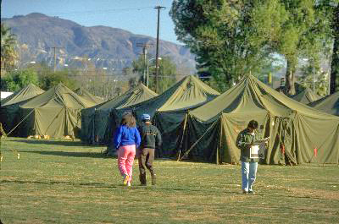
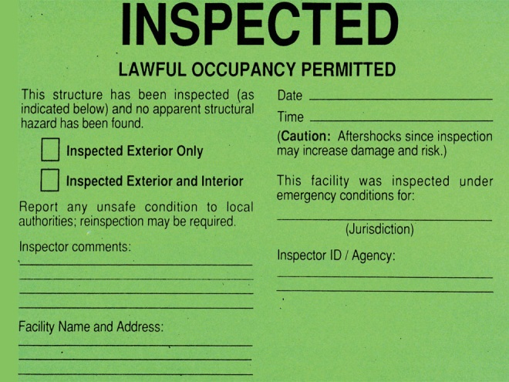
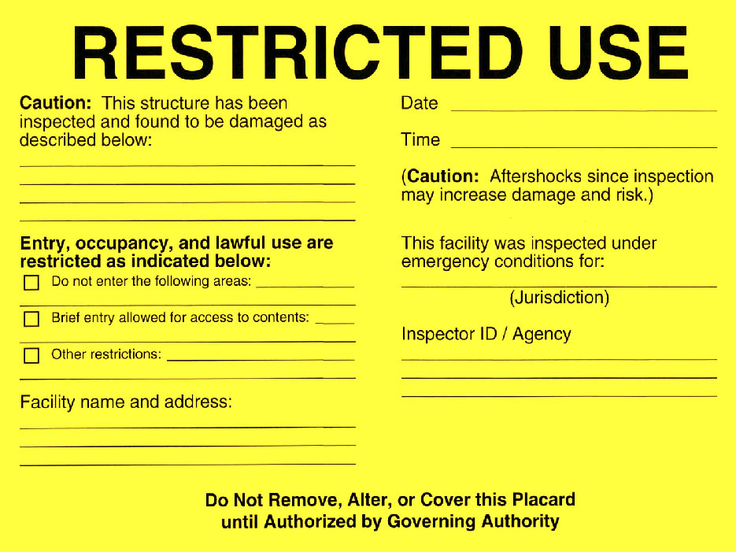
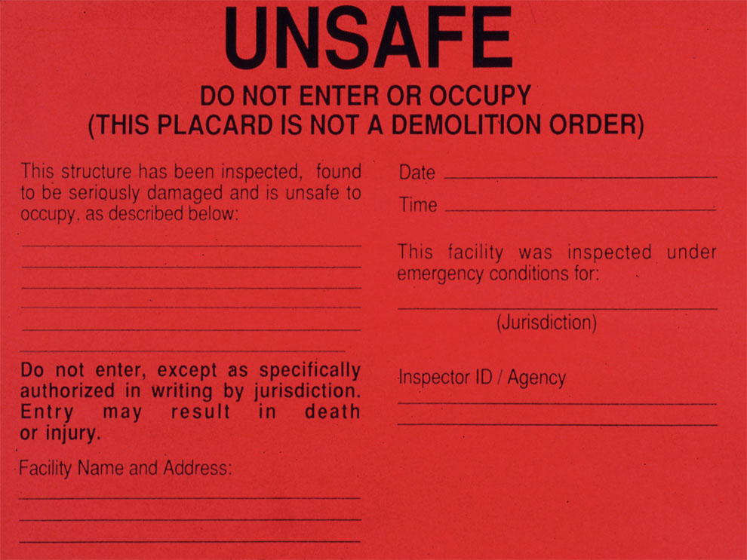
What are building safety assessments?
Building Safety Evaluators (BSEs) assess whether buildings can be safely occupied
Goal: allow people to reoccupy safe buildings
Internationally-recognized process to conduct assessments and communicate results to building owners, the public, and local authorities (ATC-20 or ATC-45)
Red/yellow/green placards
Notes:
First goal: getting people back in their buildings => less pressure on social services (e.g., tent cities). Also helps people secure their property, and businesses get back to business.
Training is based mostly on this internationally-recognized process (ATC-20) but emphasizes not being overly-conservative.
Evaluators can be engineers, architects, building inspectors and other building department personnel who have been trained in the process

Slide 6
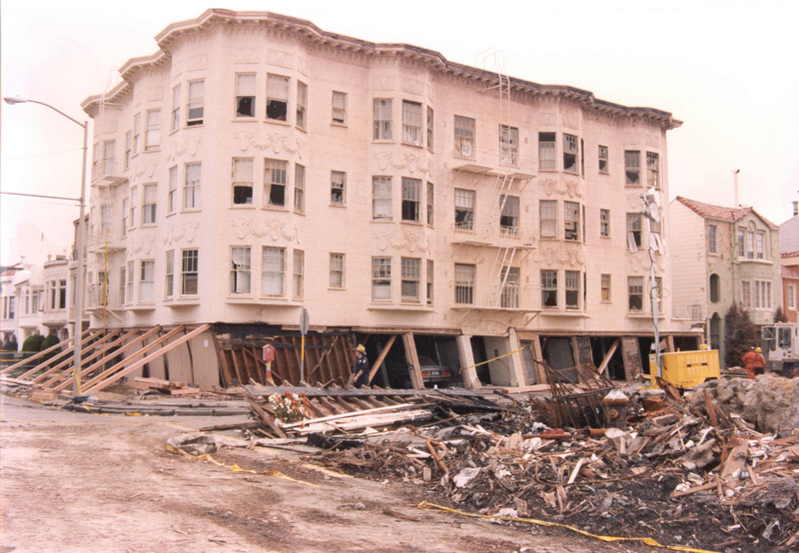
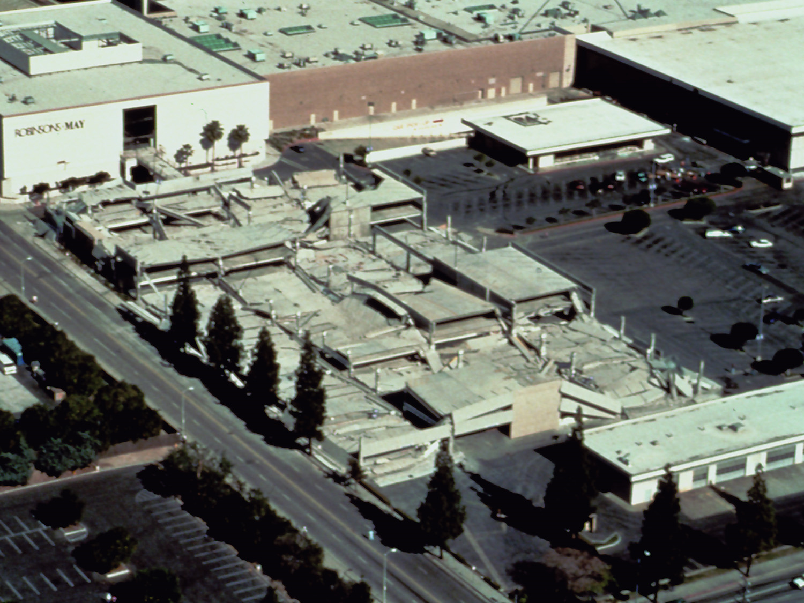
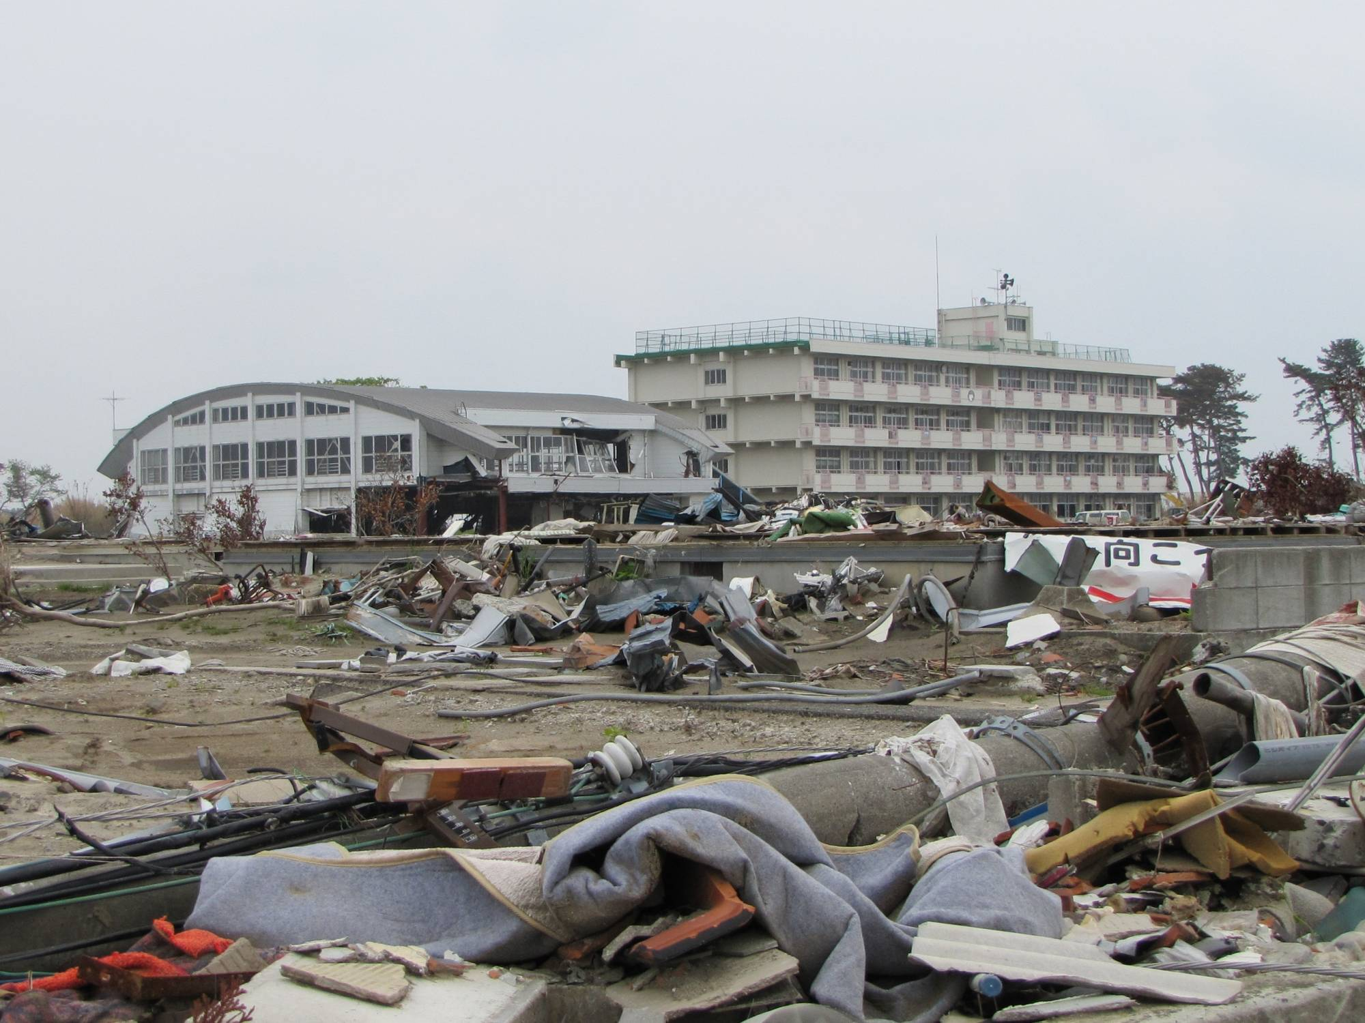
Rapid Evaluations = Faster Recovery, Safer Communities
Loma Prieta EQ (Bay Area, 1989) – San Francisco
> 150,000 buildings impacted
SF building department => 30 inspectors, 15 engineers
Northridge EQ (LA basin, 1994)
7,000 buildings unsafe to occupy (red)​
22,000 buildings restricted use (yellow)​
22,000 homeless​
Tohoku EQ (Japan, 2011) – City of Sendai
~8900 buildings
85% evaluated in 3½ weeks
20-25 teams/day (estimated need)
1500+ buildings unsafe to occupy (red)
Notes:
Looking at responding to a Seattle Fault or Cascadia Subduction Zone event, numbers don’t pencil out, if want results in a reasonable amount of time. Local jurisdictions can’t meet the demand, so volunteers are essential.
City of Sendai, Japan. Much smaller area than SF or LA Basin. 8900 bldgs. 85% completed w/in 3-1/2 weeks. Major aftershock => start over. Completed w/in 2 months of main shock. If they actually looked at every building, and if the teams average 12 evals/day, works out it could be accomplished by having approx. 20-25 teams available each day. Don’t know how they actually staffed this.
At same rate, would have taken SF 625 days to complete evaluations of every building if only rely on their staff.

Slide 7
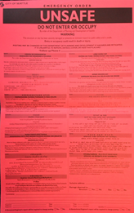
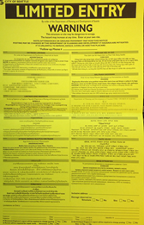
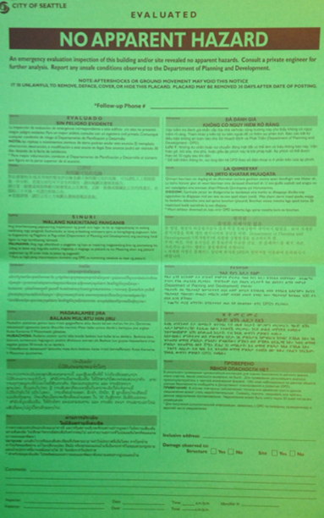
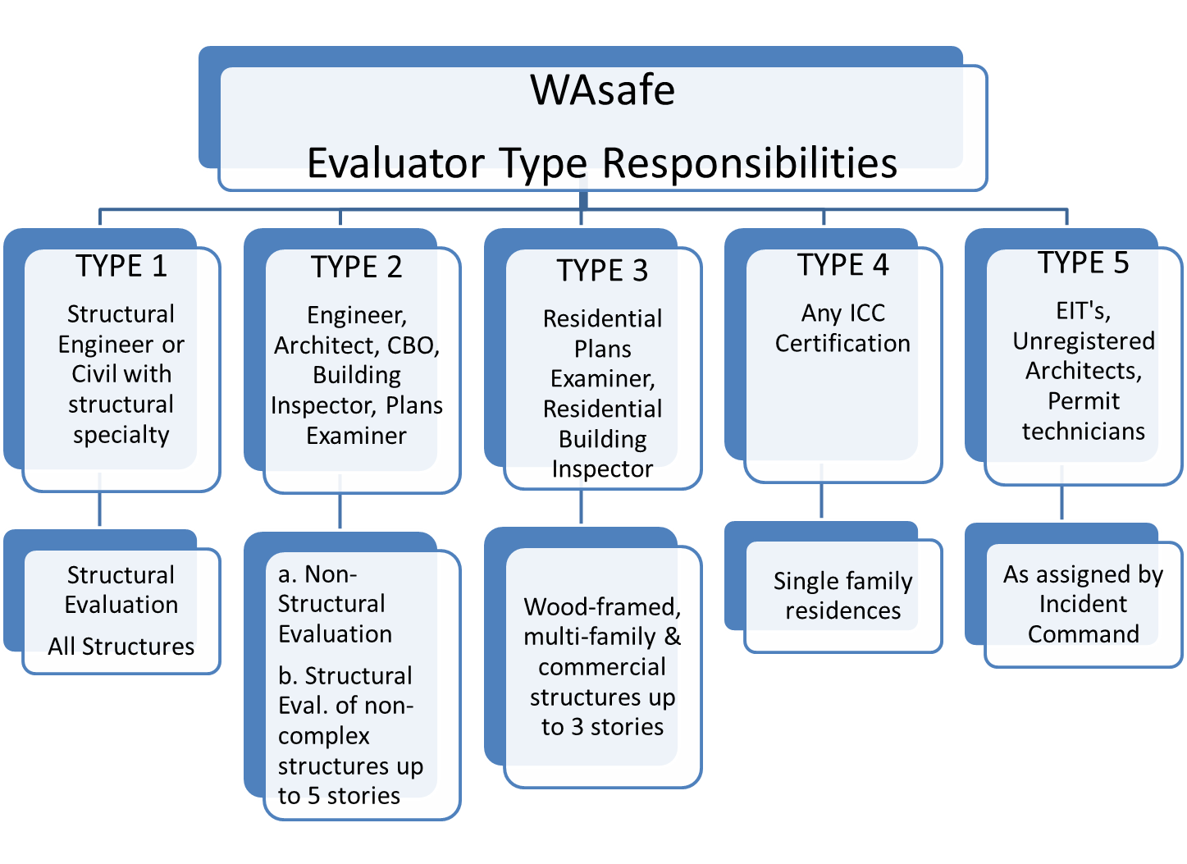
WAsafe Integration with State & Local AHJs
State-level Coordination
MOU with WA EMD recognizes WAsafe as resource
Included in State Emergency Management Plan
State EOC coordinates resource requests w/ WAsafe
Local AHJ Collaboration
Only the local AHJ has authority to post buildings (RCW 19.27.031/WAC 51-50-003)
WAsafe BSEs operate under AHJ direction
Must be deputized by AHJ
AHJ assigns work, establishes policies
Volunteer BSEs register with local EOCs
WAsafe supports smaller jurisdictions by organizing BSE dispatching
Notes:
WAsafe is formally integrated at both state and local levels. All members of the coalition are signatories on an MOU with WA EMD that recognizes WAsafe as a resource. We are a part of the State Emergency Management Plan.
WAsafe does not self-deploy volunteers. All deployments are coordinated through the WA State Emergency Operations Center and local Emergency Management Agencies, in accordance with the State’s mutual aid system (Washington State Mutual Aid System (WAMAS). Volunteers must be registered as Emergency Workers under RCW 38.52 and WAC 118-04 to receive legal protections and be eligible for deployment.
Locally, we respect the authority of the local AHJs. WA is home-rule state. Local jurisdictions only have authority to post buildings as unsafe through administrative provisions in the building code. (Latest version of IBC adopted by RCW, WAC. 2018 IBC Section 116 covers unsafe buildings and structures)
WAsafe system designed to work within that authority. We don’t self-deploy. Our training is very clear that to post placards, volunteers must be working under the authority of the AHJ and cannot act on their own.
WAsafe operates under the framework of Washington’s State’s Good Samaritan laws that provides protection from liability for volunteers and organizations in the WAsafe coalition that train the volunteers.
Once the volunteers are deputized, they are acting under the authority of the AHJ.
The AHJ determines work assignments, that is, to which sites they are sent. WAsafe has provided guidelines for the types of evaluations for which the BSE is probably qualified, but the AHJ has freedom to make assignments as needed.
There will likely be a larger need for volunteer engineers in smaller jurisdictions:
Less likely to be sent to places like Seattle
Could play a larger role in a small jurisdiction, in that the structural expertise and problem-solving may be more heavily relied-upon

Slide 8
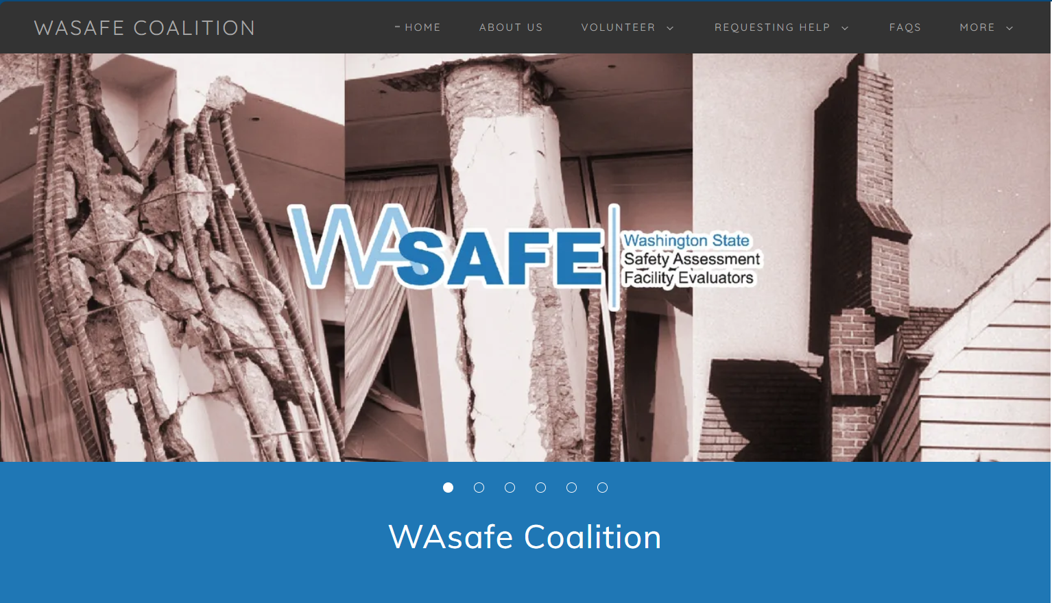
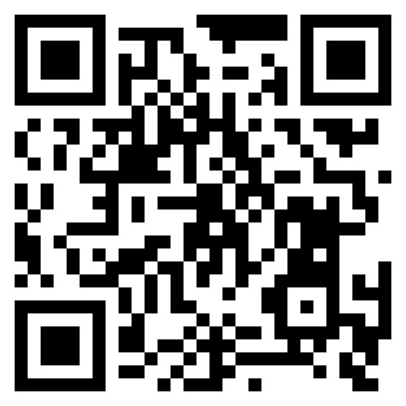
Get involved in WAsafe
Volunteer (individual)
Not dependent on joining the coalition
Take WAsafe BSE or ATC 20 class
If ATC-20, take ~1-hour online WAsafe Program & Procedures class (free!)
Start profile in WAserv (https://waserv.org)
Learn more at the WAsafe Coalition website (https://wasafecoalition.org)
Join the WAsafe Coalition (organization)
Become a signatory on MOU between WAsafe and WA Emergency Management Division
Support statewide coordination and resource sharing, and member enrollment
Notes:
Two ways for your organization to get involved with WAsafe—either as individual trained volunteers, or as member organization in WAsafe. The trained volunteers are the boots-on-the-ground, performing building safety assessments.
Don’t have to be a member of the Coalition or a member of any of the organizations to be a volunteer BSE. Just take a class, sign up in the statewide database.
Learn more at the website or use the QR code to get there.
We’ve started discussions with SAME post board about becoming a member of the coalition. This would strengthen the coalition, and help us scale during emergencies. No cost, just to work with us and EMD to become a signatory on the MOU, and then provide volunteers to help

Slide 9
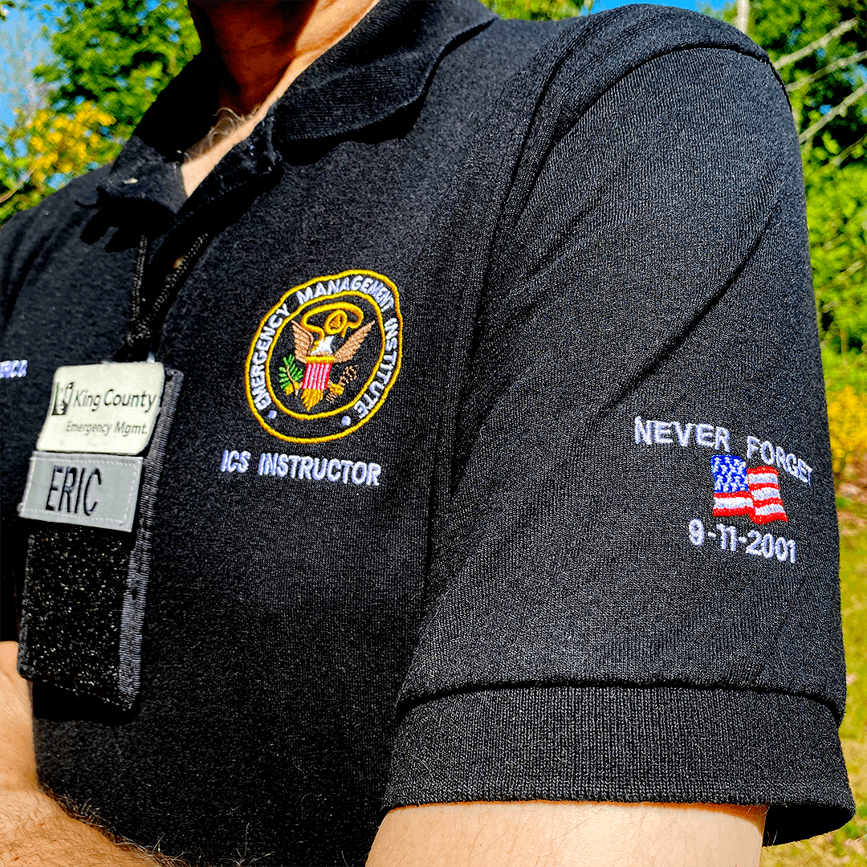
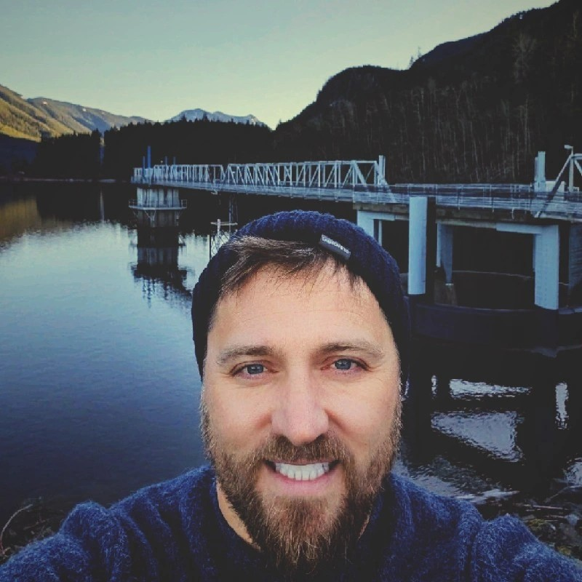
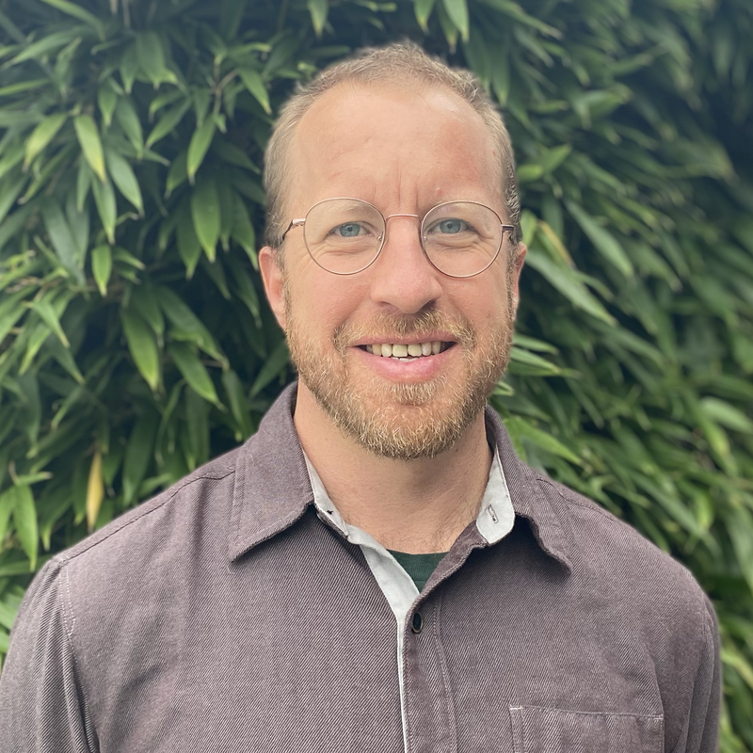

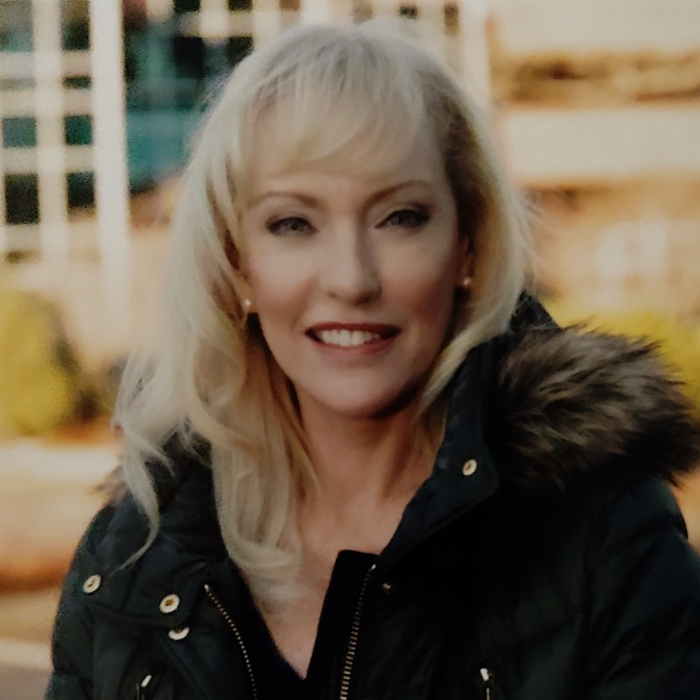
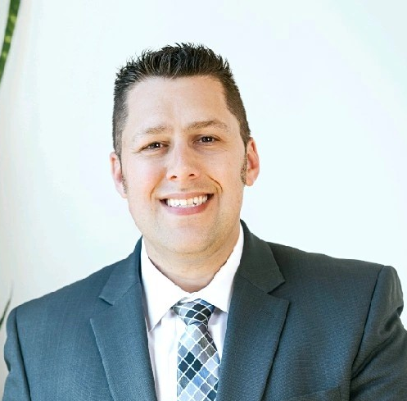
Meet the Panel
King County
Eric O'Brien – Training Program Manager
Matt Green – Emergency Management Administrator
Seattle Public Utilities
Chad Buechler – Emergency Manager
City of Seattle – Curry Mayer – Director, Emergency Management
UW
Guillame Mauger – Research Scientist
Moderator Jeremy Weikel – NAVFAC NW

Slide 10
Q&A

Slide 11
Thank you!

Slide 14
Blueprints for Crisis: Engineering with Preparedness in Mind
11:30

