Slide 1


Challenges of the
Inland Waterways
SAME
February 10, 2026
Good things
Flow from here.

Slide 2
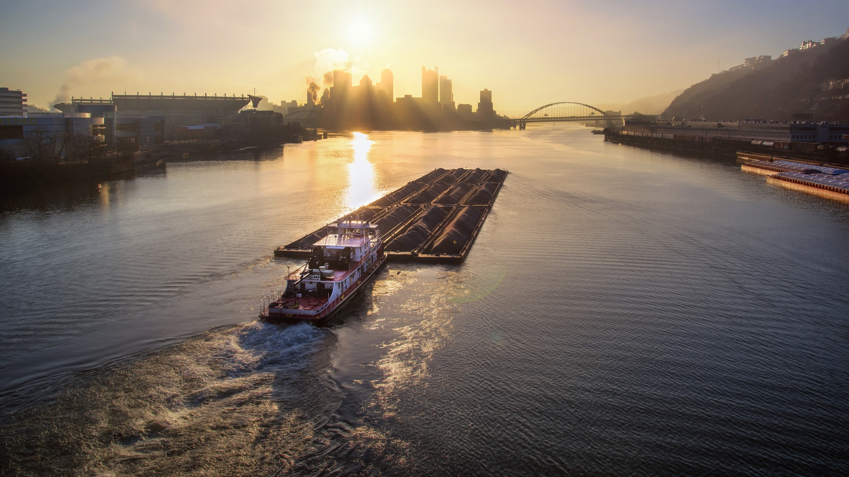

To promote the commercial use and development of the inland waterway-intermodal transportation system and to integrate that system into the economic, recreational, environmental and intermodal future of the residents and industries of southwestern Pennsylvania.

Slide 3
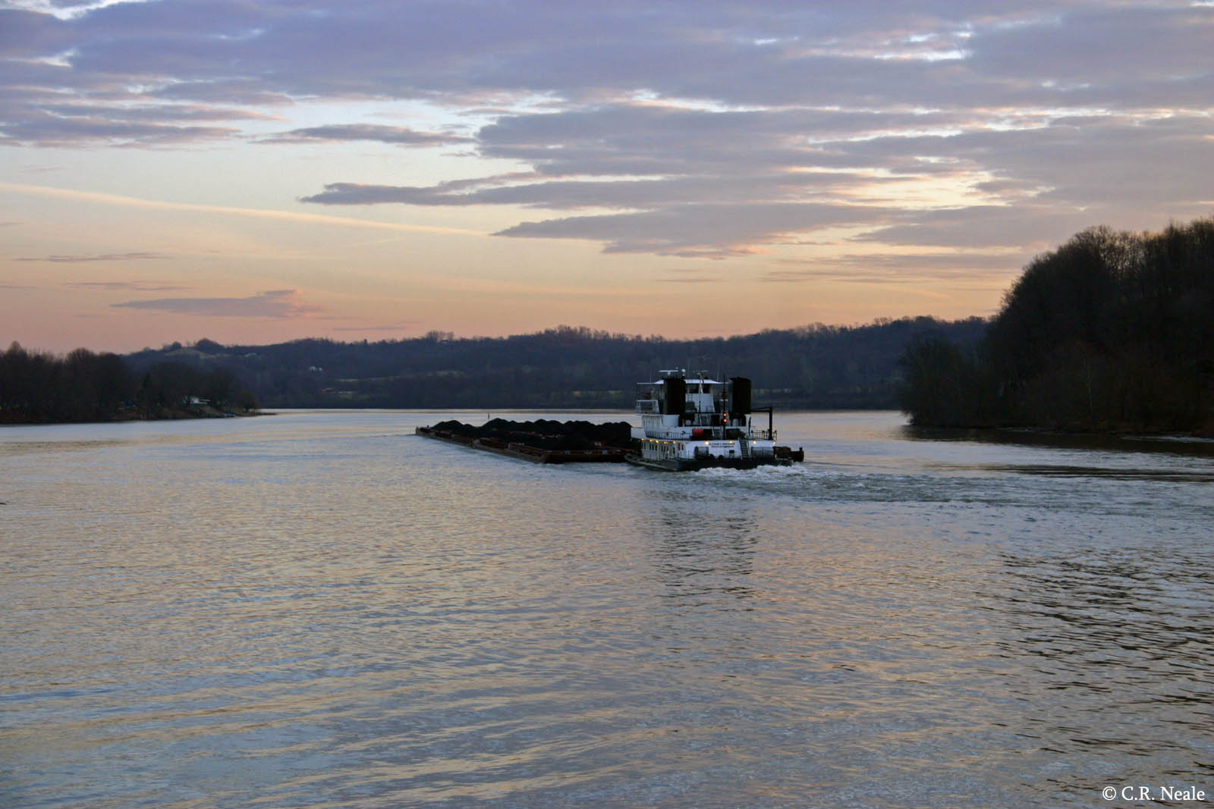

Slide 4
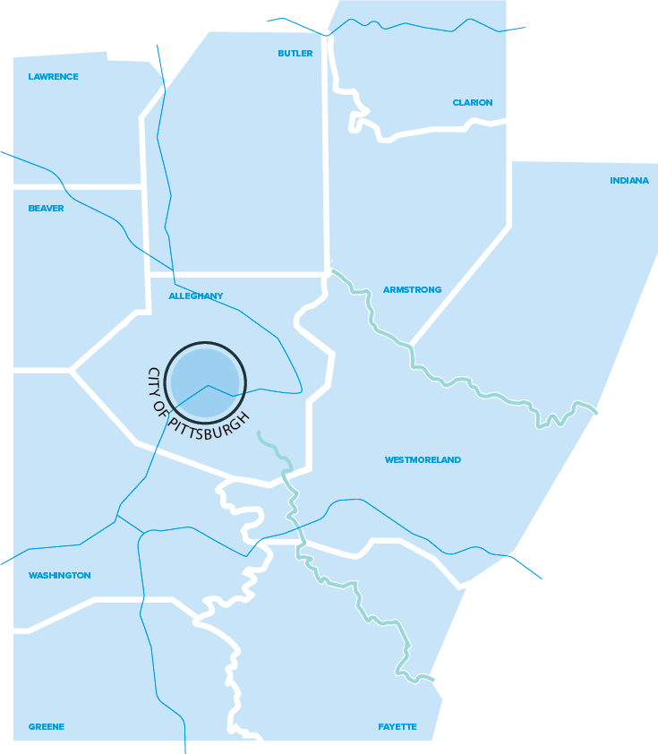

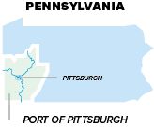
The Port of Pittsburgh Commission was of Pennsylvania created by the Commonwealth a in 1992. The Pittsburgh Port District encompasses twelve counties in southwestern Pennsylvania (including Blair County, not shown).
Notes:
Port district outline

Slide 5
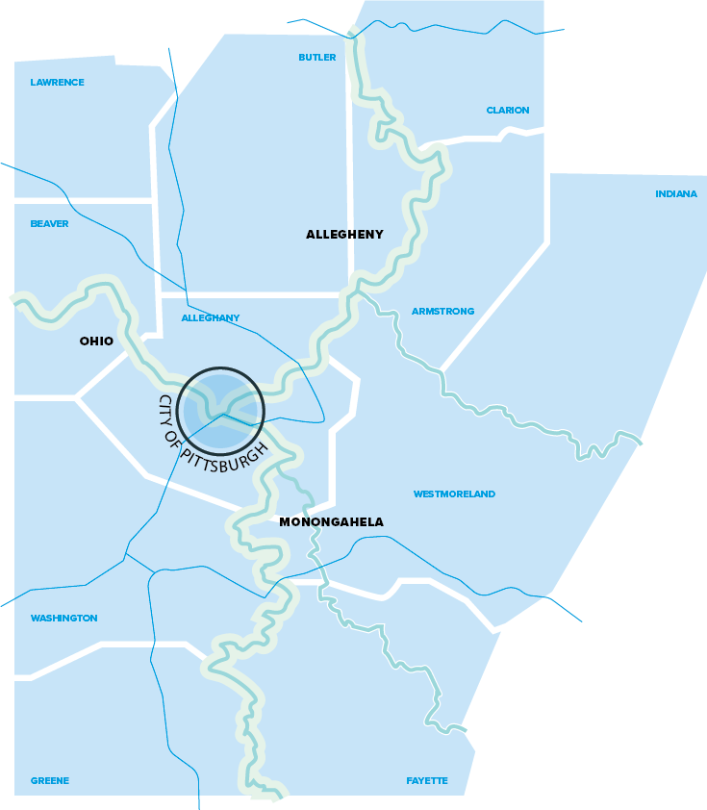
The Port consists of 203.5 miles of navigable waterways on the Ohio, Monongahela, and Allegheny Rivers
Notes:
Overlay rivers onto counties

Slide 6

ABOUT THE PORT OF PITTSBURGH
200 miles of navigable river
17 Locks and Dams
130+ terminal facilities
13 local and regional barge lines
Regulatory and oversight agencies
US Army Corps of Engineers
US Coast Guard
4th busiest inland waterway port
27th busiest port in US
26 million tons of cargo handled in 2017 (up from 23 million in 2016)
86.5 million tons of cargo locked through in 2017

Slide 7
PROMOTING COMMERCIAL
NAVIGATION
Lobby Congress for lock and dam funding
Educate public on importance of locks and dams
Act on leads for cargo and site development
Partner with regional and industry coalitions
Encourage development of new transportation technologies
River-site location assistance
Offer loans to waterway-related transportation or manufacturing companies
Assist barge companies with federal and state grant programs such as CMAQ
Offer bond programs and off-balance-sheet financing Grant management for third parties
Port security
Marine diesel repowers

Slide 8
STRATEGIC GOALS
Advocate for policies and legislation that will fund the construction, operation, and maintenance of the region’s federal inland waterway infrastructure with advocacy and legislative efforts to promote commercial and recreational use.
Give due consideration to any federal or state grant programs that could benefit the PPC or any of the stake-holders in the Pittsburgh Port district.
Promote the Port of Pittsburgh and the region’s inland waterway assets in coordination with stakeholders and other regional economic development partners
Promote the PPC’s financial tools for economic development
Advocate on public policy issues on a state and national level as it relates to issues in the port district. Provide support for proposed state and federal policies that positively impact port district issues; conversely, speak out against those policies that could have a negative impact.
Support Technological Advancements
Determine Optimal Organizational Structure Based On The Needs and Goals of the Commission.

Slide 9
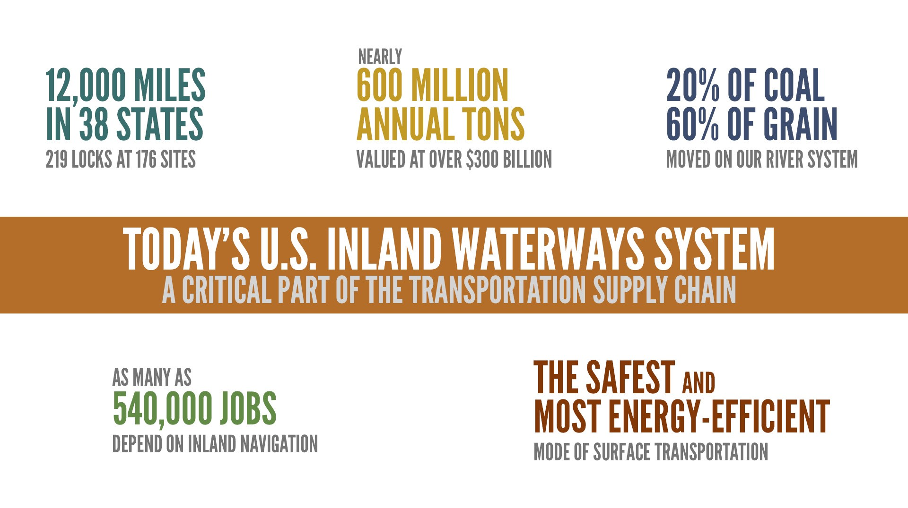

Slide 10





BENEFICIARIES OF NAVIGATION
INFRASTRUCTURE OTHER THAN
BARGE TRANSPORTATION
RECREATION
DRINKING WATER
(MUNICIPAL INTAKES)
SOURCE WATER
FOR FRACKING
HYDROPOWER
INDUSTRIAL COOLING
WATER

Slide 11
BENEFICIARIES OF
NAVIGATION INFRASTRUCTURE
40 water intakes for municipal water authorities throughout the Port District
10 on the Ohio River
15 on the Mon River
15 on the Allegheny River
DRINKING WATER
(MUNICIPAL INTAKES)

Slide 12
BENEFICIARIES OF
NAVIGATION INFRASTRUCTURE
67 industrial water intakes throughout the Port District.
15 on the Ohio River
32 on the Mon River
20 on the Allegheny River
INDUSTRIAL COOLING WATER

Slide 13
BENEFICIARIES OF
NAVIGATION INFRASTRUCTURE
Pleasure boat registrations have averaged 72,300 registered boats since 2007.
In total, the Port District has 27 marinas and 21 public boat launches
Allegheny 23,729
Armstrong 3,689
Beaver 5,682
Butler 8,806
Clarion 1,862
Fayette 4,187
Greene 1,083
Indiana 2,907
Lawrence 3,467
Washington 6,637
Westmoreland 10,249
RECREATION

Slide 14

BENEFICIARIES OF
NAVIGATION INFRASTRUCTURE
Many hydrofracturing operations use water from the Ohio River Watershed. At least 680 permits for Marcellus Shale drills have been issued throughout the counties of the Port District.
Hydrofracturing a horizontal Marcellus well may use 4 to 8 million gallons of water, within one week.
SOURCE WATER FOR
HYRDROFRACTURING

Slide 15
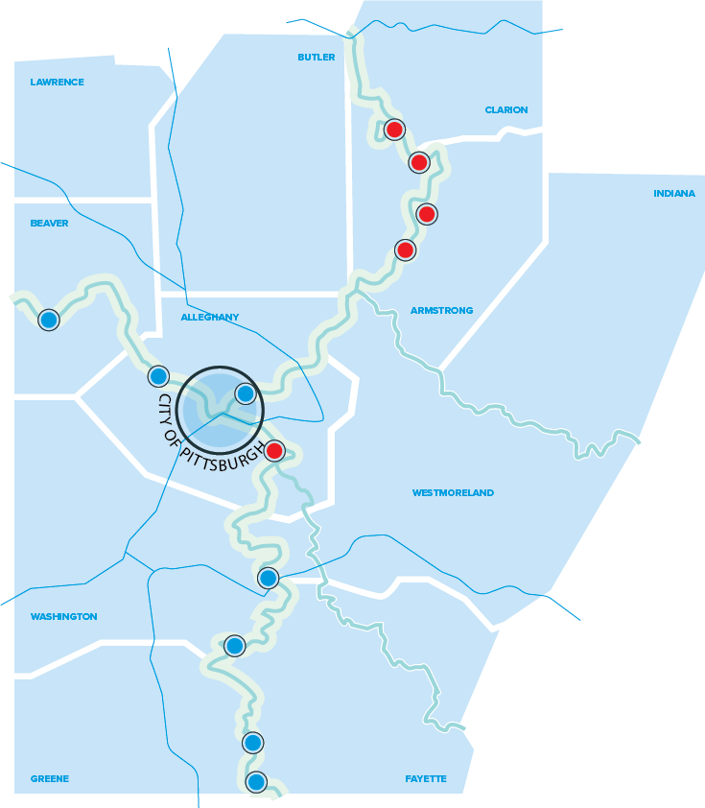

BENEFICIARIES OF
NAVIGATION INFRASTRUCTURE
LOCK/DAM WITH
HYDROPOWER
PROPOSED
HYDROPOWER
Five dams in the Port District have hydropower facilities. Four are operational.
Seven new hydropower facilities are proposed.

Slide 16
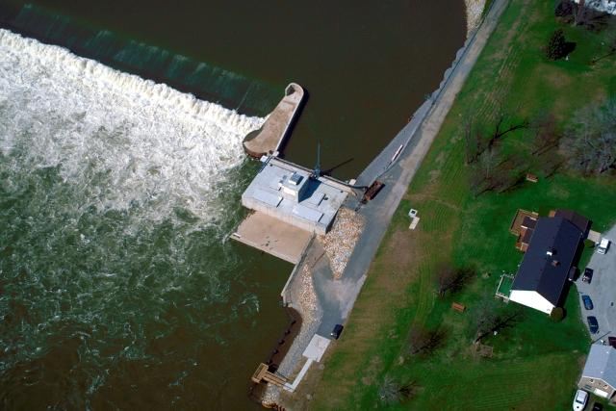
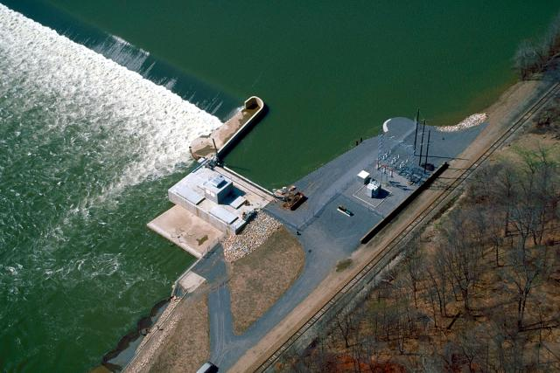
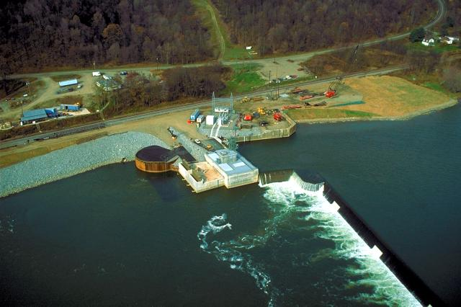
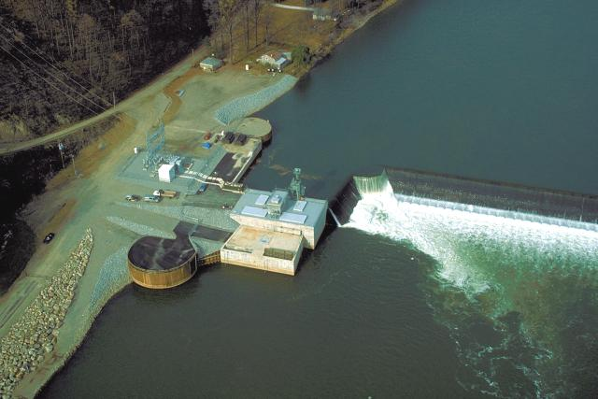
BENEFICIARIES OF NAVIGATION INFRASTRUCTURE - HYDROPOWER
Allegheny River Lock and Dam 5
Allegheny River Lock and Dam 6
Allegheny River Lock and Dam 8
Allegheny River Lock and Dam 9

Slide 17
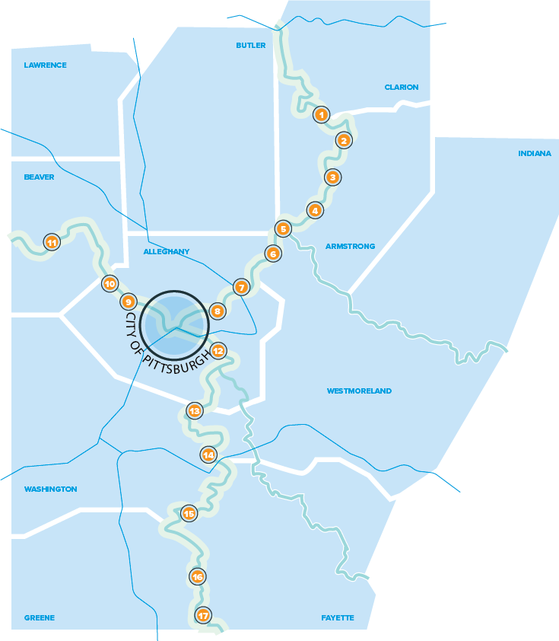
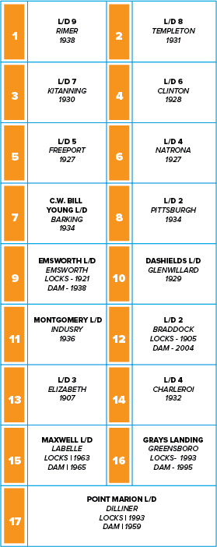

LOCKS & DAMS
LOCKS & DAMS
RIVERS
INTERSTATE
HIGHWAYS

Slide 18
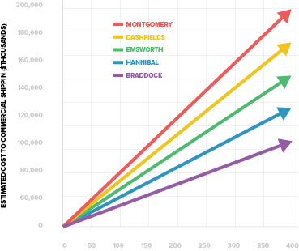
IMPACT OF CATASTROPHIC
FAILURE AND LOCK CLOSURE
UNSCHEDULED LOCK CLOSURE DAYS
1.
Unreliable system requires development of contingency plans, including construction of access roads and rail spurs that would allow transportation by other modes if necessary.
At best, unscheduled closures results in delays, use of alternative modes, increased production from alternative plants and/or mines.
At worst, an unreliable or closed systems results in a deterioration of the market position of area businesses to the point that some may close.
2.
3.

Slide 19
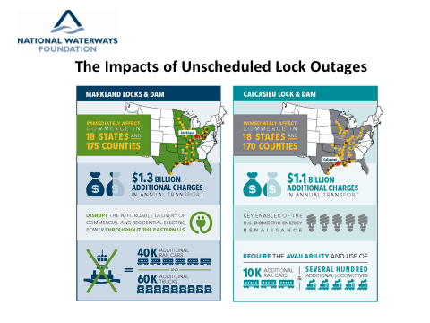

Slide 20
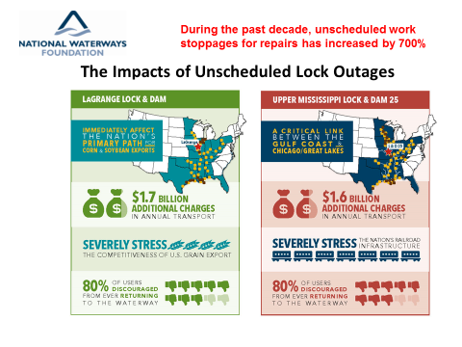

Slide 21
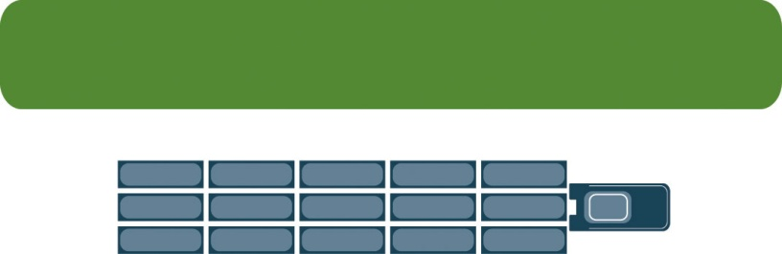
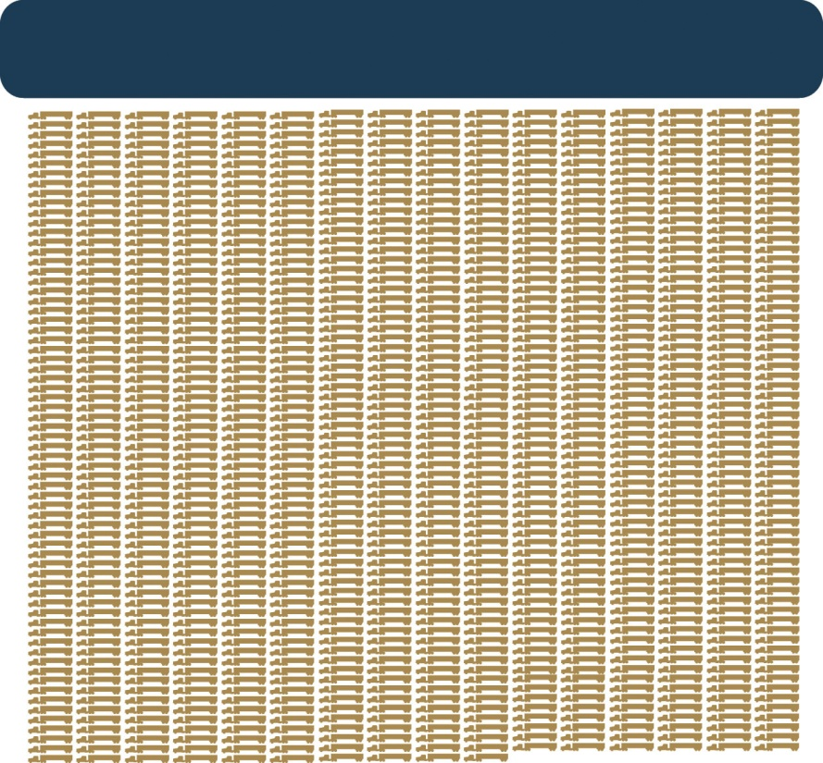
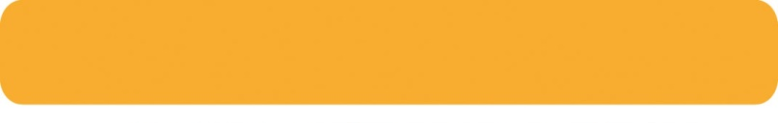

One 15-Barge Tow Equals 216 Rail Cars or 1,050 Trucks
One 15-Barge Tow
1,050 Large Semi Tractor-Trailers
216 Rail Cars + 6 Locomotives

Slide 22
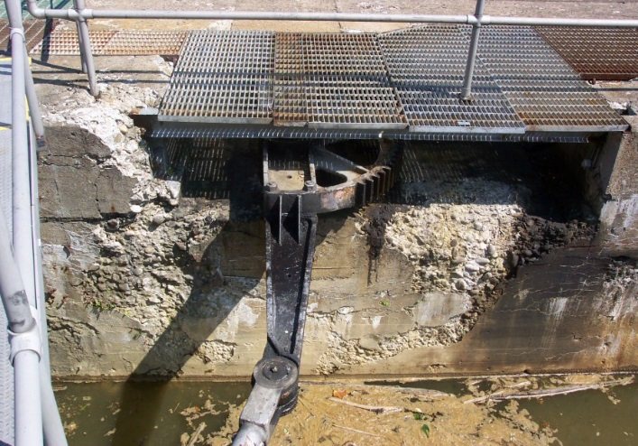
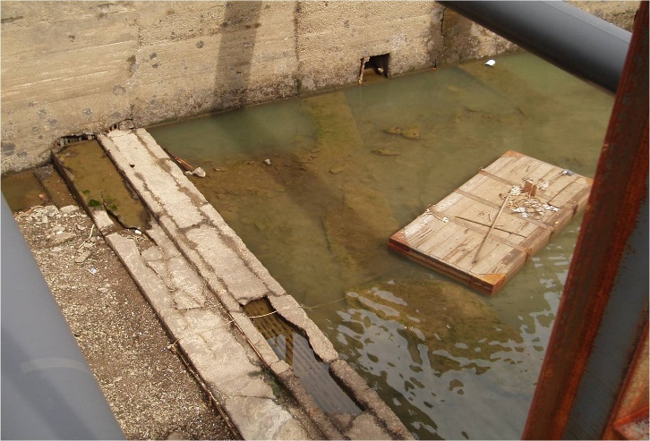
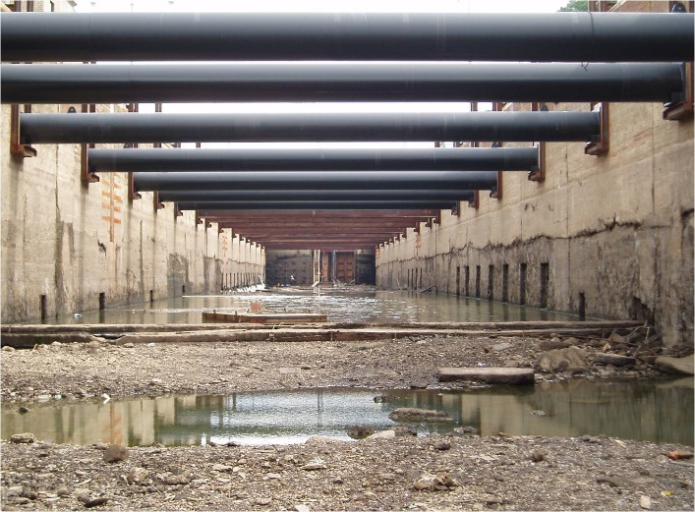
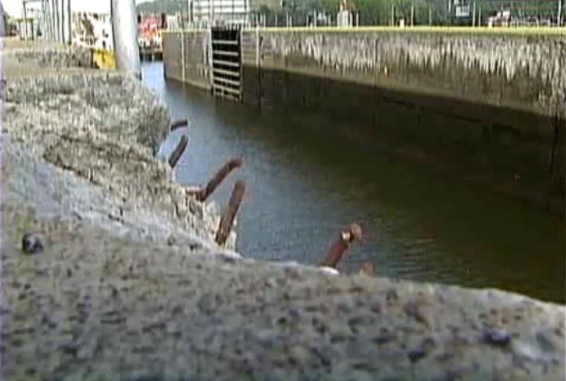
LOCK DETERIORATION

Slide 23


LOWER MON
PROJECT

Slide 24
LOWER MON PROJECT
Locks 2, 3, & 4 experience the highest volume of commercial traffic on the entire Monongahela River.
“2 for 3” project:
replace dam at L/D #2
construct new locks at L/D #4
remove dam at L/D #3.
Dam at Braddock (Lock #2) already replaced.
Project benefits estimated at $200 million per year (i.e. any lock failure would result in economic losses of $200 million per year).
Total project cost: $2.7 billion.
Funding allocation to date: $687 million.
Project cost is shared 50/50 with Inland Waterways Trust Fund.
2009 and 2015 funding from American Recovery and Reinvestment Act (ARRA)

Slide 25
LOWER MON PROJECT
Removal of Locks and Dam 3 will create a single pool, between Braddock and Elizabeth.
Monongahela River will rise a nominal 5 ft.
From Elizabeth to Charleroi, the river will drop a nominal 3.2 ft.
Existing lock chambers of 2, 3, & 4 are 56 ft in width.
Locks upstream from 4 have 84 ft chambers.
New lock chambers at 2 and 4 (with dam 3 removed) will be 100 ft wide, eliminating the bottleneck of smaller chambers downstream of larger chambers.

Slide 26
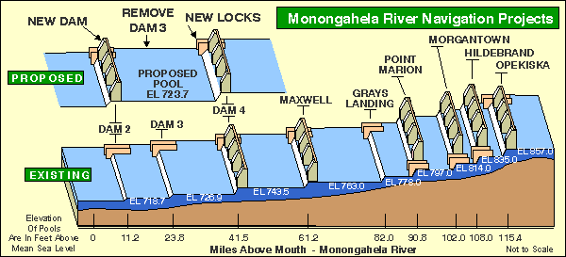
LOWER MON PROJECT

Slide 27
LOWER MON PROJECT
Removal of Locks and Dam 3 will create a single pool, between Braddock and Elizabeth.
Monongahela River will rise a nominal 5 ft.
From Elizabeth to Charleroi, the river will drop a nominal 3.2 ft.
Existing lock chambers of 2, 3, & 4 are 56 ft in width.
Locks upstream from 4 have 84 ft chambers.
New lock chambers at 2 and 4 (with dam 3 removed) will be 100 ft wide, eliminating the bottleneck of smaller chambers downstream of larger chambers.

Slide 28
LOWER MON PROJECT

Slide 29

UPPER OHIO RIVER
NAVIGATION PROJECT

Slide 30
UPPER OHIO RIVER
NAVIGATION PROJECT
Oldest locks on the Ohio River system
All over 70 years old
Smallest lock chambers on the entire river system
All three in a state of critical structural and operational degradation
Major failure of Ohio River lock would shut down entire port.
Pool loss from dam failure would cause major disruptions to:
Transportation
Municipal and industrial water intakes
Recreation
Wildlife habitats

Slide 31
UPPER OHIO RIVER
NAVIGATION PROJECT
PROJECT AREA
PROJECT AREA

Slide 32
UPPER OHIO RIVER
NAVIGATION PROJECT
Replacement of all three locks systems necessary
Eighteen years to complete multiple studies
Cost of more than $19.5 million
Eight options examined
Twin 600’ x 110’ chambers will be constructed at each site
Total cost of project is $2.69 billion
Incremental cost-to-benefit ratio is estimated at 3.8 to 1 (using 3.5% discount rate)
Study signed off just in time for 2016 WRDA
WRDA bills passed in House and Senate

Slide 33
UPPER OHIO RIVER
NAVIGATION PROJECT
Emsworth Locks showing overlay of new 110’ x 600’ chamber in place of existing 56’ x 360’ auxiliary chamber; Dashields and Montgomery facilities have similar replacement patterns.

Slide 34
ROADBLOCKS AND CHALLENGES TO IMPROVING THE WATERWAY
INFRASTRUCTURE
Intermittent federal funding
Partially funding of projects requires work to be done piecemeal
Completion times repeatedly revised and extended
Completion of project always remains unknown
Continually re-educating legislators on the value of the waterways
Convincing elected officials that the waterways should be included in infrastructure initiatives.
Publicizing the ways in which the economy is dependent on the waterways.
USACE studies
Create overly long delays in starting projects
Consume valuable funds that could be used for the project itself.

Slide 35
2018 WAS A GOOD YEAR
Congressional appropriations
Full and efficient use of Inland Waterways Trust Fund
Record funding for Operations & Maintenance (O&M)
Water Resources Development Act (WRDA) legislation enacted
Harmful tolls, user fees rejected by Congress
Existing public-private partnerships reaffirmed
New priority navigation projects
Olmstead Locks and Dam dedicated
Capital Development Plan implementation well under way

Slide 36
CAPITAL DEVELOPMENT PLAN
Phase 1 projects schedule
Olmstead: November 2018 Operational
LaGrange Major Rehabilitation: 2020
Kentucky Lock: 2032
Chickamauaga Lock: 2029
Lower Mon 2, 3, 4: 2024

Slide 37
INLAND WATERAYS TRUST FUND ANNUAL FUNDING

Slide 38
OPERATIONS & MAINTENANCE ANNUAL FUNDING

Slide 39
USACE: PUBLIC PRIVATE PARTNERSHIPS
USACE engaging in P3 infrastructure pilot projects
Implementation guidance program for P3 Pilot Program signed in January 2019.
New construction backlog approximately $100 billion
Needs for maintenance and replacement on existing projects estimated at $140 billion
Annual budget is around $6 billion

Slide 40
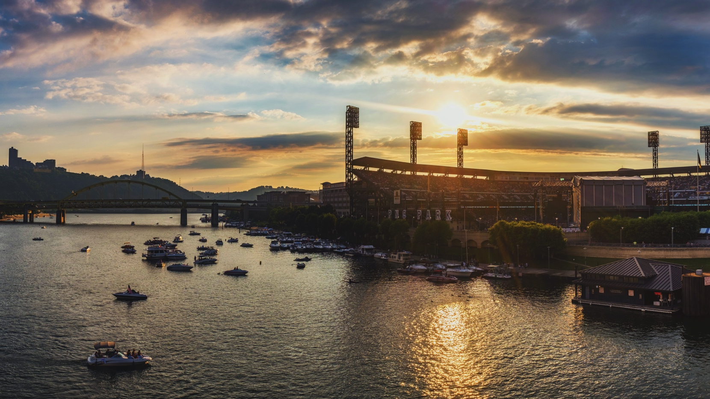

THANK YOU!

