Slide 1
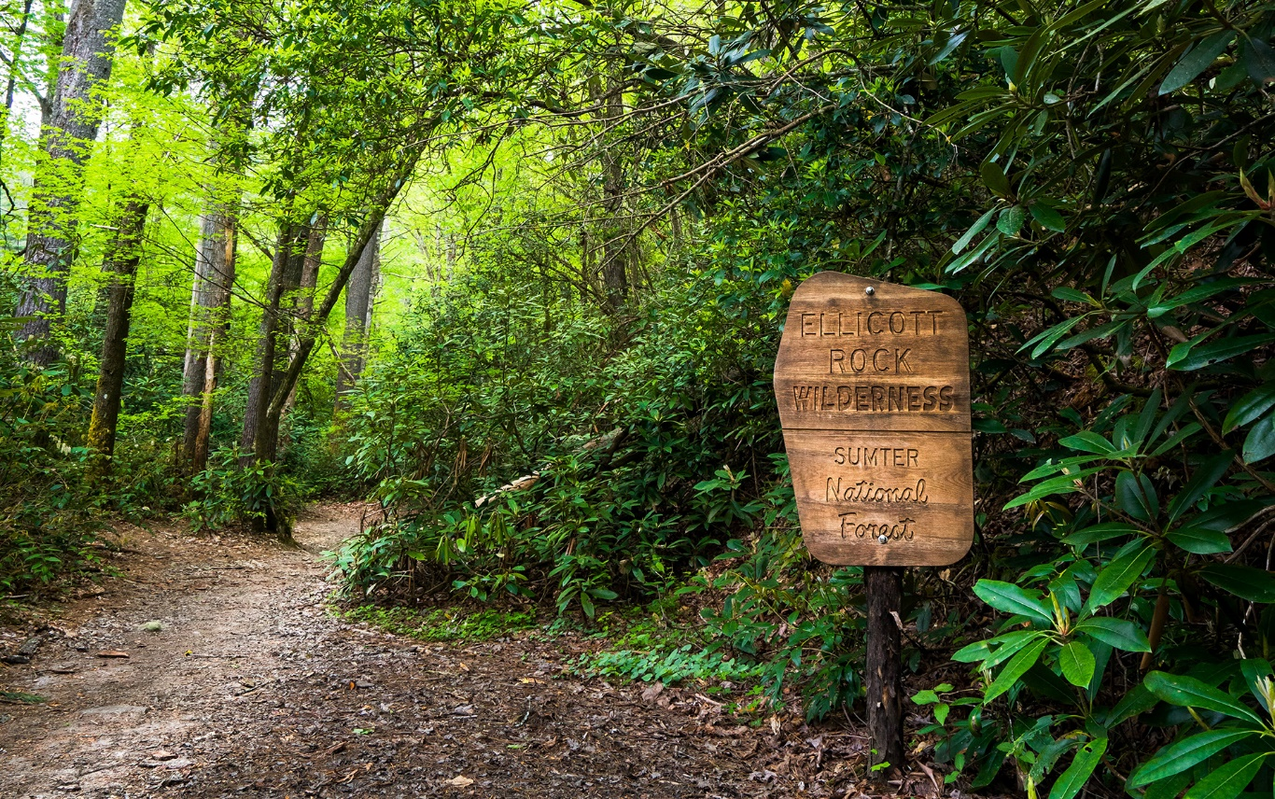
US Forest Service Construction Opportunities
Jason Campbell
Engineer Plans & Designs Program Manager
Francis Marion & Sumter National Forests

Slide 2
Introduction
Forest Service Overview
FS Funding Sources
Upcoming Projects
Project Execution Methods
Notes:
Great American Outdoors Act -- S. 3422
Overview:
Establishes the National Parks and Public Land Legacy Restoration Fund to address deferred maintenance of the National Park Service, the U.S. Fish and Wildlife Service, the Bureau of Land Management, the USDA Forest Service, and the Bureau of Indian Education.
Permanently funds the Land and Water Conservation Fund., Eliminates the 100th meridian acreage provision.
Sec. 2: National Parks and Public Land Legacy Restoration Fund

Slide 3
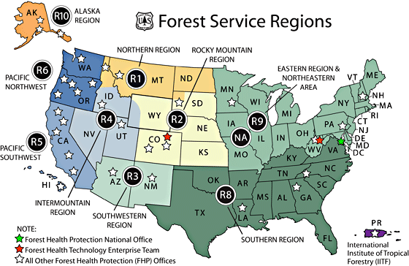
Forest Service Regions
154 national forests and 20 national grasslands, which encompass 193 million acres
Region 8 encompasses 13 States & Puerto Rico; 14 Forests & 2 Special Units

Slide 4
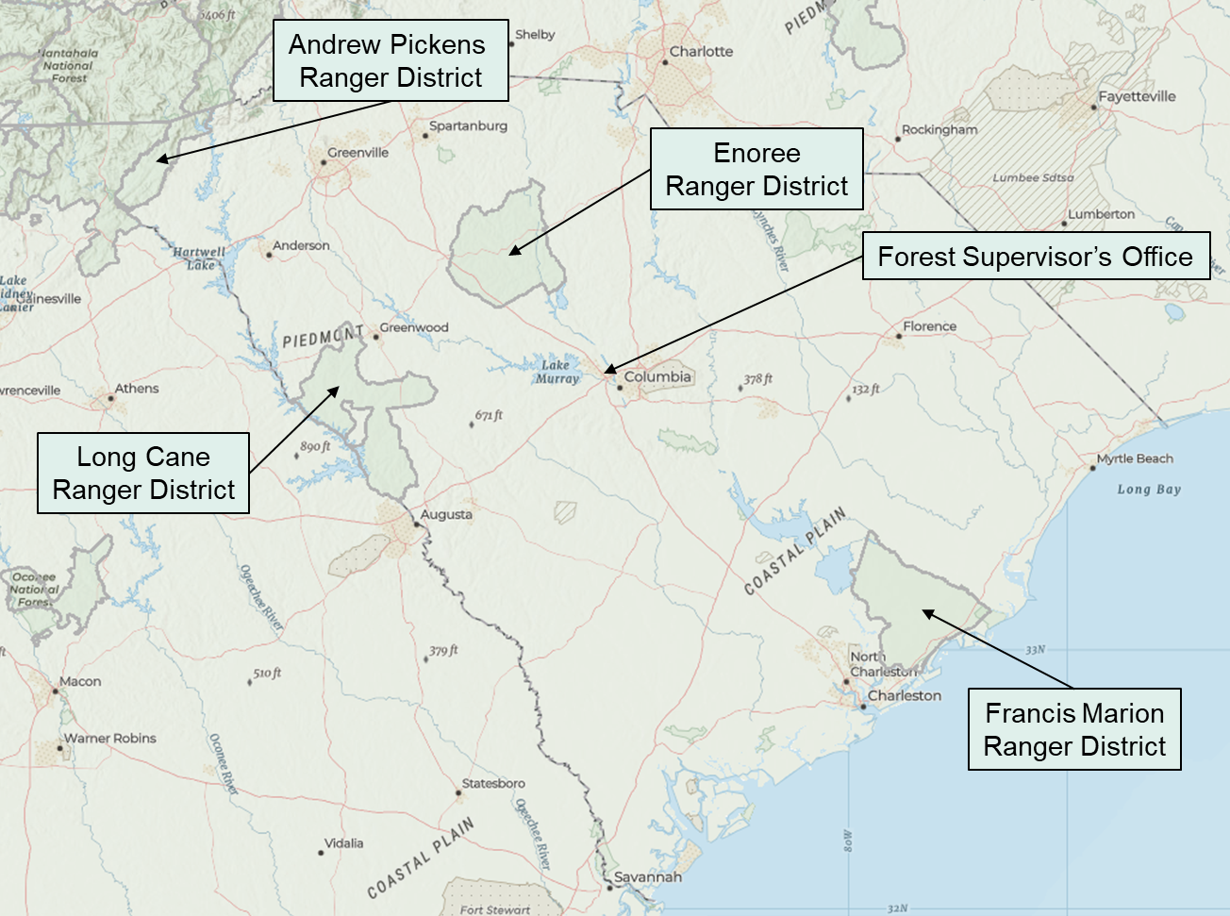
Francis Marion & Sumter National Forests
632,290 Acres
93 Facilities
1,700 Miles of Road
572 Miles of Trails
58 Road Bridges
14 Dams
100+ Recreational Sites
11,000+ Archaeological Sites
Notes:
Listing those on the WRNF, but similar projects across the state

Slide 5
FS Funding Sources
Annual Funding
Roads - ~$430K/yr
Facilities - ~$70K/yr
Trails - ~$25K/yr
Hurricane Helene Supplemental: $60M
For use across all program areas
Capital Improvement & Maintenance
$78M for FY26 FS-wide; 50% cut from previous years
Other Sources (amounts vary)
Timber Sales
Grants, Agreements, Partnerships
Emergency Relief for Federally Owned Highways (ERFO)
Federal Lands Transportation Program (FLTP)

Slide 6
FY26 Projects
Expected to advertise/award in FY26
Snake Ridge Rifle Range (AP)
NFSR 376 & 1067 Aquatic Organism Passages (EN)
Rocky Creek Bridge Replacement (EN)
Palmetto Trail Bridge & Boardwalk Repairs (EN)
Buck Hall Campground Renovation (FM)
Cooter Creek Bridge Replacement (FM)
Multiple Bridge Designs
Notes:
One add—roof /reconstruction in Meeker CO, currently in ‘sources sought’ phase

Slide 7
Planned FY27 Projects
Planned to advertise/award in FY27
Rocky Branch Bridge Replacement (EN)
Cane Gully Bridge Replacement (FM)
Mosquito Creek Bridge Replacement (FM)

Slide 8
Project Execution Methods
USFS Procurement & Property Services (PPS)
Competitive Bid
Francis Marion & Sumter NFs MATOC (Road Mx)
USFS Regional/National MATOCs & IDIQs
Region 8 A&E Shortlist (Design)
DOI/FS Interagency MATOCs
Partnerships (some examples)
The Nature Conservancy (TNC) → AOP Design & Construction
SC Forestry Commission → Road Mx
American Rivers → Dam Mx

Slide 9
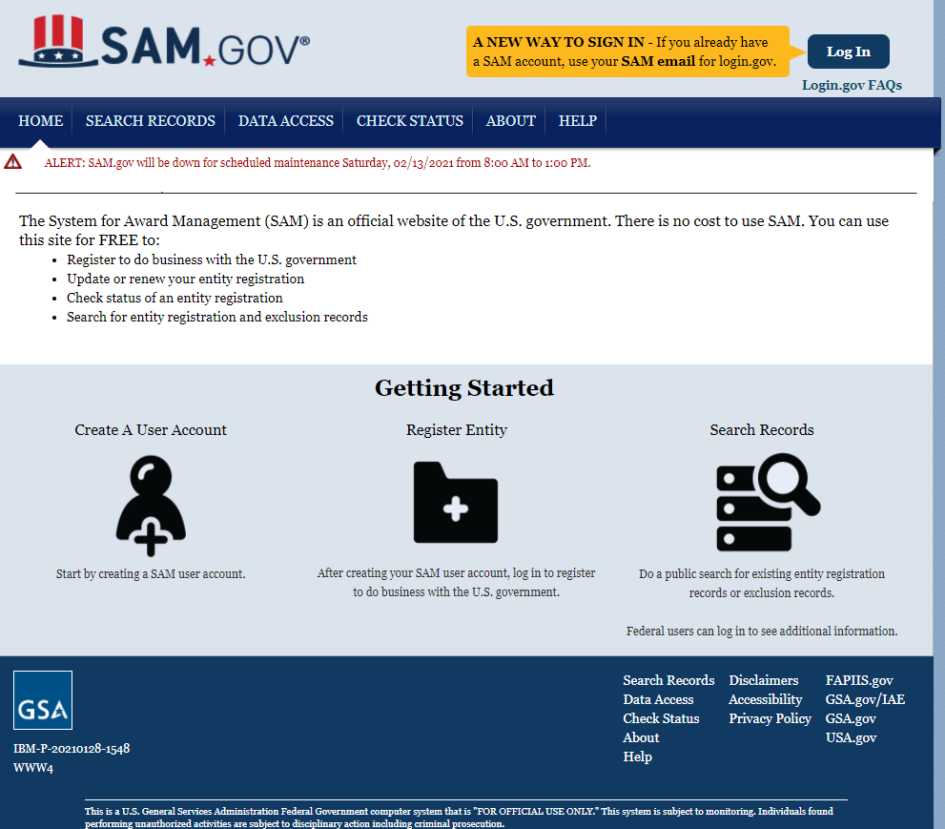
Federal Contracting – Register in SAM
Notes:
Tammy touched on some of the requirements
Federal contracting—register in System for Award Management or SAM and advertised there

Slide 10
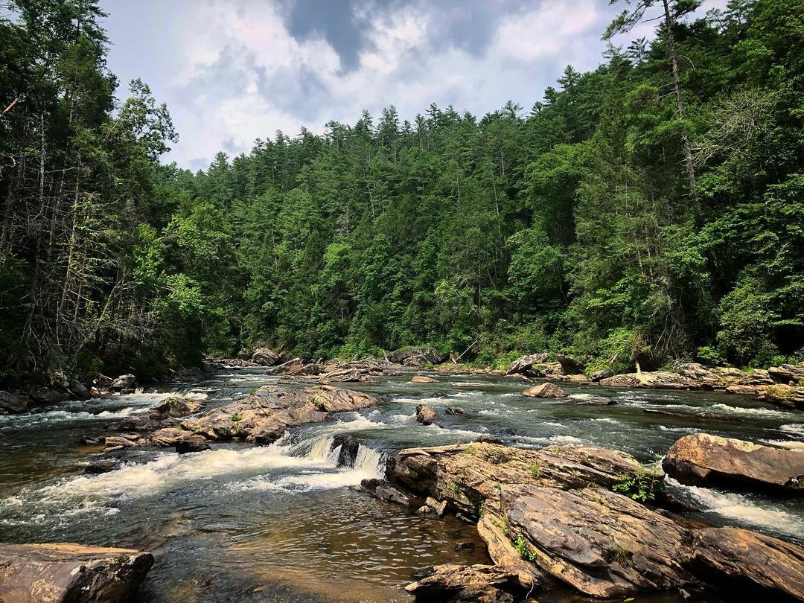
Questions?

