Slide 1

UNCLASSIFIED
628th Civil Engineer Squadron
Mission Ready Warfighters Deterring Conflict…TOGETHER!
UNCLASSIFIED

Slide 2
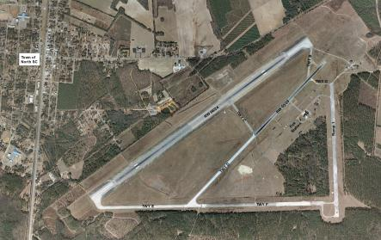
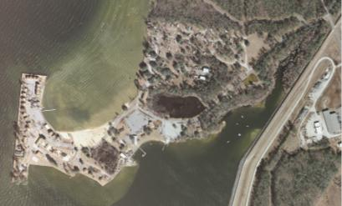
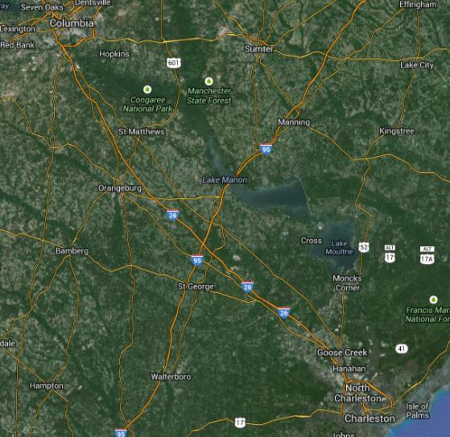
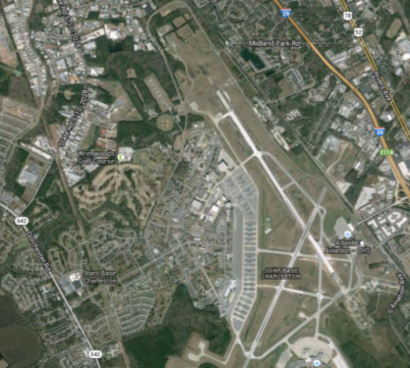
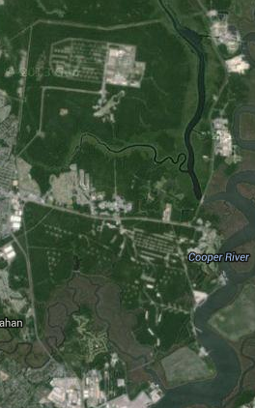
JOINT BASE CHARLESTON
UNCLASSIFIED
JB Charleston Personnel & Supported Land Areas
Total Population: 132,696
Active Duty: 11, 109
Reservist: 3, 220
Civilian: 5,040
Retirees: 73, 580
Dependents: 35, 017
North Auxiliary Airfield
Short Stay Outdoor Rec Area
10 Personnel 61 acres
15 Personnel 2,260 acres
JB Charleston Scope
Air Base
Naval Weapons Station
Acreage: 22,184
Miles of Shoreline: 22
Miles of Railway: 38
4 Runways, 3 Wharfs & 4 Piers
Housing Units: 1,616 family homes
Dorms: 541 dorm rooms
Mission Ready Warfighters Deterring Conflict…TOGETHER!
15K Personnel 16,585 acres
10K Personnel 3,278 acres
UNCLASSIFIED

Slide 3
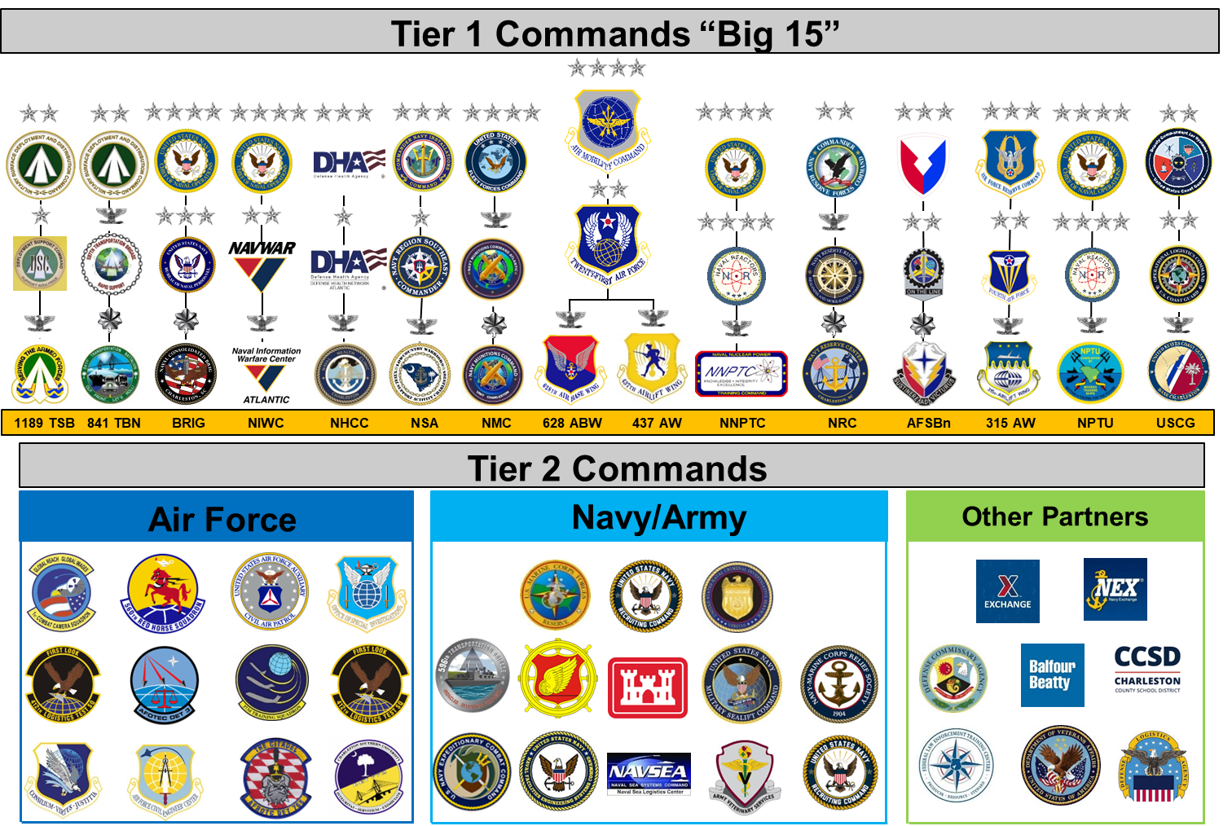
JOINT BASE CHARLESTON
UNCLASSIFIED
Mission Ready Warfighters Deterring Conflict…TOGETHER!
UNCLASSIFIED

Slide 4






ORGANIZATION STRUCTURE
UNCLASSIFIED
Our Mission: Outlaw family provides and preserves
facilities, infrastructure, and personnel to maintain
responsive and effective
global capabilities
projected from
Joint Base Charleston.
As of 01 Mar 2026: 497 Total Personnel
- 247 Military
- 250 Civilian*
*We’re hiring!
628 CES Commander
Lt Col J. Brandon Balskus
628 CES SEL
CMSgt Jeremy Snowden
Deputy Director
Mr. Salvatore Randazzo
First Sergeant
MSgt David Dreyfus
Fire & Emergency Services
(CEF)
CMSgt Jorge Arce
Explosives Ordinance Disposal (EOD) (CED)
Capt Joseph Ables
Readiness & Emergency Management (CEX)
1 Lt Davis Koskie
Installation Management (CEI)
Ms. Dana Holsclaw
Operations
(CEO)
(D) Maj Ben Fonte
Capt Jennifer Huynh
Engineering (CEN)
Mr. Todd Martin

Slide 5
UNCLASSIFIED
Community Partnerships
North Yard / NIWC Facilities / City of North Charleston
Dorchester Road Widening / Charleston County
Palmetto Commerce Parkway / Charleston County
Charleston Regional Airport Authority (CRAA) / Boeing Development & Expansion
Major Contributor to Fire Department Mutual Aid
Short Stay Sewer System / Berkeley County
Regional LiDAR Partnership / Multiple Counties
Shipboard Fire Trainer / Multiple Partners
Microgrid / Charleston County / Dominion / Santee Cooper
Unmanned Aircraft Systems (UAS) / Charleston County
Mission Ready Warfighters Deterring Conflict…TOGETHER!
UNCLASSIFIED

Slide 6
UNCLASSIFIED
Thank You!
Salvatore F. Randazzo
Deputy Base Civil Engineer
Joint Base Charleston, SC
Office: (843)963-4954
Work Cell: (843)810-0099
Personal Cell: (575)551-2286
Email: salvatore.randazzo.4@us.af.mil
Mission Ready Warfighters Deterring Conflict…TOGETHER!
UNCLASSIFIED

