Slide 1
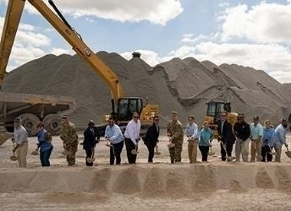
USACE Jacksonville District
Small Business Program Overview
Chief of Small Business
Kimberly Daniel-Ray
SAME Charleston Industry Day
19 March 2026

Slide 2
Briefing Purpose/Agenda
Jacksonville District Leadership
Overview of the Jacksonville District Area of Responsibility
Jacksonville District Program Areas
Contracting Opportunities Forecast
Jacksonville District Small Business Office Information & Resources

Slide 3
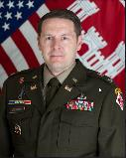
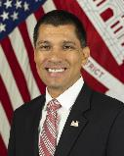
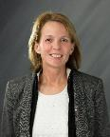
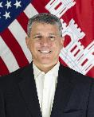
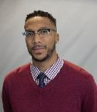
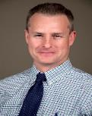
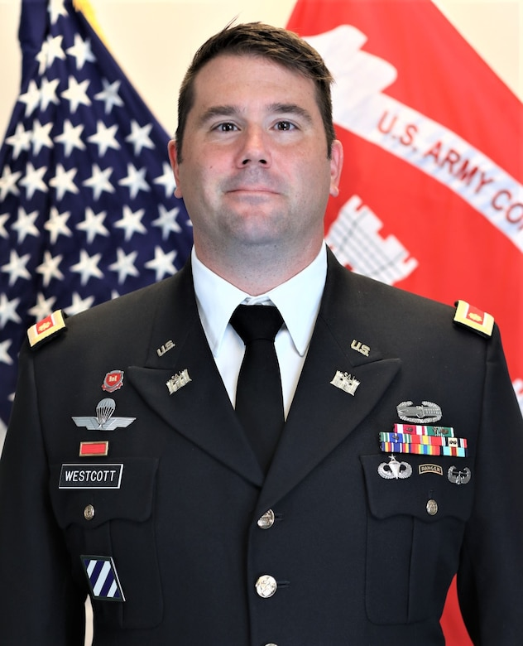
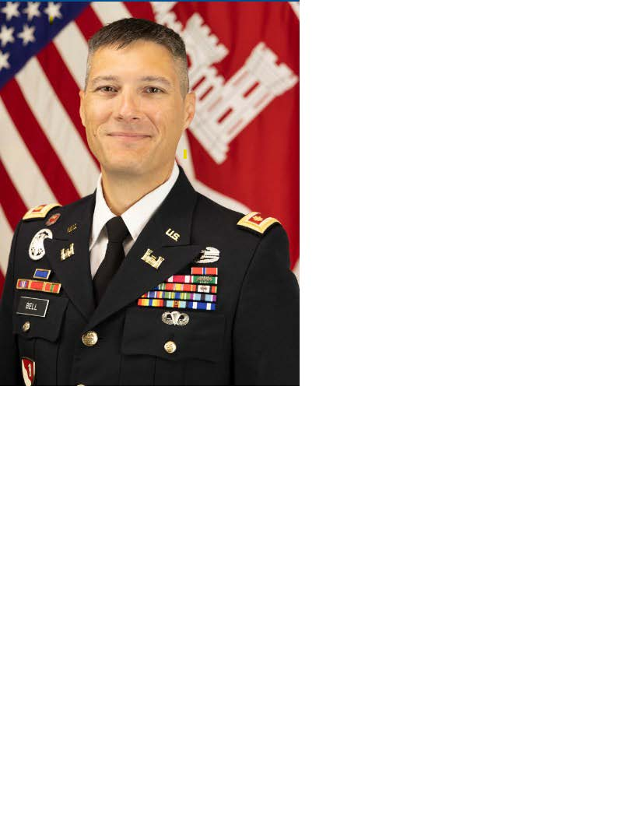
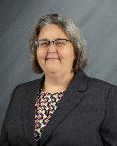
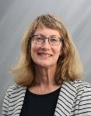
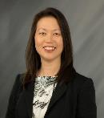
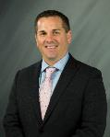
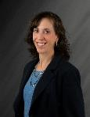
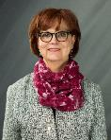
SAJ Leadership Team
Commander/
District Engineer Colonel
Brandon Bowman
Deputy District Engineer Programs & Project Management
Howard Gonzales, Jr.
Engineering Division
Laureen Borochaner
Construction Division
Gene Morisani
Contracting Division
Aldone Graham
Regulatory Division
Shawn Zinszer
Deputy District Commander
Lt Col Matt Westcott
Deputy South Florida
Major Cory Bell
Planning Division
Angie
Dunn
Operations Division
Carol Bernstein
Resource Management
Sandra
Moschettieri
Real Estate Division
Tim
McQuillen
Office of Council
Elizabeth Vavrica
Chief of Staff
B.J. Fagan

Slide 4
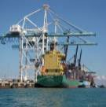
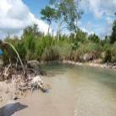
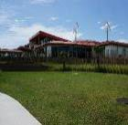

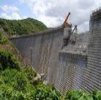
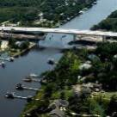



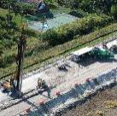
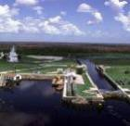
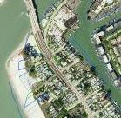


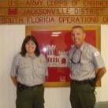
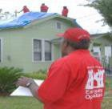
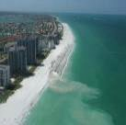


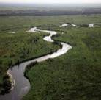
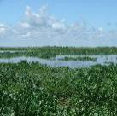
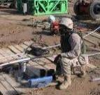








Mission Areas
Deliver value to the Nation by anticipating needs & collaboratively engineering solutions that support national security, energize our economy, & increase resiliency.
Navigation
Flood/Coastal Storm Risk Management
Ecosystem Restoration
Operations/Recreation
Contingency Operations
Real Estate
Military/Interagency & International Services
Regulatory

Slide 5
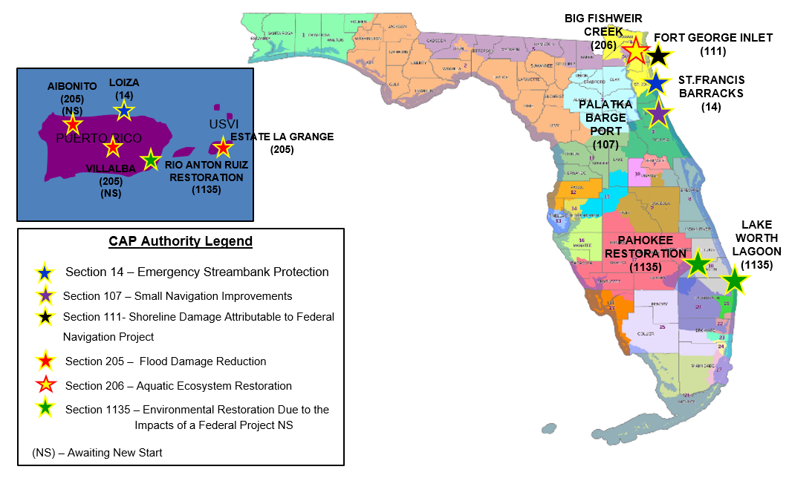
Jacksonville District Active Small/CAP Projects

Slide 6
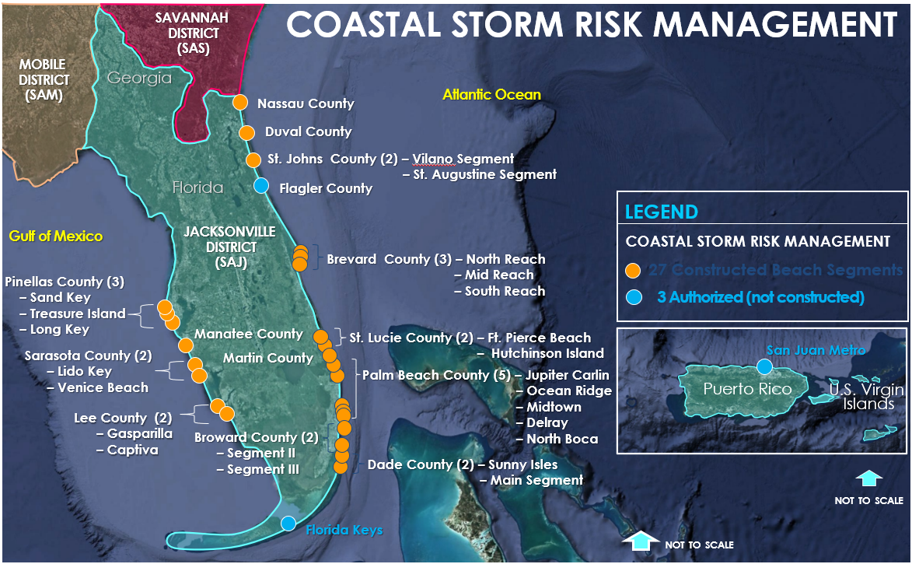

Slide 7
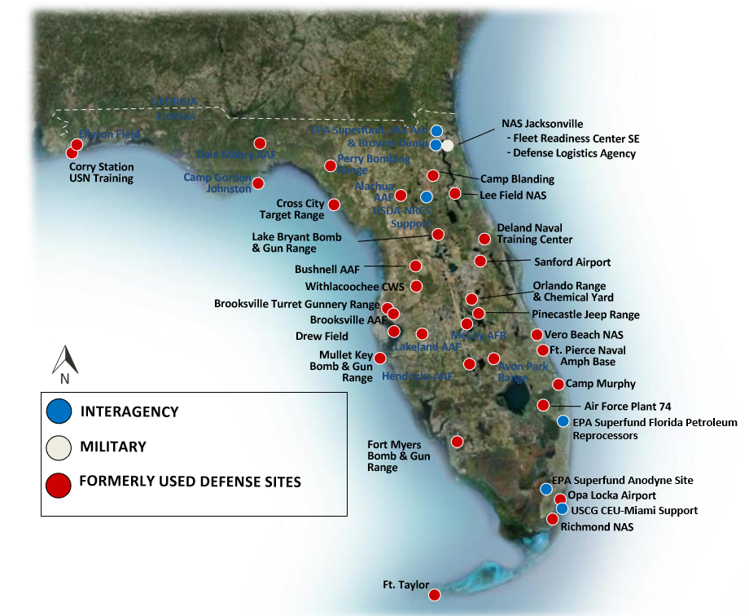


Slide 8
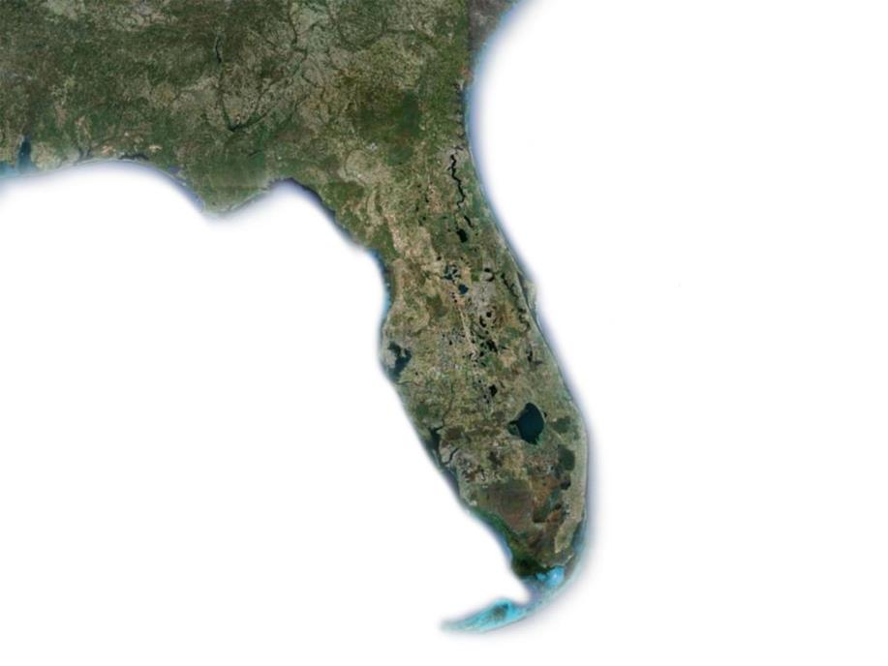
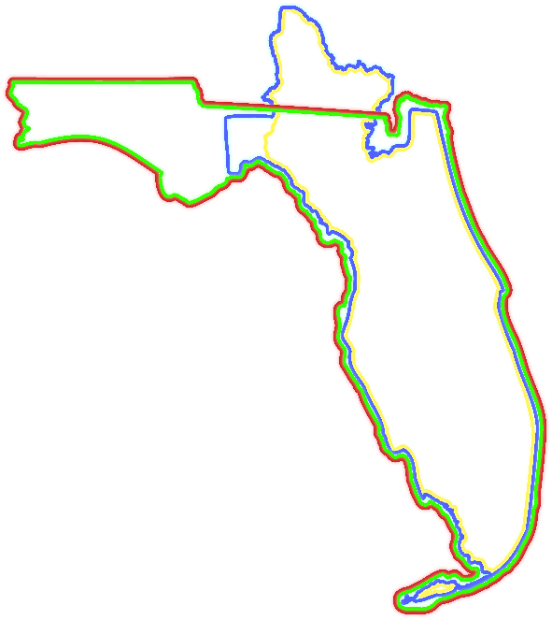

Our Vision
To be a great engineering force of highly disciplined people working with our PARTNERS to deliver innovative and sustainable solutions to the Nation’s engineering challenges.
Our Goals
Ready for All Contingencies
Engineering Sustainable Water Resource Solutions
Building Effective, Innovative Engineering Solutions
Recruiting and Retaining Strong Teams
Our Area of Responsibility
Florida
Georgia
Puerto Rico
U.S. Virgin Islands
GEORGIA
DISTRICT HEADQUARTERS
Jacksonville
Pensacola
Panama City
Gainesville
AREAS OF RESPONSIBILITY
Palatka
CIVIL WORKS
Portions of Florida and Georgia (defined by watersheds)
REGULATORY
Florida
Puerto Rico and the Antilles
REAL ESTATE AND MOBILIZATION
Portions of Florida and Georgia
MILITARY
Florida
Jacksonville covers SRM and IIS only
Mobile District covers MILCON
Puerto Rico, Antilles, and Caribbean Basin
Jacksonville responsible for Project Management of MILCON, IIS & SRM.
Note: TF VIPR is responsible for construction/contract admin in PR & VI
FLORIDA
Cocoa
Tampa
Melbourne
West Palm Beach
Palm Beach Gardens
Clewiston
Wellington
Ft. Myers
Naples
Miami

Slide 9
Jacksonville District FY26 Top 5 Small Business NAICS
Rank | NAICS | NAICS Description | Dollars
1 | 237990 | OTHER HEAVY AND CIVIL ENGINEERING CONSTRUCTION | $236,489,468
2 | 326199 | ALL OTHER PLASTICS PRODUCT MANUFACTURING | $8,990,583
3 | 562910 | REMEDIATION SERVICES | $3,432,658
4 | 236220 | COMMERCIAL AND INSTITUTIONAL BUILDING CONSTRUCTION | $520,444
5 | 541330 | ENGINEERING SERVICES | $329,137
Current as 2/17/2026

Slide 10
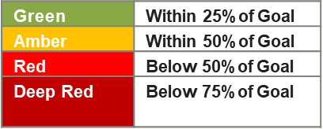
FY26 Small Business Accomplishments
USACE - SAJ | Actions | SB Eligible Dollars | % Dollars | Goal | Variance
Small Business Eligible | 204 | $490,106,270
Small Business | 112 | $250,384,289 | 51.09% | 36% | 15.09%
SDB | 58 | $221,056,712 | 45.10% | 22% | 23.1%
SDVOSB | 6 | $-48,687 | (0.01%) | 2% | -1.99%
Women Owned | 26 | $260,333 | 0.05% | 4% | 3.95%
HUBZone | 16 | $473,983 | 0.10% | 6% | 5.1%
Notes:
FY26 Goals in review
Metrics on the FY26 SB Goals accomplishment will be provided each Command and Staff.

Slide 11
First Things First
If you are brand new to Government contracting, it is advised that you take a few steps before pursuing USACE contract opportunities. We want you to be as prepared as possible to perform successfully on a Government contract and continue to partner with us for years to come!
Register your company as an entity at *SAM.gov.
Understand the small business programs available through the SBA.
Determine what agency or agencies buy what you sell!
Understand how the Federal Government procures supplies and services.
Search for specific opportunities and notices by NAICS, location, agency code, etc. via SAM.gov.
Visit with your local APEX Accelerators.
*Note: During the registration process, you must indicate you want to participate in the Disaster Response Registry and provide the required information on the Disaster Response Information page within the Assertions module. Once your registration is active, you will be added to the Disaster Response Registry and contracting officers will be able to locate your company through the Disaster Response Registry Search.

Slide 12
First Impressions – Capability Statements
The Value of Time:
Don’t waste an opportunity to make a favorable impression!
Don’t waste the Contracting Official’s time.
Know the customer’s mission and something about their buying habits.
Where possible provide a well-designed capability statement (2-3 Pages)
Tailor your presentation based on the customers needs.
Discuss relevant topics during the presentation.
Don’t confuse the government agency’s roles – The Small Business Office, SBA, and APEX should help prepare you for event; not the Contracting Officer!
When you appear before the Contracting Officer or Gov’t Official – Their response: Welcome to the big league; show me your skills please!

Slide 13
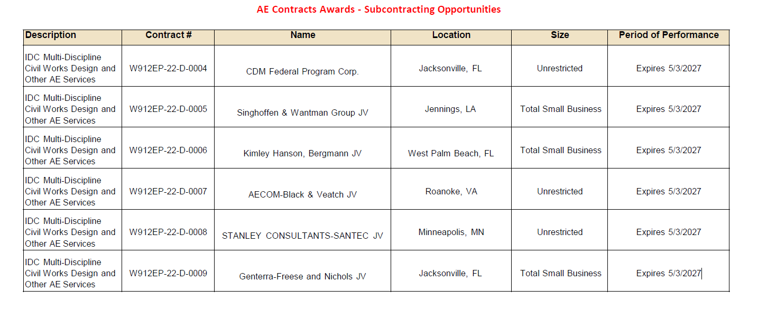
Subcontracting List

Slide 14
Hurricane Response Opportunities

Slide 15
FY26+ Business Opportunities Forecast
Opportunity | Location | District / Center | Estimated Solicitation Release Date (Quarter) | NAICS | SBSA / Unrestricted | Solicitation Type
C23/24 North Reservoir CNT 4B | Primary Florida | Jacksonville District | 1st Qtr FY2027 | 527990 | Unrestricted | RFP
C23/24 North Reservoir CNT 4C | Primary Florida | Jacksonville District | 1st Qtr FY2028 | 527990 | Unrestricted | RFP
C23/24 North Reservoir CNT 4D | Primary Florida | Jacksonville District | 1st Qtr FY2029 | 527990 | Unrestricted | RFP
C23/24 North Reservoir CNT 4E | Primary Florida | Jacksonville District | 4th Qtr FY2030 | 527990 | Unrestricted | RFP

Slide 16
FY26+ Business Opportunities Forecast
Opportunity | Location | District / Center | Estimated Solicitation Release Date (Quarter) | NAICS | SBSA / Unrestricted | Solicitation Type
O&M: IWW Jacksonville-Miami, FL | Primary Florida | Jacksonville District | 3rd Qtr FY2026 | 237990 | SBSA | IFB
Mayport Dredging | Primary Florida | Jacksonville District | 3rd Qtr FY2026 | 237990 | SBSA | IFB
Banana River (NASA) Maintenance Dredging | Florida | Jacksonville | 4th Qtr FY2026 | 237990 | SBSA | RFP
O&M: St. Lucie Inlet | Florida | Jacksonville | 4th Qtr FY2026 | 237990 | SBSA | IFB
Manatee Harbor, FL (O&M) | Florida | Jacksonville | 3rd Qtr FY2026 | 237990 | SBSA | IFB

Slide 17
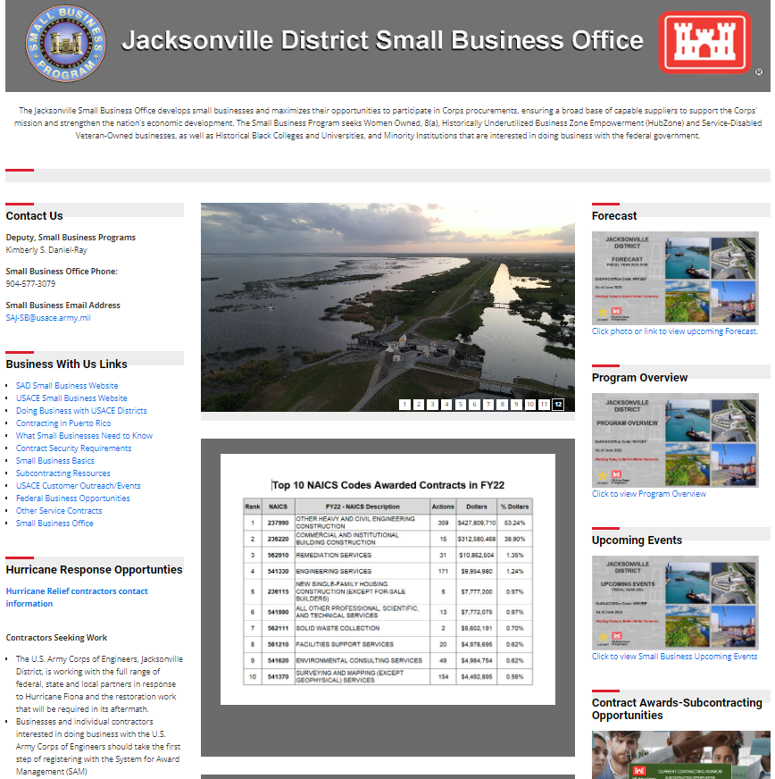
Jacksonville District Small Business Website
Search our Website to see:
Forecast
Program Overview
Upcoming Events
Contracts Awards-Subcontracting Opportunities
Additional Resources
Website Link: https://www.saj.usace.army.mil/SmallBusiness/

Slide 18
Resources
USACE Resources
Main Website: https://www.usace.army.mil/
Infrastructure Work Plans: https://www.usace.army.mil/Missions/Civil-Works/Budget/
Contracting: https://www.usace.army.mil/Business-With-Us/
Contracting Questions? Email DoingBusinessWithUs@usace.army.mil
Small Business: https://www.usace.army.mil/Business-With-Us/Small-Business/
Small Business Questions? Email Small-Business-HQ@usace.army.mil
Government-wide Resources
www.sam.gov: Official government system for contracting opportunities, registering to do business, wage determinations and contract data
www.FPDS.gov: Search any unclassified contract award (DoD data has 90-day delay)
www.USASpending.gov: Official open data source of federal spending information
www.sba.gov: Small Business Administration website has information regarding small business size standards, small business types and more
https://www.aptac-us.org/: Free resource dedicated to help local businesses compete successfully in the government marketplace. (Can also help you register with sam.gov)

Slide 19
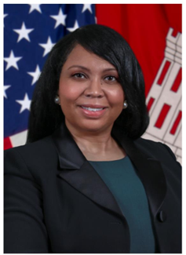
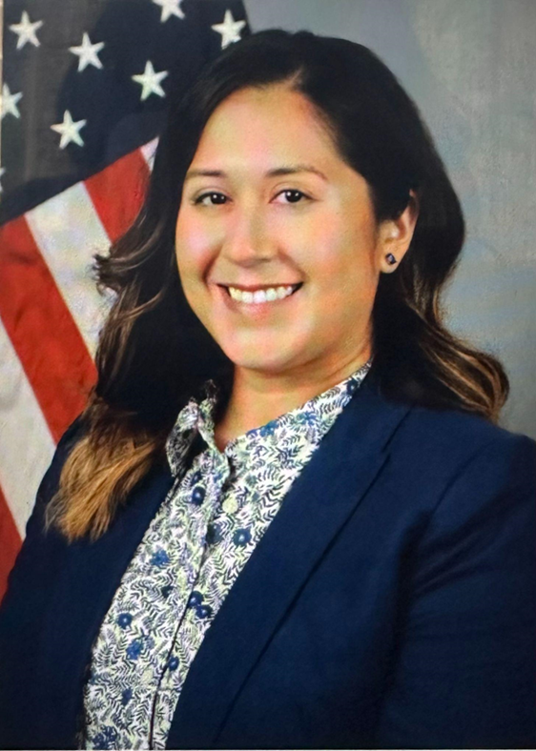

Jacksonville District Office of Small Business Programs
Kimberly (Kim) Daniel-Ray,
Chief of Small Business Programs
USACE, Jacksonville District
Mobile: (904) 318-6436
Small Business Email: SAJ-SB@usace.army.mil
Alexandria (Alex) Lavey,
Small Business Professional
USACE, Jacksonville District
Office (904) 232-1005
Small Business Email: SAJ-SB@usace.army.mil

Slide 20
For More Information
U.S. Army Corps of Engineers | Jacksonville District
http://www.saj.usace.army.mil/
Office of Small Business Programs
SAJ-SB@usace.army.mil
On Facebook www.facebook.com/JacksonvilleDistrict
On YouTube! www.youtube.com/JaxStrong
On Twitter www.twitter.com/JaxStrong
On Flickr www.flickr.com/photos/jaxstrong
Useful Restoration Sites: www.evergladesrestoration.gov
www.sfwmd.gov

