Slide 1

The 628th Contracting Squadron
March 2026

Slide 2
Mission & Vision
Mission
Provide agile acquisition support and contract execution to Joint Base Charleston Mission Partners and mission-ready forces to Combatant Commanders.
Vision
Be the premier operational contracting squadron in the Air Force.

Slide 3
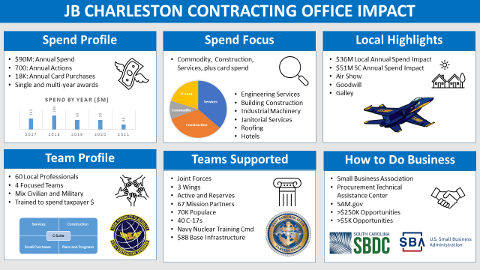
What We Do
Notes:
Tenant units only receive indirect CONS support through ABW units (i.e. Custodial and Grounds through CES, Base Telecom through CS, etc.) CONS’ Requirement owner is actually an ABW unit.
Supported units can provide direct mission funding (Army, Navy, etc.) to CONS for mission requirements (furniture, equipment, services, etc.)
Supported Units:
Naval Support Activity Charleston
Nuclear Power Training Unit (NPTU)
Navy Nuclear Power Training Command (NNPTC)
Army Field Support Battalion Charleston (AFSBn-CH)
841st Transportation Battalion
Navy Consolidated Brig
Navy Munitions Command (NMC)
Naval Heath Clinic Charleston (NHCC)
Naval Information Warfare Center (NIWC)

Slide 4
How We Do It
In order of preference:
Government Purchase Card
Purchase Request, aka “Form 9” or “PR”
Military Interdepartmental PR (MIPR)
Notes:
MIPR’s
- Fees – most buying agencies charge fees (% of purchase price) for use. GSA, USACE, SPAWAR
- Manning – CONS manning is earned by the number of actions awarded and dollars obligated. Large use of MIPRs will negatively affect our manning

Slide 5
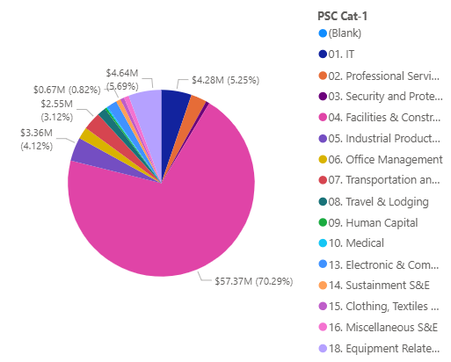
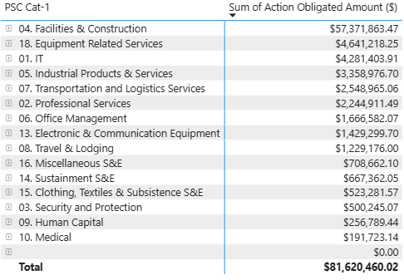
FY25 Spend by Product Service Code
*The data set contains negative or zero values that cannot be shown in this chart.

Slide 6
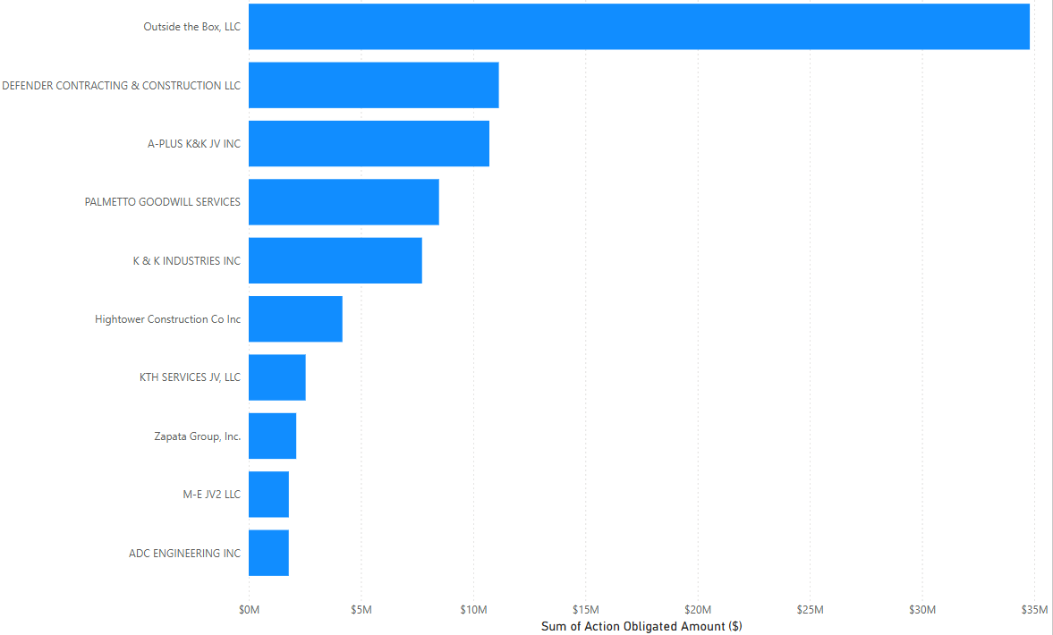
FY25 Top Contractors
$34,804,030
$11,145,614
$10,723,417
$8,479,483
$7,722,904
$4,175,180
$2,536,574
$2,119,071
$1,787,394
$1,784,015

Slide 7
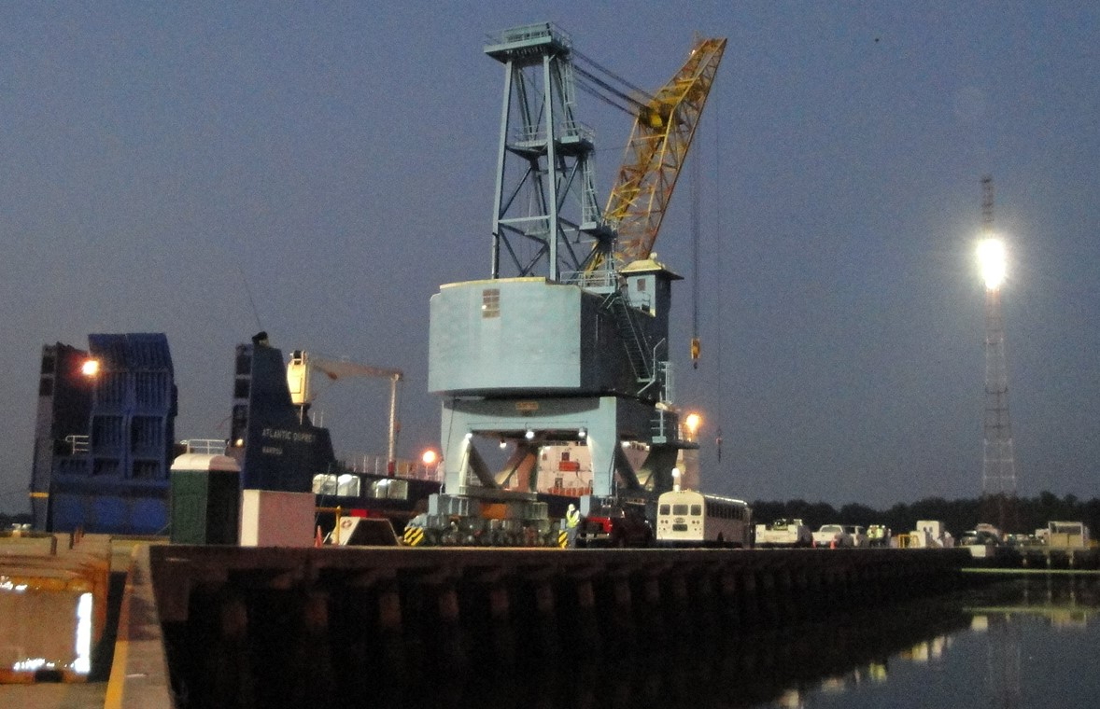
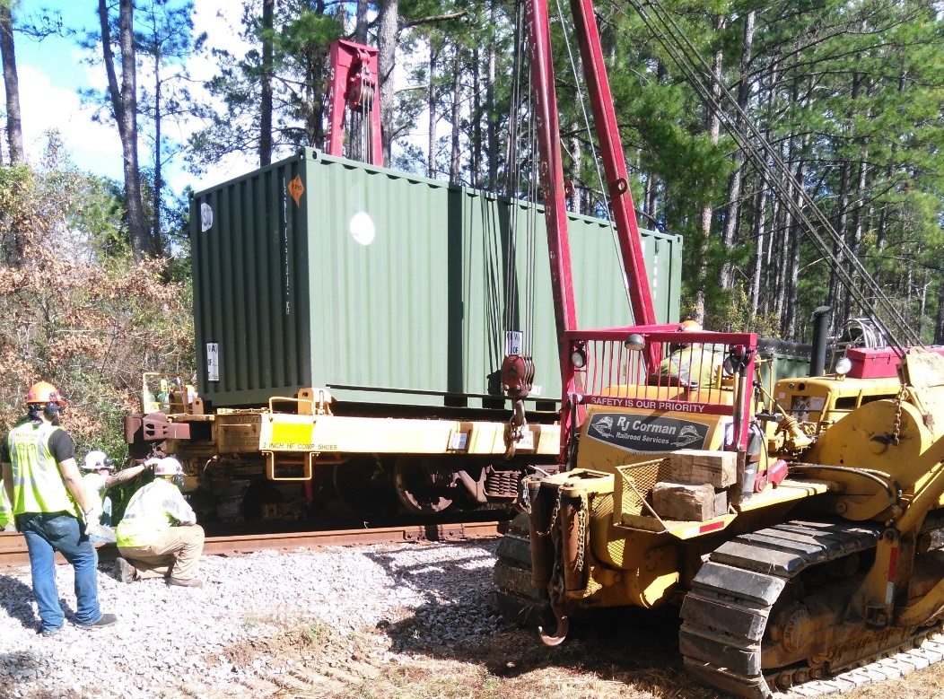
PKA - Commodities & Services
Terry Harrelson - Flight Chief
Notes:
Pictures of one time service contracts, repair & paint crane and train derailment
45 Ton Crane built in 1969, some parts are obsolete and required the purchase of refurbished parts. Recent project included requirement to repaint it to continue to preserve it. Project required lead paint containment.
Train was carrying inert munitions (370 lbs)

Slide 8
Upcoming Services Solicitations Watch Sam.Gov for details
FORMAL Services Setaside RFP Est.
Base Telecommunication Service Unknown Apr 2026
Joint Base Custodial 8(a) Comp Apr 2026
Hoits and Crance Maintenance SB Apr 2026
Giant Voice Maint Unknown May 2026
Washer/Dryer Lease & Maintenance SB Jun 2026
Refuse 8(a) Comp Apr 2027
Utility Marking SB May 2027
PSD ID Adm Support SB May 2027
Alert Fac (Front Desk & Cleaning) 8(a) Jun 2027
Elevator Maintenance & Testing LB Feb 2028

Slide 9
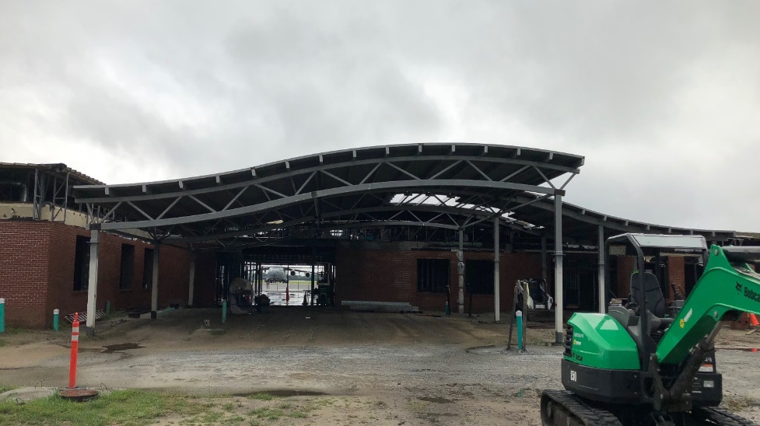
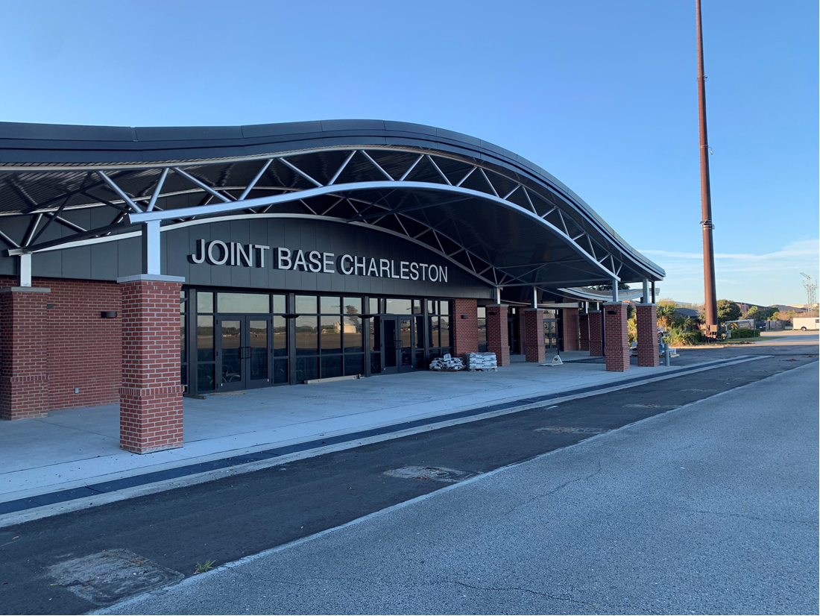
PKB - Construction
Robert Hale- Flight Chief
Notes:
The CONS Construction Flight has 22 personnel organized across 3 acquisition teams
We are a mix of military and civilian personnel and currently have two military personnel deployed and three civilian vacancies (including FC position).
Currently managing $176M in contract capacity and working acquisition for a $42M FY20 program

Slide 10
Upcoming Construction Solicitations Watch SAM.gov for details
CONSTRUCTION:
IDIQ’s: RFP Est.
Railroad Maintenance & Repair Mar 2026
Facility Enhancement and Maintenance Apr 2026
SABER Apr 2026
MACC Apr 2026
Rubber Removal and Paint Striping Jun 2026
A&E Jul 2026
FORMAL CONSTRUCTION:
Hangar Fall Protection ($500K - $1M) Apr 2026
Repair Intersection Runway ($10M - $25M) Apr 2026
SB SET-ASIDES:
We will issue Sources Sought Synopses on sam.gov to help determine level of set-aside
Please respond!!!

Slide 11



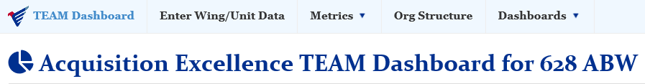


PKP – Plans & Programs
Mr. Ray Alls – Flight Chief

Slide 12
The 628th Contracting Squadron
Questions?

Slide 13
Joint Base Charleston POCs
Construction:
Robert Hale (843)963-5170
Services:
Terry Harrelson (843)963-5156
Plans and Programs:
Ray Alls (843)963-6300
Government Purchase Cards:
Admiral Lee (843)963-5190
Director of Small Business:
Barbara Bonnette (843)963-3328

