Slide 1
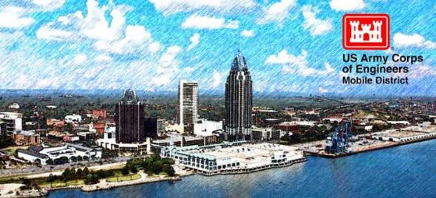
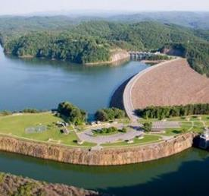
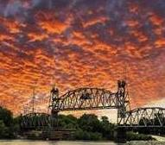

UPCOMING OPPORTUNITIES
Mobile District
COL Kelsey Shaw,
Mobile District Commander
Carl Wade,
Mobile District
Chief of Contracting

Slide 2
Program Trends & Observations
Unprecedented times for USACE … $90B portfolio, workforce sized for $30-35B portfolio
  Strong MILCON & Civil Works appropriations support
  Aging Civil Works Infrastructure – Demopolis, Holt locks & others
  Other Federal agencies seeking USACE expertise
Industry Feedback/Proposal Observations
  Impact of inflation, labor, material and global supply chains…30% price increase, lead times for key items, willingness to hold pricin
  CMMC – on the horizon
Growth Opportunities & Locations in Mobile District
  MILCON – MacDill (KC46 & SOCOM), Columbus (T7 Fielding), Redstone (Space & Missile), Eglin, Patrick (Space Port of Future), Anniston Army Depot (Army Organic Industrial Base)
  Defense Health Agency – new market sectors and locations
  Environmental – AFFF, PFOS/PFOA, EPA Superfund
  Civil Works – Coastal Resiliency, Design work for BIL and WRDA authorizations
  LATAM – Large harbor construction efforts (Peru, Guatemala)
  Interagency – Veterans Administration, NASA, Homeland Security
Key Acquisition Needs for FYs 26/27
  Construction Contracts
  Replenish AE Capacity
  Defense Health Agency D-B and O&M
  Environmental
  Construction Management Services
  O&M Personnel (NAV Lock Operators, HYDRO Maintenance Trainees, Rangers)
Reliance on Industry Partners

Slide 3
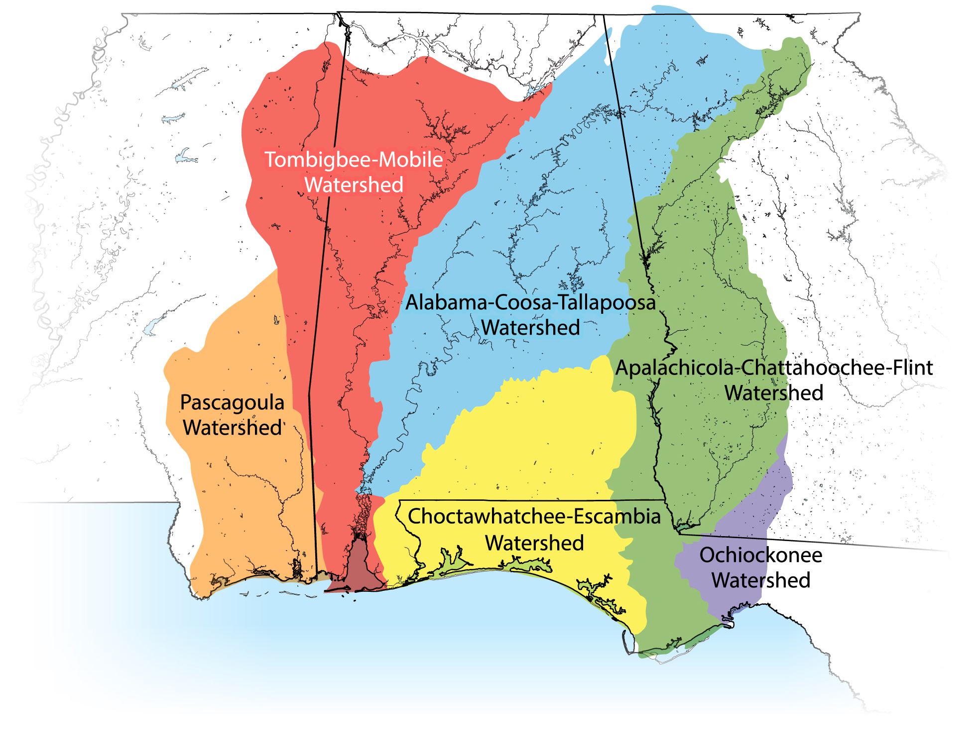



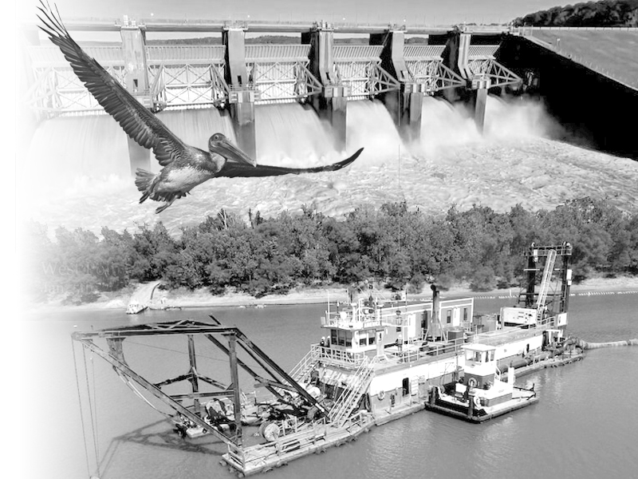




Mobile district boundaries – civil works
Major Missions
Coastal/Inland Navigation
Recreation
Hydropower
Dredging
Flood Control & Disaster Response
Environmental
Engineering with Nature

Slide 4
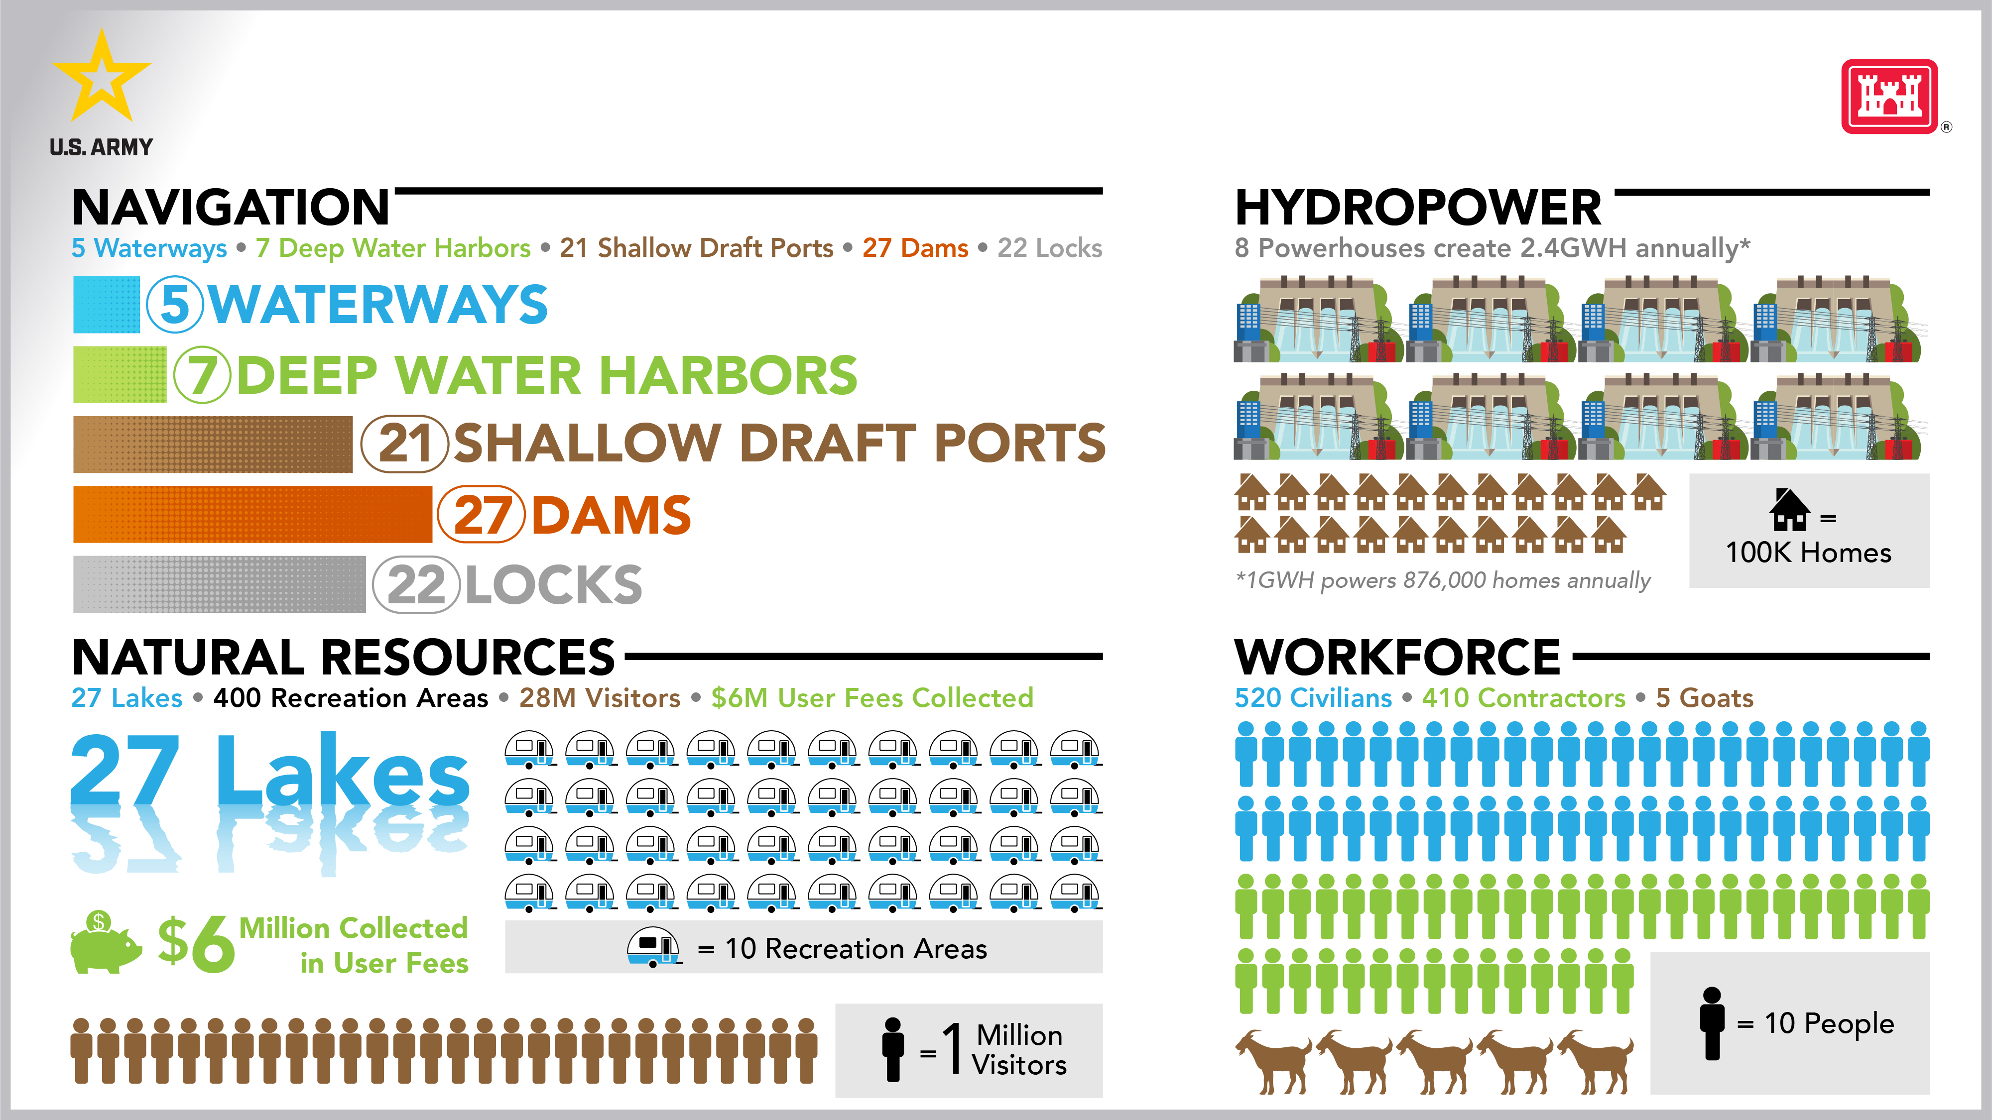
Operations division stats

Slide 5
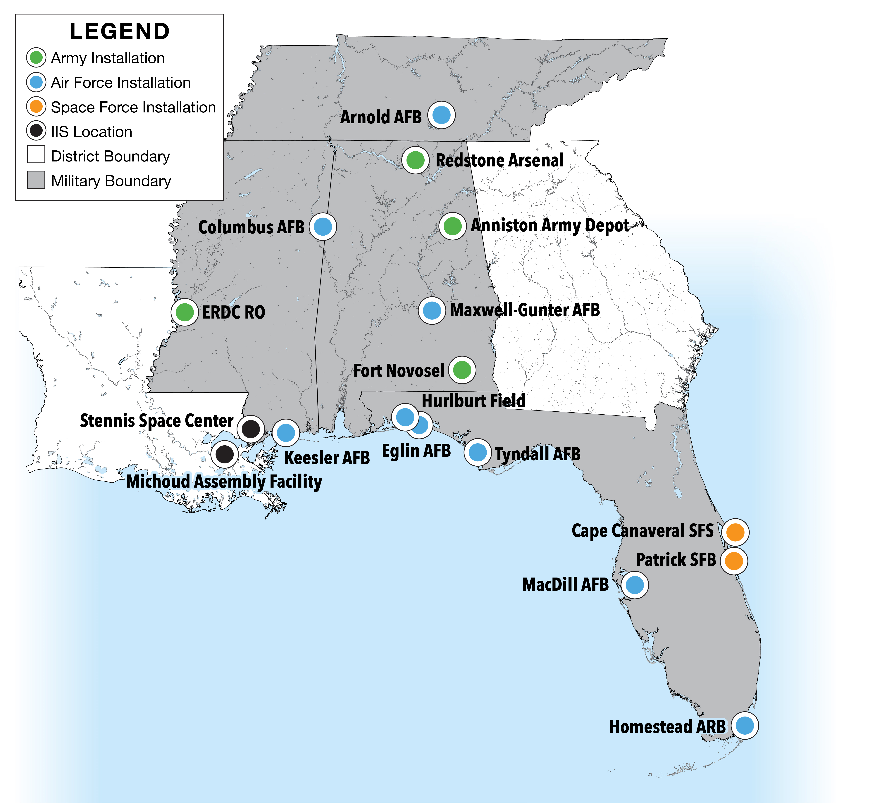
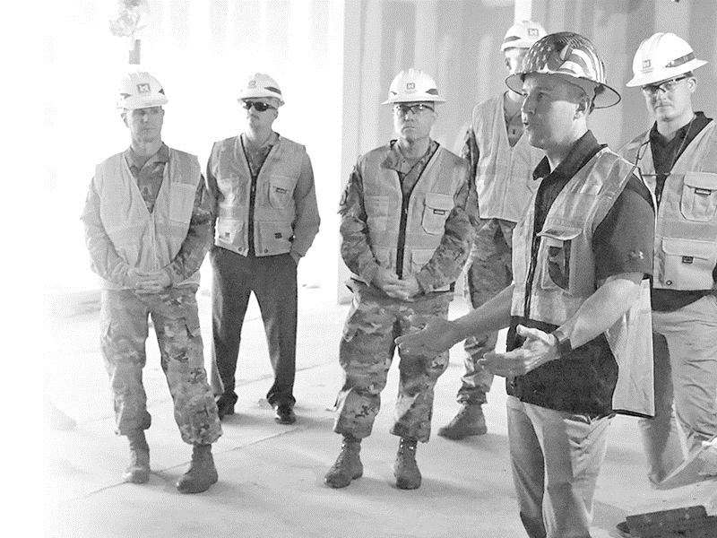
Mobile district boundaries – MILITARY
Areas of Support
Defense Readiness
  Aviation Hangar Facilities
  Space Force Base of the Future
Quality of Life for Soldiers, Airmen, and Guardians
  Barracks and Dormitories
  Child Development Centers
Organic Industrial Base (OIB) -Anniston

Slide 6
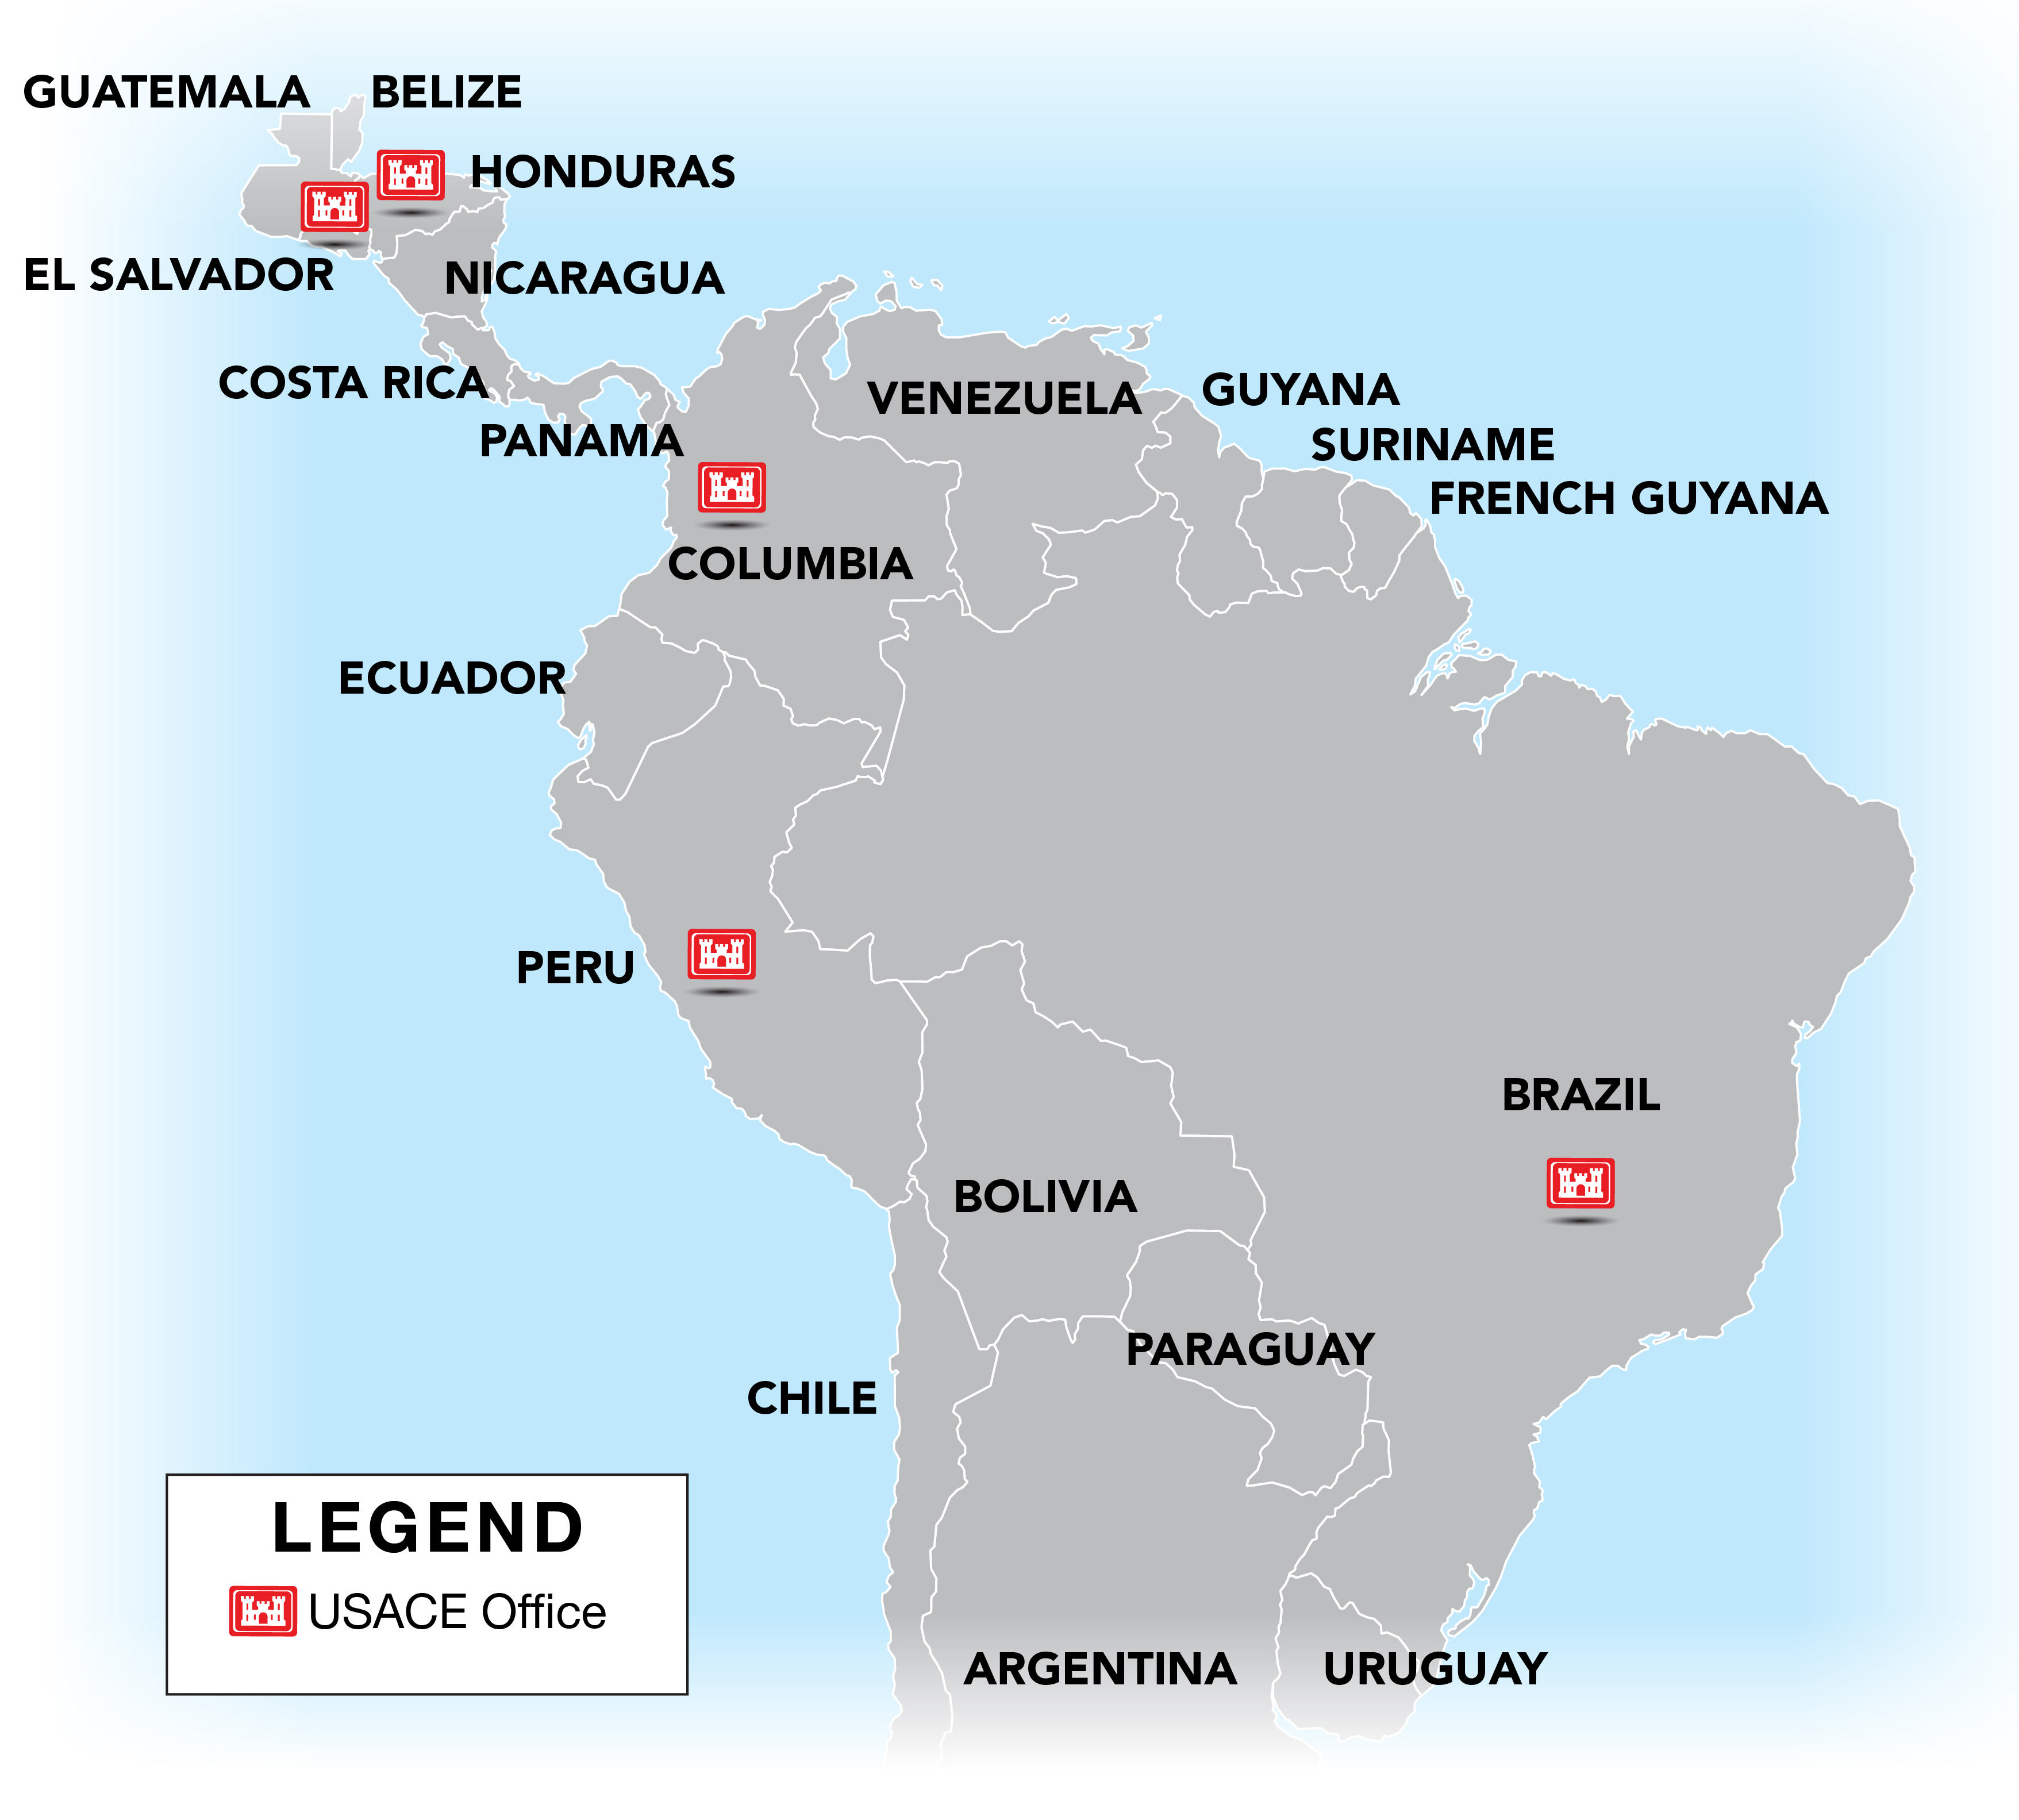

Mobile district boundaries – Latam
Lines of Effort
Foreign Military Sales (FMS)
  Peruvian Navy
Garrison Support
  Soto Cano Air Base
Civil Works/Studies
  Panama Canal
  Studies
Strategic Engagement to USSOUTHCOM

Slide 7
A-E Brooks Acts Opportunities – NAICS 541330
(Unless otherwise Noted), Mobile District AOR
Projects | Set-Aside Category | Est. Award Value | Projected Advertise Date
AE Services for Military Design and Construction Program (MILCON Replacement) | UR/SB Reserve – Shared | $499M | 3rd Qtr, FY26 *
AE Services for Horizontal Design | UR/SB Reserve – Shared | $49M | 2nd/3rd Qtr FY26 *
AE Services for Civil Works Design | UR/SB Reserve – Shared | $49M | 3rd Qtr, FY26 *
AE Services for Master Planning | SB | $10M | 1st Qtr, FY27
AE Services for Survey and Mapping | UR/SB Reserve - Shared | $99M | 1st Qtr, FY27
AE Services for IIS(OCONUS) | SB | $49M | 4th Qtr FY26/1st Qtr FY27
AE Services for the Water and Wastewater TCX | UR | $49M | 1st Qtr, FY27
AE Services for BUILDER | UR | $249 | 3rd Qtr FY26*

Slide 8
INTERAGENCY
Project | Set-Aside Category | Est. Award Value | Projected Advertise Date
Auburn Lab, USDA | UR | <$100M | Awarded
COBRA Incinerator Bldg | DHS MATOC | <$10M | 3rd Qtr, FY26
Campus Solar Training Canopies | DHS MATOC | <$20M | 3rd Qtr, FY26
FEMA Temporary Structures & Equipment | SB | <$5M "C" | 4th Qtr, FY26
ENVIRONMENTAL REMEDIATION
Project | Set-Aside Category | Est. Award Value | Projected Advertise Date
AE Services for Environmental Restoration Program (ER/HTRW/PFAS) | UR/SB Reserve - Shared | $249M | 3rd Qtr, FY26

Slide 9
CONSTRUCTION – LATAM
Project | Set-Aside Category | Est. Award Value | Projected Advertise Date
General Aircraft Hangar | UR | >$10M | 3rd Qtr, FY26
Cooperative Security Location Comalapa, El Salvador
Facilities Operation & Maintenance Service Contract | UR | $5M-$10M across 5-year period | 4th Qtr, FY26
Naval Medical Research Unit - South
Callao, Peru
MATOC - Repair and Minor Construction in South America | UR | $150M | 1st Qtr, FY27
MATOC - Harbor Construction for the Peruvian Navy | Countries having a common border with Peru will not be allowed to construct on a Peruvian Naval Base | TBD | 3rd Qtr, FY27
Callao, Peru
Vehicle Maintenance Shop | UR | >$10M | 1st Qtr, FY28
Soto Cano Air Base, Honduras

Slide 10
CONSTRUCTION – CIVIL WORKS
Project | Set-Aside Category | Est. Award Value | Projected Advertise Date
Hancock County Beach and Dune | Competitive SB | <$30M | Mar 26
- Dune Vegetation Contract | SB (8a sole source) | <$4M | 2nd Qtr, FY27
Deer Island Restoration
(Harrison Co., MS)
- Breakwater Construction | TBD (pending market research) | <$20M | May 26
- Island Construction | TBD (pending market research) | <$10M | 4th Qtr, FY27
- Planting Contract | SB (8a sole source) | <$4M | 1st Qtr, FY28
Jackson County, MS
-Beach and Dune | Competitive | TBD | Apr 27
-Tantalon- Shamrock Drainage (EI) | MATOC Pool (SB) D-B-B | $1.5 - 2 M | Apr 27
-Bayou to Verlon Drainage (EI) | MATOC Pool (SB) D-B-B | $1.5 - 2M | Aug 26
Meridian, MS Trunk Sewer (EI) | MATOC Pool (SB) D-B | $7 - 9 M | 2nd Qtr, FY 27
West Point, GA Water Intake (EI) | MATOC Pool (SB) D-B | $6 – 8M | 2nd Qtr, FY 27

Slide 11
Construction – Medical
Project | Set-Aside Category | Est. Award Value | Projected Advertise Date
Design Build Western Region MATOC | UR/SB | $249M | 2nd Qrt FY26
Operations & Maintenance East of Mississippi MATOC | UR/SB | $450M | 3rd Qrt FY26
Operations & Maintenance West of Mississippi MATOC | UR/SB | $450M | 3rd Qrt FY26
Design Build Hawaii Region MATOC | UR/SB | $99M | 2nd Qrt FY27

Slide 12
CONSTRUCTION – MILCON FY26
MILCON 26 Project Name | Installation | Estimated Award Value | Projected Advertise | Set-Aside Category
Open Storage Area, Depot Level | Anniston | <$10M | 3rd Qtr FY26 | SB
NITROGEN COVERSION FACILITY | Arnold | <$12M | 3rd Qtr FY26 | SB
WATER TANK STORAGE | Columbus | <$15M | 3rd Qtr FY26 | SB
LRSO Hardware Software Development Test Facility | Eglin | <$25M | 2th Qtr FY26* | SB
EPH Barracks | Eglin/Duke | <$100M | 3rd Qtr FY26* | UR
F35A DEVELOPMETAL/OPERATIONAL TEST B64 | Eglin | <$25M | 3rd Qtr FY26 | UR
Const. Range Rd. 218 By-Pass | Eglin | <$10M | 3rd Qtr FY26 | SB
F-35A DEVELOP TEST 2-BAY MAINT HANGER | Eglin | <$40M | 3rd Qtr FY26 | UR
F-35A DEVELOPMENTAL/OPER TEST 2-BAY HANGER | Eglin | <$45M | 3rd Qtr FY26 | UR
KC-46A GEN PURPOSE WAREHOUSE | MacDill | <$10M | 3rd Qtr FY26 | SB
KC-46A A/C SE SHP/STOR FCLT | MacDill | <$5M | 3rd Qtr FY26 | SB

Slide 13
MILCON MATOC POOLS
Unrestricted South Pool | Unrestricted North Pool
Caddell Construction Co. (DE), LLC | BL Harbert International, LLC
RQ Construction, LLC | Brasfield & Gorrie, LLC
Korte Construction Company | Caddell Construction Co. (DE), LLC
Hensel Phelps Construction Co. | Hensel Phelps Construction Co.
BL Harbert International, LLC | Korte Construction Company
The Whiting-Turner Contracting Company | The Whiting-Turner Contracting Company
Small Business North
EMR, Inc. | Southeast Cherokee Construction, Inc.
Healtheon, Inc. | Southeastern Industrial Barlovento JV-2, LLC
Howard W. Pence, Inc. | Speegle Construction, Inc.
Roundhouse-MV JV | Webb, LLC (dba WEBCO)

Slide 14
CONSTRUCTION – MILCON FY27
MILCON FY27 Project Name | Installation | Estimated Award Value | Projected Advertise | Award FY
Access Control Point | Anniston | <$100M | 4th Qtr, FY26 | FY27
Rpl. General Purpose Warehouse | Anniston | <$35M | 1st Qtr FY27 | FY27
ADAL INSTALLATION ACP GATE 2 | Arnold | <$20M | 1st Qtr, FY27 | FY27
CONSOL LAUNCH SPT FAC 1 | Cape Canaveral | <$70M | 1st Qtr, FY27 | FY27
CONSOL SHOP/LAB FAC 2 | Cape Canaveral | <$20M | 1st Qtr, FY27 | FY27
CONSTRUCT CONSOL SHOP/LABORATORY FAC 1 | Cape Canaveral | <$30M | 1st Qtr, FY27 | FY27
CONSOLIDATED LAUNCH SUPPORT FACILITY 2 (ROTF) | Cape Canaveral | <$70M | 2nd Qtr, FY27 | FY27
T-7A ALLIED SUPPORT | Columbus | <$10M | 1st Qtr FY27 | FY27
CLEAR WATER RINSE BIRD BATH | Eglin | <$10M | 1st Qtr, FY27 | FY27
CHILD DEVELOPMENT CENTER | Eglin | <$50M | TBD | FY27
Power Generation Microgrid | Eglin | <$45M | 2nd Qtr, FY27 | FY27
361ST ISRG MISS OPS FAC | Hurlburt | <$70M | 2nd Qtr FY26 | FY27
Hazardous Material Storage Building, Insta | Rucker | <$10M | 4th Qtr, FY26 | FY27
(ARAC) Navigation Building, Air | Rucker | <$10M | 4th Qtr, FY26 | FY27
Aircraft Parts Storage | Rucker | <$10M | 4th Qtr, FY26 | FY27
Vehicle Maintenance Shop | Rucker | <$5M | 2nd Qtr, FY27 | FY27
CONSOLIDATED STORAGE & WAREHOUSE PH 2 | Patrick | <$35M | 1st Qtr, FY27 | FY27
CONSOLIDATED STORAGE & WARHOUSE PH 1 | Patrick | <$45M | 1st Qtr, FY27 | FY27
CTC: Propulsion Systems Building | Redstone | <$55M | 2nd Qtr, FY27 | FY27
Airfield Fire And Rescue Station | Redstone | <$10M | 4th Qtr, FY26 | FY27
Lab and Test Building | Redstone | <$90M | 3rd Qtr, FY26 | FY27
Airfield Runway Asphalt Overruns | Redstone | <$5M | 4th Qtr FY26 | FY27
Gas Pipelines | Redstone | <$5M | 4th Qtr, FY26 | FY27
Access Control Building | Redstone | <$10M | 4th Qtr, FY26 | FY27

Slide 15
CONSTRUCTION – MILCON FY28
MICON FY28 Project Name | Installation | Estimated Award Value | Projected Advertise | Award FY
Construct Water Storage Tanks | Cape Canaveral | <$10M | 2nd Qtr, FY28 | FY28
Install Redundant Power Distribution | Cape Canaveral | <$10M | 2nd Qtr, FY28 | FY28
Construct Consolidated Base Support Complex | Cape Canaveral | <$40M | 2nd Qtr, FY28 | FY28
Consolidated Munitions Storage | Cape Canaveral | <$200M | 2nd Qtr, FY28 | FY28
Widen ICMB Road | Cape Canaveral | <$40M | 2nd Qtr, FY28 | FY28
Lab and Ops Bldg | Columbus | <$10M | 3rd Qtr, FY28 | FY28
T-7A Allied Support | Columbus | <$10M | 1st Qtr, FY27 | FY28
Working Dog Treatment Facility (Replacement Veterinary Clinic) | Eglin | <$20M | 2nd Qtr, FY28 | FY28
WTIC (Weapons Tech Integration Complex) | Eglin | <$1.2B | 2nd Qtr, FY28 | FY28
EMSO Superiority Complex (FTFA213101/P2)) | Eglin | <$200M | 3rd Qtr, FY28 | FY28
(UROC) Communications Center | ERDC | <$15M | 3rd Qtr, FY28 | FY28
GSL - Geodynamics | ERDC | <$10M | 2nd Qtr, FY28 | FY28
JETS | ERDC | <$5M | 4th Qtr, FY27 | FY28
GSL - Unconventional Counter Measures | ERDC | <$10M | 3rd Qtr, FY27 | FY28
JCSE Joint Communication Support Element | MacDill | <$70M | 2nd Qtr, FY28 | FY28
Relocate Lift Station B650 | Patrick | <$10M | 1st Qtr, FY28 | FY28

Slide 16
CONSTRUCTION – OTHER FY26/FY27

Slide 17
CONSTRUCTION – OTHER FY28

Slide 18
O&M DREDGING
Project | Set-Aside Category | Est. Award Value | Projected Advertise Date
Mobile Harbor Unit Price | UR | $25M | 3rd Qtr, FY26
Hopper Rental (Gulf Regional IDIQ) | UR | $49M | 4th Qtr, FY26*
Pensacola Harbor Unit Price | UR | $5M-$10M | 4th Qtr FY26

Slide 19





USACE mobile small business office points of contact
Ms. Sonya D. Rodgers
Chief, Office of Small Business Programs
email: sonya.d.rodgers@usace.army.mil
Office: 251-690-3597
Cell: 251-283-8465
U.S. Army Corps of Engineers
Mobile District
P.O. Box 2288
Mobile, AL 36628-0001
Mobile District
Small Business Office
/usacemobile
Notes:
To close I have a few points I’d like to summarize.
Still some opportunities on the table for FY23 for our SB Partners – always looking to meet our goals.
Our program is expected to be about $1.5 Billion per year for the foreseeable future.
MILCON growth at MacDill (SOCOM, new tanker aircraft facilities), Cape/Patrick (range of the future), Columbus AFB (new T7 trainer), Redstone (MSIC, Von Braun renovation), Anniston (Army Industrial Base), and Eglin will always have a large workload.
Our IIS workload with DHA is growing as we pick-up more hospital O&M across CONUS. Environmental growing due to PFAS
Interagency also continues to grow with significant work for NASA at Redstone, DHS at former Ft. McClellan, Agricultural Research at Auburn.
We are also early into a potential $100M+ FMS case to design/build facilities for the Peruvian Navy in Lima, as highlighted yesterday by BG Hibner.
Civil Works will be $400M+/year due to BIL, growth of environmental infrastructure (water and wastewater systems) in AL/MS/GA, and strong funding support for our traditional programs.
Lastly, please mark your calendars for our Mobile Post Industry Day 25-26 October in downtown at the Battle House Hotel.

