Slide 1
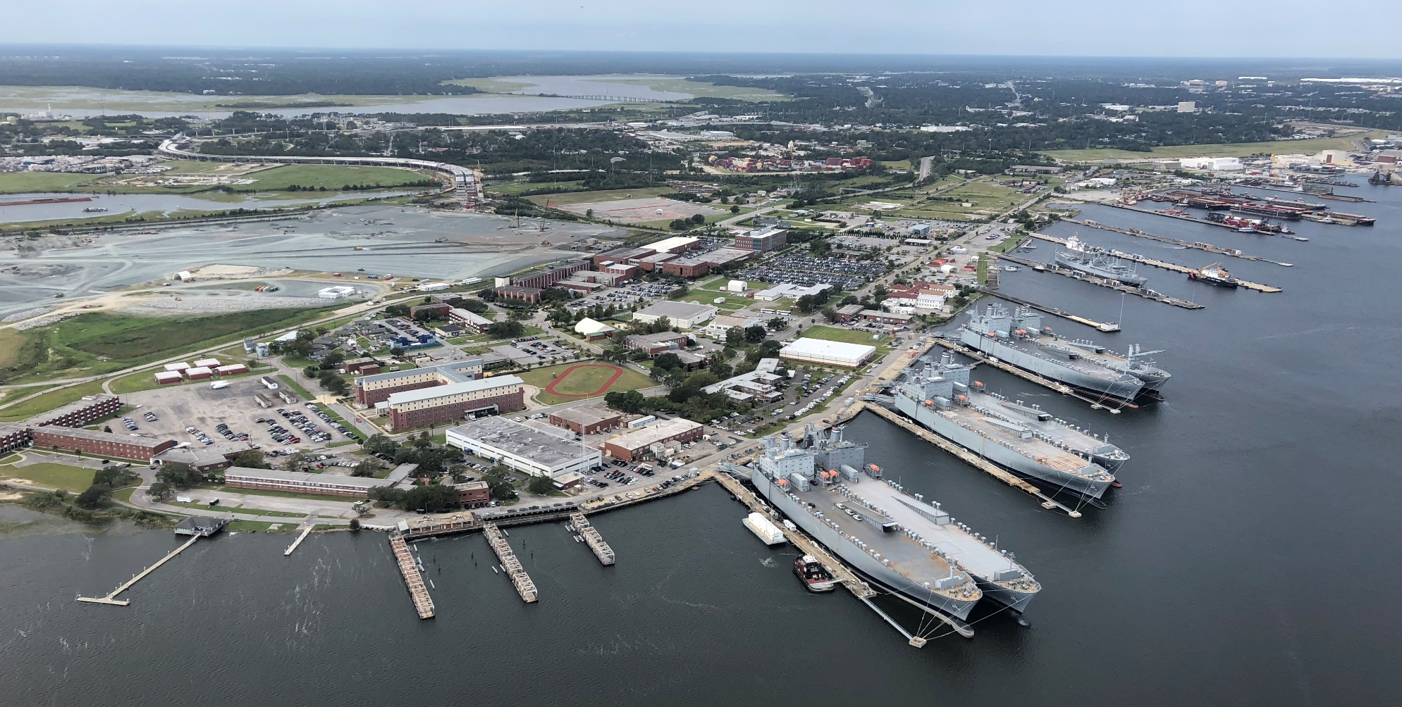
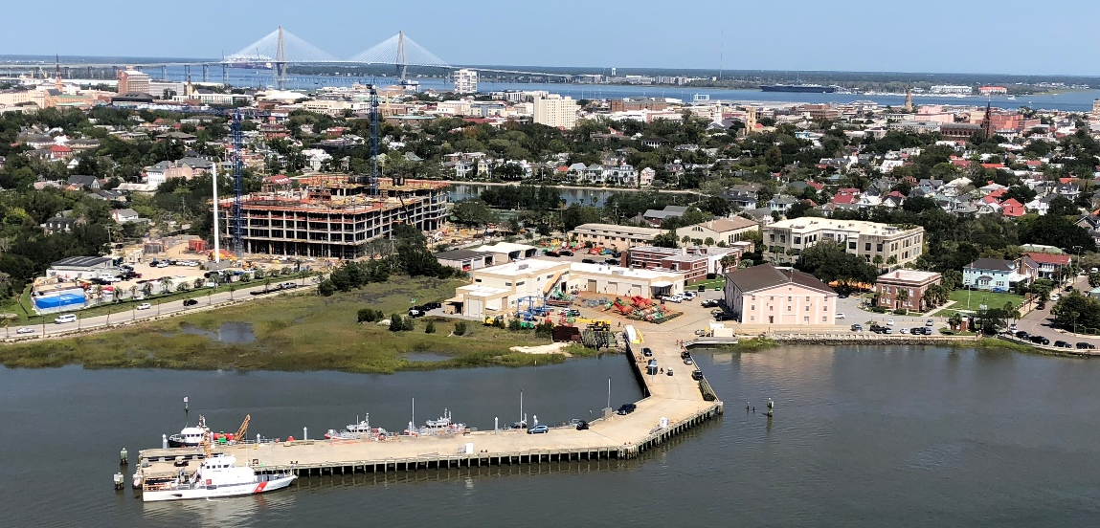
USCG Base Charleston
CAPT Eric J. Jones
Commanding Officer

Slide 2
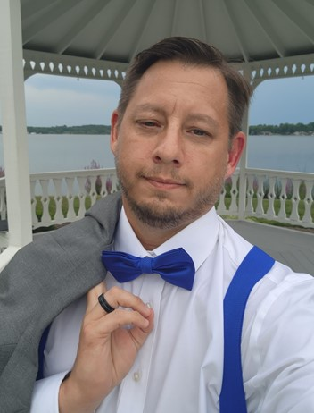
Senior Field Contracting Officer Shannon S. Bistline
Shannon S. Bistline serves as the Senior Field Contracting Officer (SFCO) at U.S. Coast Guard Base Charleston, where he leads a dynamic team of civilian and active-duty personnel in delivering comprehensive procurement and contracting support. His area of responsibility spans from Myrtle Beach, SC, to Daytona Beach, FL, and includes Base Charleston and the District Southeast Regional Support Team North (RST-SE).
Mr. Bistline oversees all phases of the contracting lifecycle—from initial requirement identification through to award recommendation—ensuring compliance with the Federal Acquisition Regulation (FAR) and Defense Federal Acquisition Regulation Supplement (DFARS). He manages a diverse portfolio that includes service contracts, goods, transportation, lodging, galley/messing, and construction. In FY25 alone, RST7N executed over 84 contracts totaling more than $3.8 million, including 40 construction contracts, underscoring the scale and impact of his team's operations.
In his role, Mr. Bistline also supervises micro-purchase teams and provides strategic oversight to align contracting efforts with mission objectives. He plays a critical role in contract performance monitoring, negotiation of modifications, and the delivery of strategic recommendations through program and policy analysis.
A proud U.S. Navy veteran, Mr. Bistline served honorably from 1994 to 2014. He holds a Master of Business Administration (MBA) from the University of Phoenix (2008) and previously supported the Naval Information Warfare Center (NIWC) Tacmobile, Special Projects and Polar (Antarctica) Program.
Outside of his professional accomplishments, Mr. Bistline is a recognized Shodan (Black Belt) in both Judo and Traditional Jujitsu. He is the Judo Instructor for the Citadel Judo Club and at his own Dojo SAN REI DOJO in Summerville, SC. Among all of his achievements, he considers marrying his wife and raising their two amazing children to be his greatest and most fulfilling accomplishment.

Slide 3
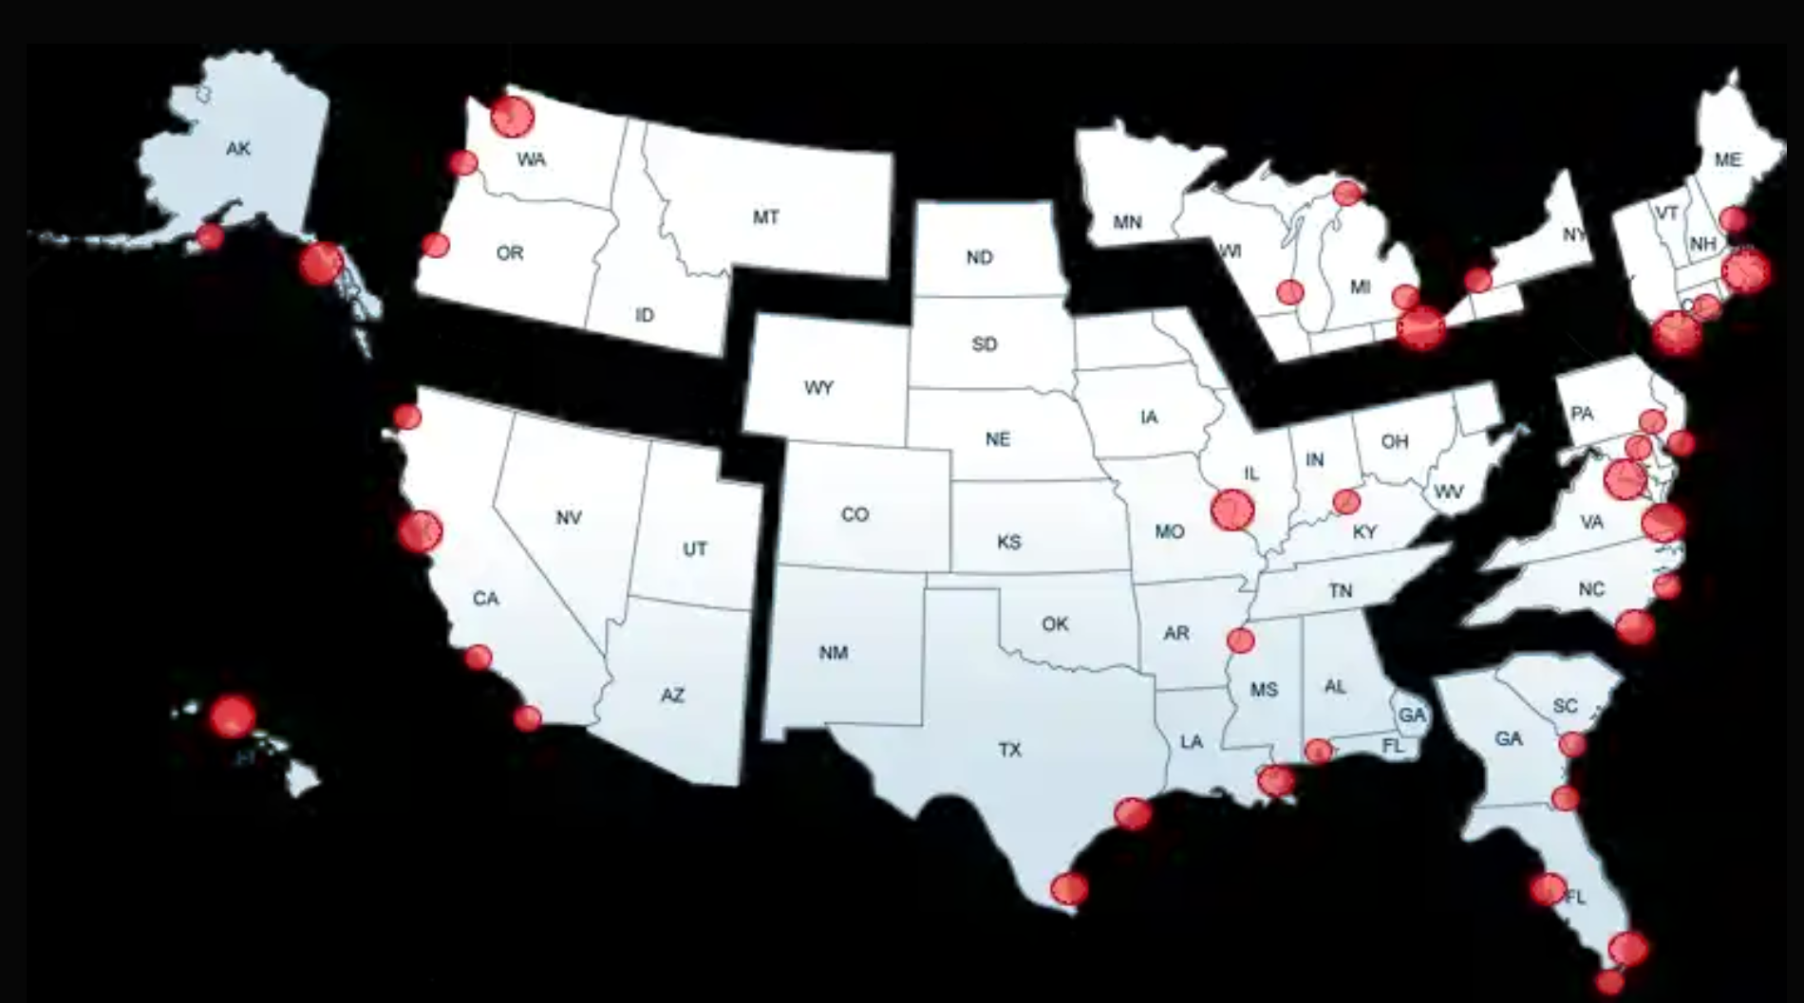
USCG Districts

Slide 4
RST-SE Area of Responsibility
Base Charleston: Serves as a mission support hub for operations within the northern 7th Coast Guard District – Staff of 3 Military member and 2 Civilians.
Sector Charleston
Area of Responsibility (AOR): Covers South Carolina and Northern and Coastal Georgia.
Key Units:
Station Charleston
Station Georgetown
Station Tybee
Station Brunswick
Air Station Savannah
Marine Safety Unit Savannah
Aids to Navigation Teams in Charleston, Georgetown, and Tybee
USCGC James
USCGC Hamilton
USCGC Willow
USCGC Cormorant
USCGC Anvil
3. Sector Jacksonville
AOR: Encompasses 40,000 square miles of ocean and inland waterways from King’s Bay, GA to Port Malabar, FL.
Key Units:
Station Ponce de Leon Inlet
Station Port Canaveral
Multi-Mission Station Mayport
Aids to Navigation Teams at Ponce de Leon and Jacksonville Beach
Marine Safety Detachment Canaveral
Cutter fleet including MARIA BRAY, HAMMER, MORAY, HERON, and TARPON

Slide 5
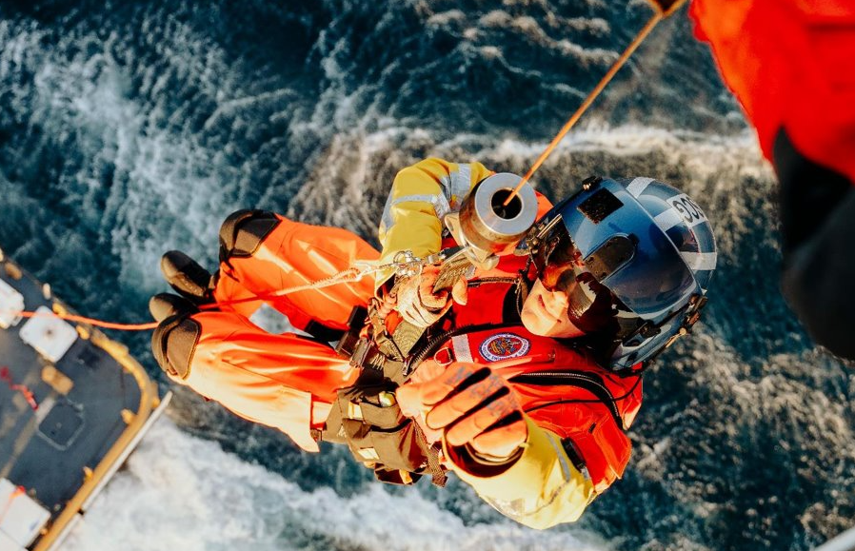
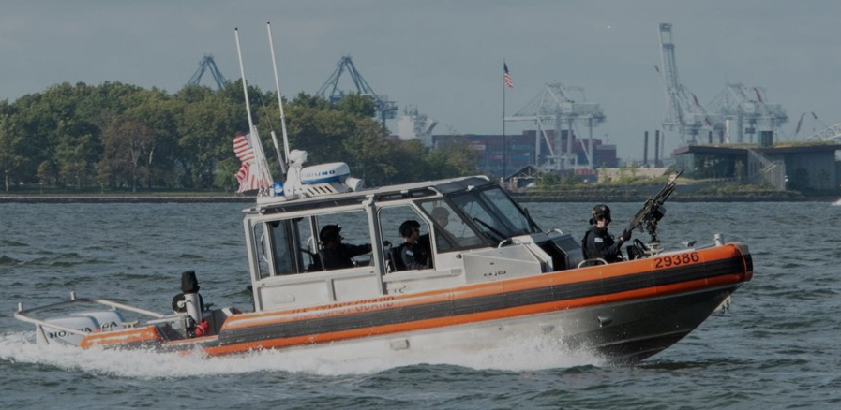
Coast Guard 11 Statutory Missions
Ports, Waterways & Coastal Security
Drug Interdiction
Aids to Navigation (ATON: including maintaining the nation's lighthouses, buoys & VTS; legacy ATON missions including lightships & LORAN)
Search & Rescue (SAR)
Living Marine Resources
Marine Safety
Defense Readiness (National Security & Military Preparedness)
Migrant Interdiction
Maritime Environmental Protection
Law Enforcement
*Polar, Ice & Alaska Operations (including the International Ice Patrol)

Slide 6
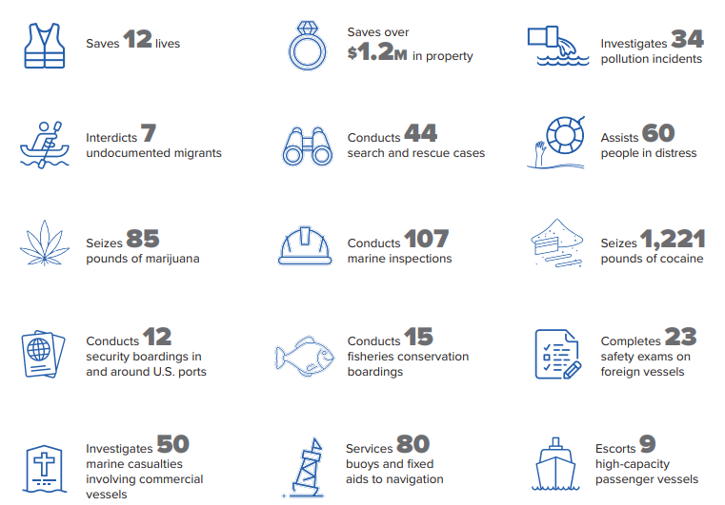
On an average day, the Coast Guard will…

Slide 7
Base Organization
Bases are located at all major force concentrations & integrate field mission support delivery across 7 departments & 75 mission support business lines (base services).

Slide 8
Base Charleston - Contracting Team
Senior Field Contracting Officer
- Shannon Bistline
Purchasing Agent – Contracting Officer
- Julia Kline
Office Chief – Contracting Officer
- SKC Adam Hitchcox
Contracting Specialist
- SK1 Jeffrey Andrade
Shared inbox: SMB-BaseCharleston-RST7N-PurchasingContracting@uscg.mil

Slide 9
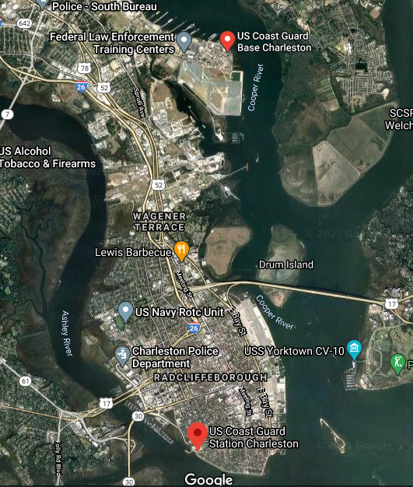
Base Charleston: Current State
Provides local mission support services to 11 tenant commands
Provides regional support to Coast Guard units in SC, GA, and northeastern FL
Split campuses:
North Charleston (Register Street)
Charleston (Tradd Street)

Slide 10
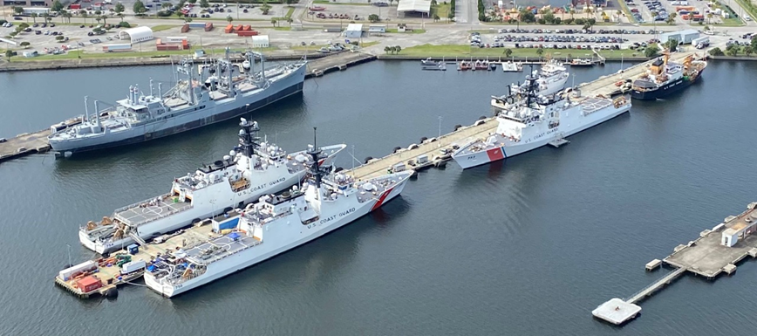
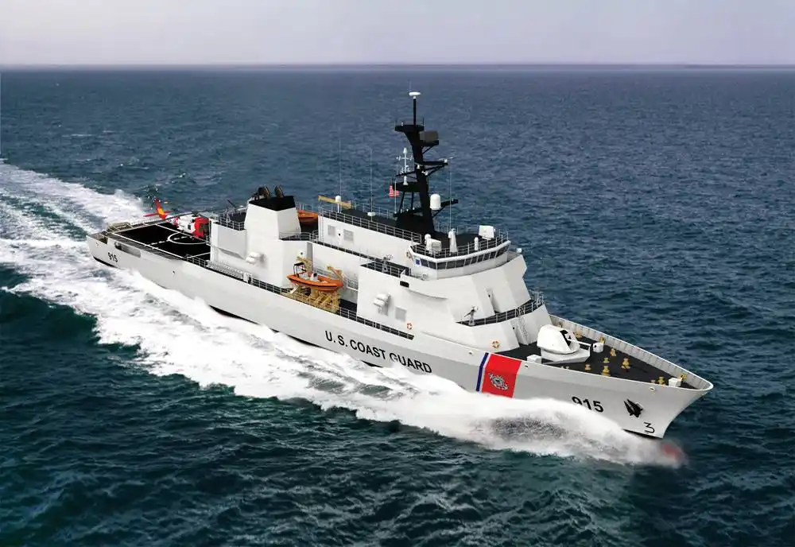
Base Charleston Projected Growth
Cutter Homeporting (currently 4 cutters and 2 buoy tenders):
FY30+: Charleston notional homeport for up to 5 Offshore Patrol Cutters with ~100 personnel each
USCG Personnel in greater Charleston: 1,300 today; 2,300 by 2030.

Slide 11
RAPID INFRASTRUCTURE PROJECT IMPLMENTATION TEAM
This Rapid Infrastructure Project Implementation Team(RIPIT) was executed to support and empower the Coast Guard workforce to maximize their operational impacts.
In FY25, in alignment with Force Design 2028, RIPIT delivered measurable, service-wide results to improve living and working conditions for our workforce
In just 39 days, RIPIT delivered results at speed and scale -identifying, developing, and executing over $26 million to complete 626 projects to improve habitability and reinforce safety, readiness, and sustainment. (30 projects and 2.1 Million out of Charleston)

Slide 12
RIPIT 2.0
In FY26, RIPIT 2.0 will commence to continue to build on that success and identify opportunities
RIPIT will remain focused on rapid, meaningful improvements to the Sailors living and working conditions while building a scalable execution model for sustained habitability outcomes in FY26 and beyond.
Projects will be executed through contracting mechanisms and support from LOGCOM and CG-SHORE.

Slide 13
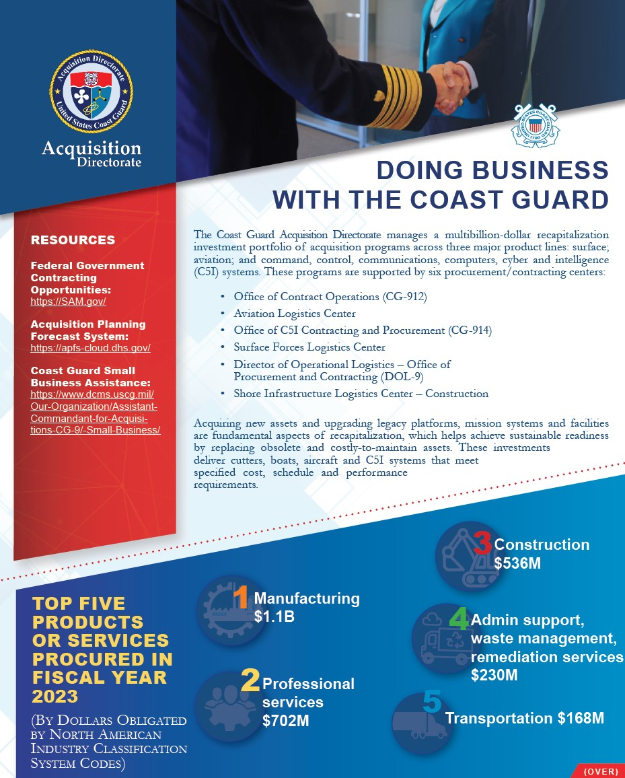
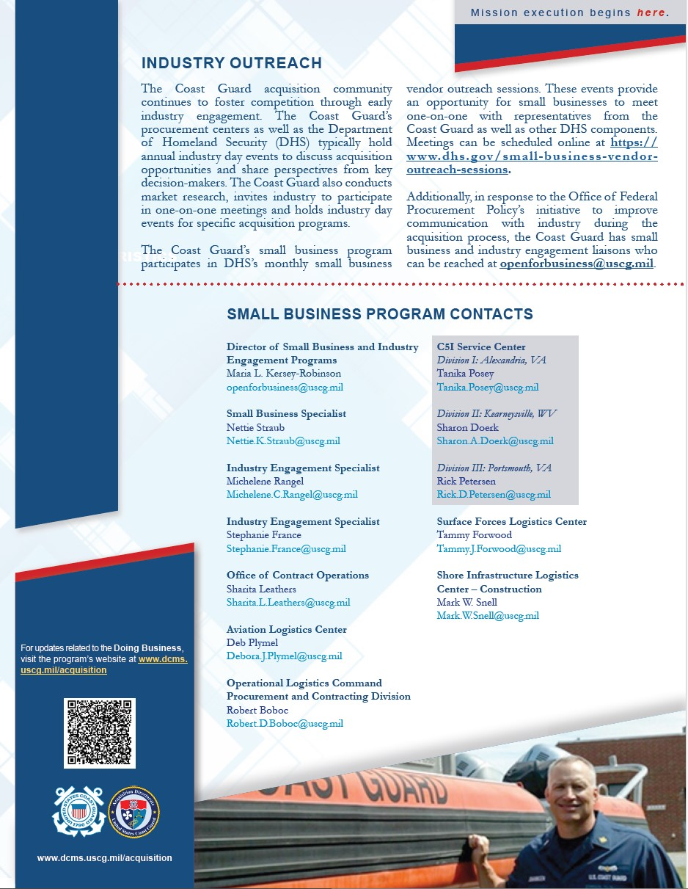
Doing Business with the USCG

Slide 14
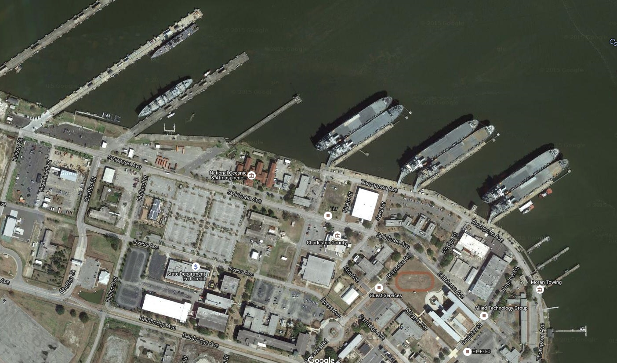
Questions?

