Slide 1
UNCLASSIFIED/FOUO
Society of American Military Engineers (SAME)
Mr. Frank Handoe
Deputy, Transition Service Manager
Directorate of Human Resources
U.S. Army Installation Management Command
Controlled by: DHR
CUI Category: UNCLASSIFIED/FOUO
Limited Dissemination Control: DL ONLY POC: frank.c.handoe.civ@army.mil (253) 477-4778
As of: 5 Oct 2026

Slide 2



TRANSITION ASSISTANCE PROGRAM (TAP)
Introduction
The Transition Assistance Program (TAP) is a congressionally mandated program. TAP is responsible for providing Soldiers with counseling, employment, educational workshops, and seminars required to achieve the Veterans Opportunity to Work (VOW) Act 2011, Career Readiness Standards (CRS) mandated compliance as outlined in the NDAA, AR 600- 81, (CHPs 2, 4, and 7) and DOD 1332.35.

Slide 3

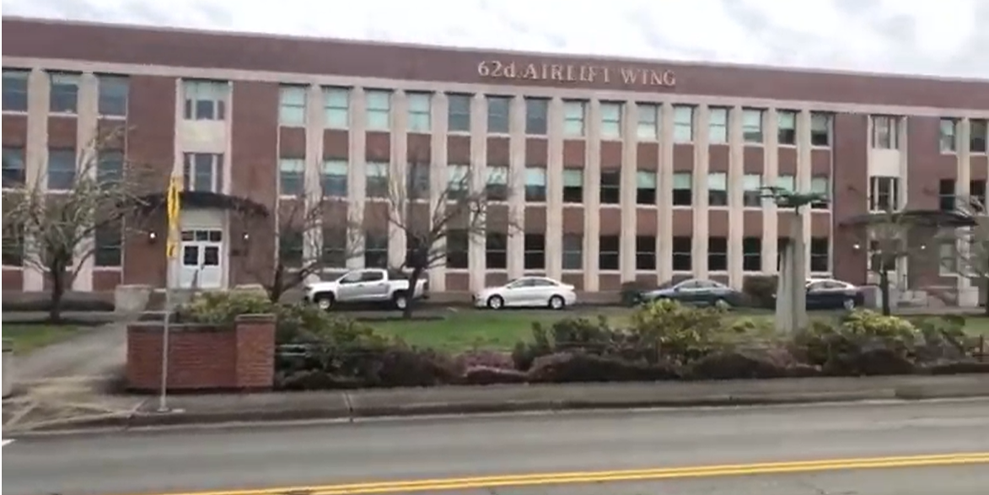
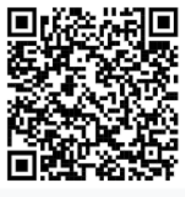


JBLM TAP Locations
Hours of Operation
Monday – Friday 0730-1600
McChord Field 100, COL Joe Jackson Ave, JBLM, WA 98438
Phone: (253) 967-3258
Email: usarmy.jblm.imcom.list.dhr-tap-outreach@army.mil
Main Hub – North Fort
Hawk Career Center
11577 41st Division Drive, JBLM, WA 98433
McChord Field
McChord Field
SFAC
9059 Gardner Loop Road, JBLM, WA 98431
SFAC

Slide 4
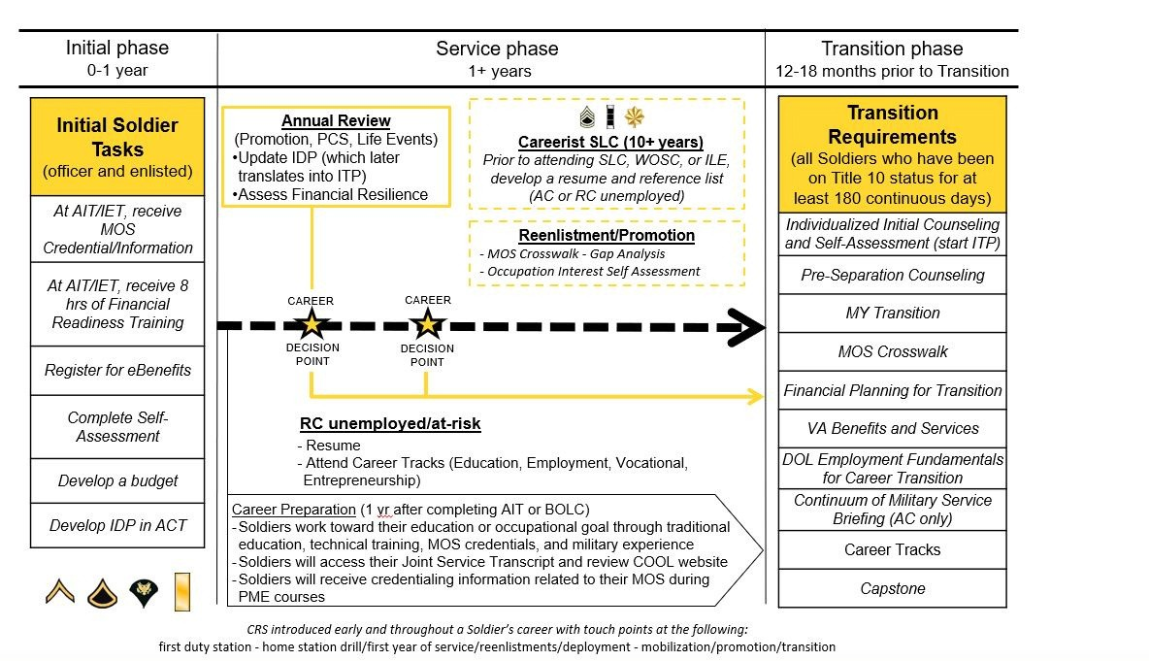

SOLDIER LIFE CYCLE OVERVIEW

Slide 5
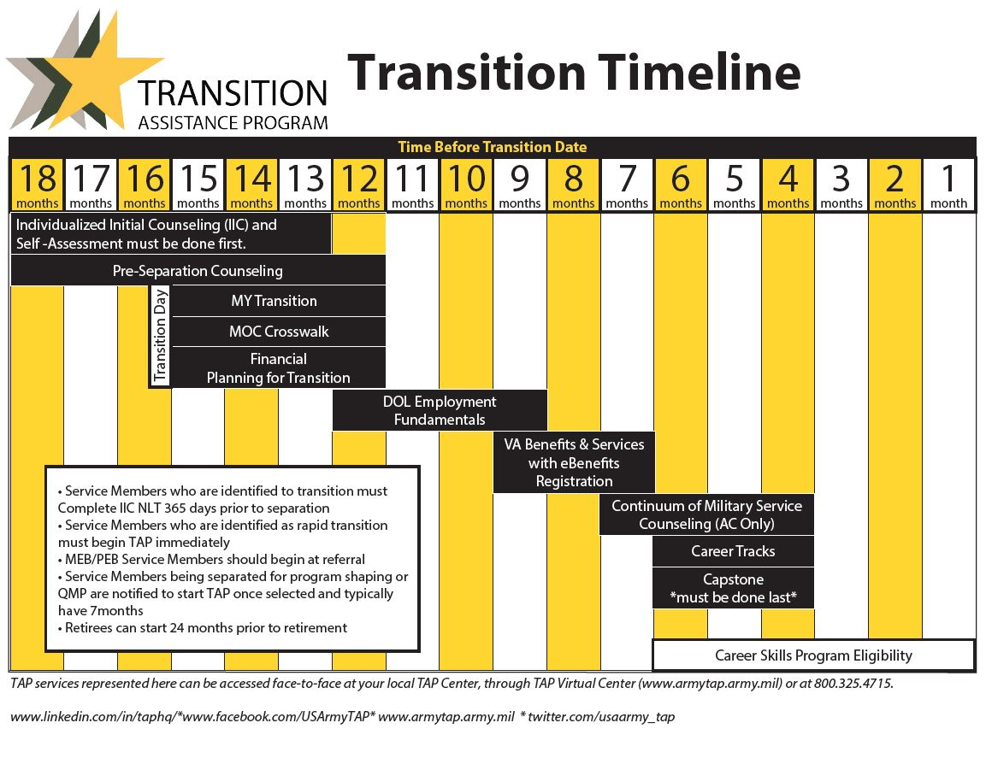
TRANSITION TIMELINE

Slide 6


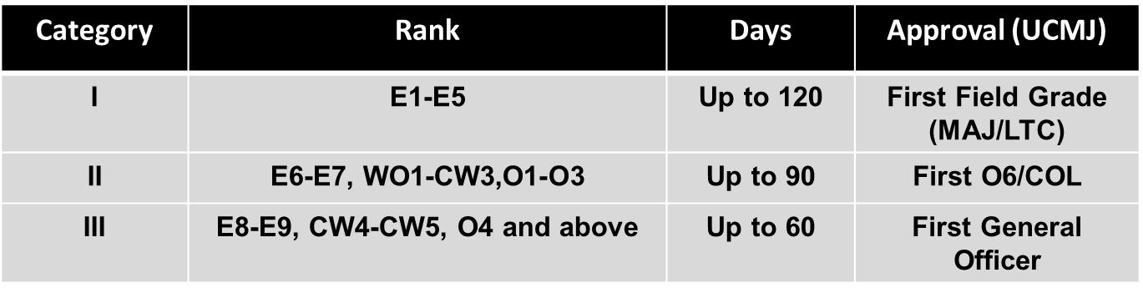
ARMY CAREER SKILLS PROGRAM (CSP)
Apprenticeships l Internships l On-the-Job Training l Employment Skills Training
As part of Army TAP, Soldiers are provided with the opportunity to participate in the Career Skills Program. Approval authority is granted to HQDA
G -1 for all providers requesting to partner with the Career Skills Program requiring 121 days or more to complete. This includes Individual Internships
and all approved DoD programs. Delegation of authority to The Adjutant General (TAG) is authorized.
Three Category System
Battalion Commander's Role
Approval authority for Soldier participation in accordance with AR 600 -8-10 (Leaves & Passes).
Releases Soldier from daily unit duties to participate.
Maintains daily accountability of Soldier. Soldiers can be terminated from CSPs due to military necessity.
Prepare a letter of participation for the Soldier.
If applicable, processes DA Form 31, for AA.
Soldier Eligibility
Soldiers within 180 days of discharge/release from active duty
Offerings range depending on installation, but Administrative Absence can be approved to attend another location's CSP.

Slide 7
Types of Training
Should not exceed 120 days without HQDA G-1 Approval
Only one CSP can be conducted
SM must clear JBLM prior to separation, CSP does not impact this function
CSP can be completed in Veteran status; Internships completed on or before ETS
TAP is completed prior to starting a program
Commanders can enroll Soldiers that are administratively flagged
Assign qualified Soldiers participating in a program to excess positions (known loss) in IPPS-A
IDES / SRU Soldiers begin CSP immediately following their Medical Retention Determination Point
All programs briefed will fall into one of three categories:
Employment Skills Training: functions like a school and uses either GI Bill or industry funding. Soldiers are not limited to taking more than one EST during their transition period.
Pre-Apprenticeship: Registered training with industry approved by the Department of Labor. All training costs are industry funded training places graduates into industry ahead of peers enrolling under traditional methods. Service Members are limited to one P.A. opportunity
* With program completion and acceptance into a apprenticeship, you can use the GI Bill to earn education credits and access the BAH Stipend
Internships: Function as an employment experience, the training provider and or Service Member coordinate the experience. Internships must be funded through military wage and thus must be started and completed while on active duty. Service Members are limited to one internship
Graduates from any of the above are afforded an interview with the industry they trained with for a career-based position with a livable wage.

Slide 8












CAREER SKILLS PROGRAM (CSP)
*
AR 600-8-10
(14) Career Skills Program.
(e) Planning must include sufficient time after completion of CSP for Soldiers to return to their permanent duty station to complete physical and administrative out- processing requirements in accordance with AR 600–8–101, to include unit-level and installation-level out-processing and final out, before the separation or retirement date.
usarmy.jblm.imcom.list.dhr-tap-outreach@army.mil
Career Skills Program (CSP) :: U.S. Army Installation Management Command
DOD SkillBridge Program (osd.mil)

Slide 9

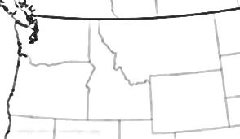
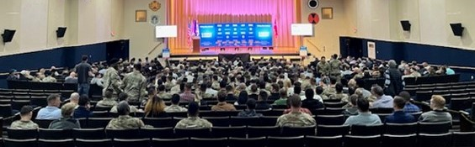

TAP At JBLM
The Transition Assistance Program (TAP) provides service members with the resources and training needed to successfully transition from military to civilian life, empowering them to make informed career decisions, develop skills, and gain the self-confidence necessary for success in the global workforce
JBLM TAP
CSP
VOW
Partners
Hiring Our Heros
824 Job Seekers
395 Interviews
Sector Events
IT
First Responder
153 Employers
380 Job Offers
Federal Employment
806 Job Seekers
155 Employers
3 Federal Transition Support Staff
24 Transition Support Contractors
18 Career Skills Programs
64 Hiring Fairs
714 Employers
7912 Job Seekers
1001 Interviews
80 Resumes Accepted
1325 Follow-Ups
372 Job Offers
≈5.3M saved UCX 2024
7000 SMs Transition From JBLM Annually
TAP supports 10,000 SMs from a 5 State AOR & Pacific Theater
WA State Veteran population grows by 6000 annually
2025 Weekly Hiring Fairs
Our Partners* Include: Airframe & Powerplant • Airstreams • Amazon Web Services • American Legion • American Red Cross • AmeriCorps • Aspire • Association of the United States Army (AUSA) • Boots to Business • Boots to shoes • Career Team • Center for Advanced Manufacturing Puget Sound • Commercial Driver School • Concrete Preservation Institute • Disabled American Veterans • Employment Security Department • ETS Sponsorship • Forge Now • GAF Roofing • Galvanize • Goodwill WA • Heavy Equipment Colleges of America • Helmets to Hardhats • Hire GI • Hire Heroes USA • Hire Military • Hiring Our Heroes • International Union Partners and Allied Trades • Lacey Veteran’s Hub • Microsoft Inc. • Military Service to Education • Onward to Opportunity • Pacific Mountain Workforce Development Council • Recruit Military • Ryder • Smart Heroes • SSMCP • Support the Enlisted Project • Troops into Transportation • Troops to Teachers • Universal Technical Institute • USO • Veterans in Piping • Veterans of Foreign Wars • Vets 2 Tech • WA State Department of Social and Health Services • WA State Department of Veterans Affairs • WorkEx • Workforce Central • Work Source WA
*Inclusion does not indicate endorsement
usarmy.jblm.imcom.list.dhr-tap@army.mil

Slide 10

CONCLUSION
The Transition Assistance Program is a pipeline for Military talent.
Get involved with Skillbridge/Career Skills Program
Get involved in Hiring Events

Slide 11
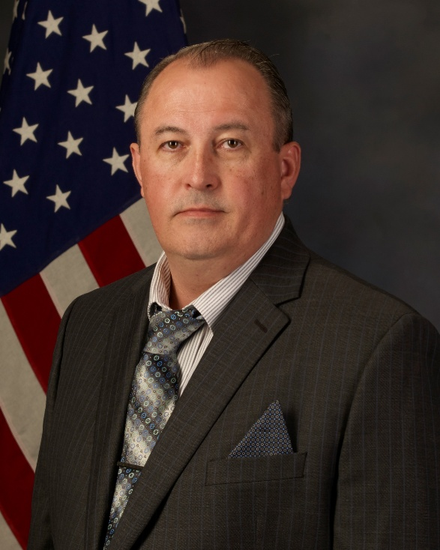


POINTS OF CONTACT
Transition Service Manager
Chris Gentz
(253) 477-4749
Christopher.a.Gentz.civ@army.mil
Deputy, TSM
Frank Handoe
(253) 477-4778
frank.c.handoe.civ@army.mil
Contractor Installation Manager
Ta Mouton
(253) 967-3258
ta.t.mouton.ctr@army.mil

