Slide 1




TRANSITION ASSISTANCE PROGRAM (TAP)
A congressionally mandated program that provides information, tools, and training to ensure Service members and their spouses are prepared for the next step in civilian life.
Title 10 U.S.C., Sections 1142, 1143, 1144
NDAA FY 19 John S. McCain, Section 552—Improvements to TAP
NDAA FY20, Sections 570c, 570f
DoDI 1332.35—TAP for Military Personnel
PG, p. 11

Slide 2
TAP OVERVIEW
You are here
Individualized Initial Counseling
Pre-Separation Brief
Managing Your (MY) Transition
NLT 365 Days
Begin TAP Courses
DOL Employment Fundamentals of Career Transition
VA Benefits and Services
Financial Planning for Transition
MOC Crosswalk
2-Day Tracks
Continuum of Service
Capstone
Employment
Vocational
Education
Entrepreneurship
NLT 90 Days
PG, p. 17

Slide 3
Upcoming Job and Skillbridge Fairs
Skillbridge Fair
23 November 2026
Bangor Plaza
11:00-2:00
Skillbridge Fair
7 January 2027
Fleet and Family Support Center
11:00-2:00
Spouse Job Fair
15 October 2026
Fleet and Family Support Center Bangor
4:00-7:00
Job &Skillbridge Fair
22 April 2027
Olympic College
1000-200
Robin Moeller 360-315-3066
Kate Roschmann 360-369-5465

Slide 4



NRNW
SKILLBRIDGE PROGRAM
LINKING TRANSITIONING SERVICE MEMBERS WITH CIVILIAN TRAINING OPPORTUNITIES

Slide 5
SkillBridge Overview
An opportunity for eligible Service members, with proper Commander approval, to participate in an authorized SkillBridge training program up to 180 days prior to separation.
  Training available at little to no cost to participants
  Service members receive Service pay and benefits
  High probability of post-experiential placement
  Veterans and Military Spouses may be eligible to participate in select programs, when authorized by the Industry Partner/Employer
What is SkillBridge?

Slide 6
Eligibility of SkillBridge Programs:
Have completed at least 180 days on active duty and are expected to be discharged from active duty with an Honorable discharge, including General discharge (under Honorable conditions), within 180 days of the date of commencement of participation in such program;
Program now allows
Tier one (enlisted E5 and below) - 180 days or less.
Tier two (enlisted E6-E9) - 120 days or less.
Tier three (officers O4 and below) - 120 days or less.
Tier four (officers O5 and above) - 90 days or less.
Be separating from the Navy and have sufficient time remaining under their contract to complete the program prior to established separation date;
Have successfully passed their most recent physical fitness assessment;
Be recommended for advancement or promotion and retention on most recent evaluation or fitness report;
Have completed their Transition Assistance Program requirements;
f. Have attended an ethics brief or completed a DoD approved ethics training
presentation within the last 12 months from the start date of the skills training
program; and
g. Have not previously completed, currently participating in, or had
participation terminated from an employment skills training program.

Slide 7
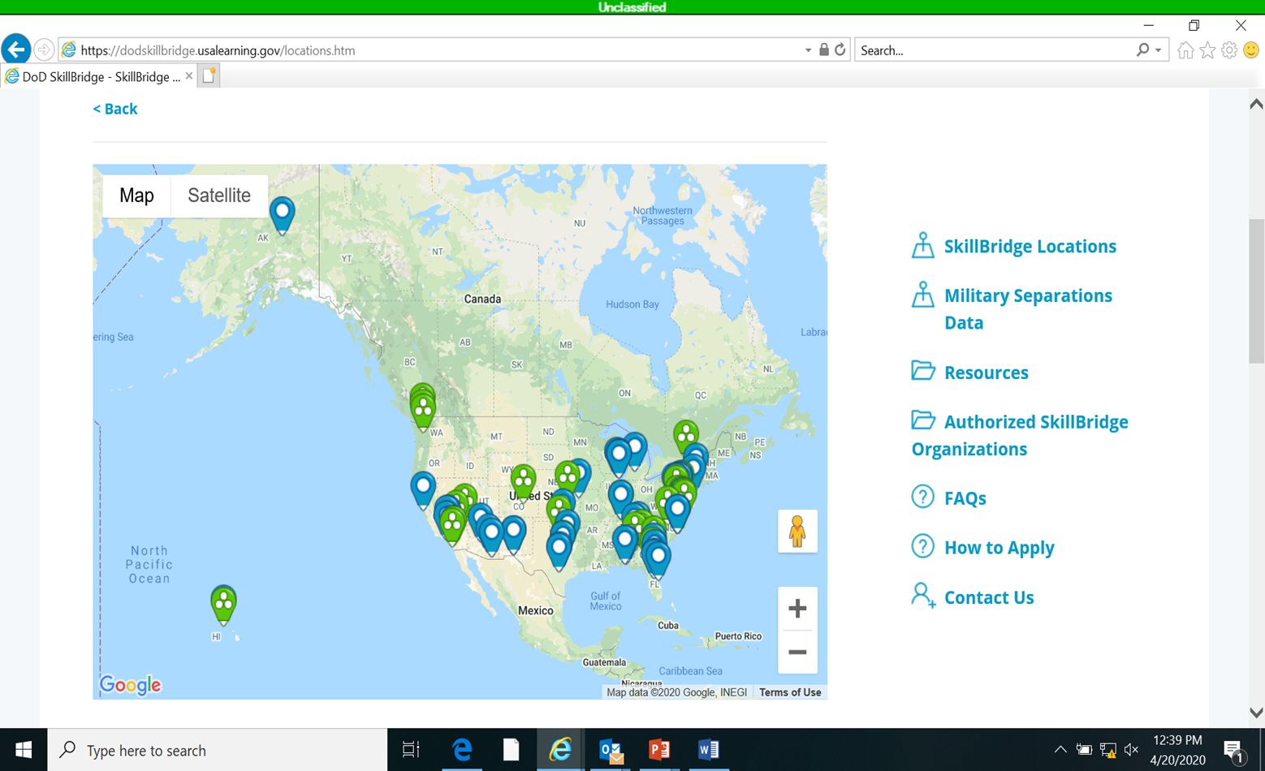

DoD SkillBridge Web Portal
SkillBridge main page:
https://dodskillbridge.usalearning.gov/index.htm
https://dodskillbridge.usalearning.gov/locations.htm
SkillBridge locations map:

Slide 8
How To Apply
Pick up a NRNW SkillBridge SOP from the TAP team.
Complete the checklist contained in the SOP and route with your Special Request Chit WHILE talking to SkillBridge Programs. (pick and apply to more than one so you have options.)
Log in to MyNavyED at www.navycollege.navy.mil
Access SkillBridge Portal and complete the steps.
Contact information for the OPNAV SkillBridge Office:
(703)-604-5310
Navy_Skillbridge.fct@navy.mil

Slide 9
Command Approval
Contact your Command Career Counselor to discuss next steps associated with Special Request Chit routing
Assemble your SkillBridge request package. At minimum include:
Copy of Current Policy
Proof of Eligibility (Participant eligibility as outlined in current policy)
Proof of Training Program Authorization (DoD SkillBridge website screenshot, or OSD signed MOU)
Program Enrollment or Pre-Enrollment Forms (as required)
Special Request Chit
Submit your SkillBridge Special Request Chit in accordance with your command routing protocols
Once approved, provide proof of command authorization (signed request chit and/or any required program enrollment forms) back to the training provider, and proceed with any additional enrollment requirements.
NOTE: If training required pre-approval from your command, just to participate in screening/selection, you may be required to provide your command with an acceptance letter before final approval is granted.
Obtain any required permissive TAD/TDY orders from you command, prior to training commencement

Slide 10
Training Authorization
How to Participate – For Industry Partners/Employers
NEW! SkillBridge Provider Handbook
Step 1: Identify if your opportunity could serve as a successful SkillBridge program
Step 2: Learn about/prepare for the application process
Step 3: Self-nominate your organization as SkillBridge or “Career Skills” Program
Step 4: Keep in touch
Step 5: (If approved) Remain engaged
Reviewing applications can take up to 45 days and may require potential Providers to answer questions from the DoD and/or Service representatives. Allow for upwards of 60-90 days total processing time from initiation to determination.
Resources: https://dodskillbridge.usalearning.gov/resources.htm
Industry Partners/Employers: https://dodskillbridge.usalearning.gov/industry-employers.htm
Notes:
SkillBridge Provider Handbook now available for Industry Partners/Employers to reference in the resources section on the DoD SkillBridge website.

Slide 11

For More Information
Contact FFSC
Transition Assistance Program (TAP) Staff at the Fleet and Family Support Center
1-866-854-0638
Notes:
Fleet and Family is here to assist you with your Skillbridge choices and help you complete your application packet.

Slide 12

For More Information
Contact FFSC
Transition Assistance Program (TAP) Staff at your local Fleet and Family Support Center
1-866-854-0638
Notes:
Fleet and Family is here to assist you with your Skillbridge choices and help you complete your application packet.

